Slide 1
Sharing Family and History Though Food
OHCE District Leader Lesson
2021
Notes:
Welcome to the leader lesson “Sharing Family and History Through Food.”

Slide 2
Introduction
Memories and history are tied to food
Some good, some not
Sharing memories and teaching history to children are important
Food is an valuable tool
This Photo by Unknown Author is licensed under CC BY-NC
Picture of birthday cupcakes.
Notes:
When you think about it memories, good and bad, are often tied to food.
Sharing food with children is a good opportunity to share those memories about your life, your family history, even the history of your area, the nation and the world. And to create some new memories for both you and them as you go.

Slide 3
Objectives
Use shared memories and experiences to grow closer to children.
Use shared food experiences to teach family history.
Teach children basic cooking skills.
This Photo by Unknown Author is licensed under CC BY-NC-ND
Picture of strawberries and ice cream
Notes:
The objectives of today’s lesson are to:
Use shared memories and experiences to grow closer to children.
Use shared food experiences to teach family history.
And to teach children basic cooking skills.

Slide 4
Food memories are more than taste, smell, color and Texture
Food memories tend to be the strongest associative memory people have
Involve all your senses so they have a big impact
Combine with the situation when the memory was made
The place, the people, the conversations, the feelings, the smells, etc.
This Photo by Unknown Author is licensed under CC BY-NC
Picture shows the five senses: vision, hearing,
smell, taste and touch.
Notes:
Food memories are more than taste, smell, color and texture.
They tend to be the strongest associative memories we have because they involve all our senses. As those memories are made they combine with where you were at the time, what was happening, what was being said, how you felt, colors and smells beyond the food. Everything that was going on at the time.
For example, think of cotton candy and what else comes to mind? Perhaps a ball game, a visit to a county fair or a school festival. Or how about an ice cream cone. Does it bring back a special day at the zoo? Did it melt down your arm? Did you get in trouble because you got chocolate all over your clothes? Was the weather hot or rainy? So many memories can be tied to one food.

Slide 5
Why the strong connection between memory and food
May have developed as a survival tactic known as conditioned taste aversion (Chambers, 2018)
a learned association between the taste of a particular food and illness such that the food is considered to be the cause of the illness
Forebears ate a plant, got sick, remember the plant and never eat it again
Direct link between region of brain where tastes are remembered and area that remembers the time and place (Chinnakkaruppan, et al., 2014)
Taste is associated with memories of where something positive or negative happened
Notes:
There are a couple of theories on why there is such a strong connection between memory and food.
One is that early humans developed a survival tactic known as conditioned taste aversion. When a human would eat a new food, they would remember it. If they got sick after eating that food they would associate the food with the illness and not eat that food again. Those that avoided the food had a better chance to survive.
Another researcher suggests a there is a direct link between a region of the brain where tastes are remembered and the area of the brain that remembers time and place. This link is most associated with memories where something positive or negative happened. So you’re more apt to have food memories of birthday cake than the peanut butter sandwich you took to school everyday. Not that the sandwiches on average school days weren’t good, just not unusual.

Slide 6
Sweet food have more memories
Sweets activate brain’s reward centers which convert short activities into long term memories
Reason more memories are associated with sweet foods
This Photo by Unknown Author is licensed under CC BY-SA
Picture of candy corn
Notes:
There are more food memories associated with sweet than savory foods. That’s believed to be because sweets activate the reward center in the brain that converts short term activities, like eating candy corn, into long term memories. Even if you don’t like the food, such as the candy corn pictured here, the memories associated with it can be good because of all the other things you associate with the food. Savory foods make memories too, just not as often. For example, thanksgiving turkey and grilled hot dogs bring out strong memories for many people.

Slide 7
Sharing and creating food memories
Check Activities handout for a starting point…Sharing Stories and Histories
Notes:
Some suggestions on using food to share your own memories and family history with children are in the Activities handout. The first one you can try is the chart on the first two pages. It is basically a list of talking point for you and the child or children. Opening the door to discussion of what it was like when you were young compared to their experiences helps build the bond between you. The entire chart doesn’t need to be completed in one sitting nor do you have to limit yourselves to only the questions on the chart. It is useful to write down the answers for a memory book though. You can come back to the chart and revisit some questions as the children age. Asparagus may not make the list when they are five but may have shown up when they are teenagers. The list can give you clues about other food activities they would enjoy based on their responses.

Slide 8
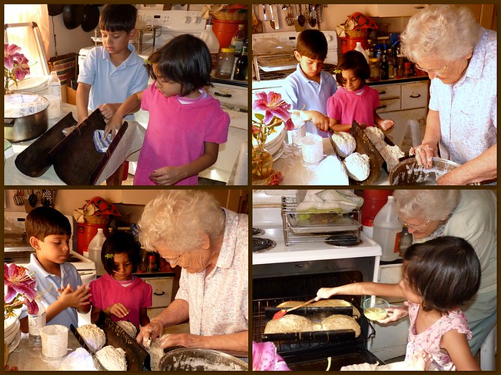
Creating food memories with children
Activities that involve food
Do it together
Talk together
Decide together
Cook/prepare food together
Eat together
Buy food together
Clean up together
Make it a fun, positive experience
This Photo by Unknown Author is licensed under CC BY-NC-ND
Picture of woman cooking with children
Notes:
Probably the most important thing to remember when you create food memories with children is that what you do, you should do together. Decide what you want to do by talking about options, cook together teaching as you go, eat together, buy food together when eating out or at the grocery story, clean up together. As you do each of these things, talk together about why you’re doing it, how you learned to do the same thing and who you learned it from, taste as you go (as long as you keep food safety in mind). Always keep the lines of communication open. If they don’t like the food, find out why. How could it be made better? Try again.
Make it a fun, positive experience. Offer constructive criticism but don’t redo their work.

Slide 9
Age and appropriate cooking skills
Age | Appropriate cooking skills
2-years old | Scrub fruits and vegetables
 | Carry unbreakable items
 | Dip foods
 | Wash and tear salad greens
 | Break bread into pieces
3-years old | Pour liquids into batter
 | Mix batter
 | Shake liquid in a closed container
 | Spread butter or soft spreads
 | Knead dough
 | Wash fruits and vegetables
 | Serve food
 | Put things in the trash
Age | Appropriate cooking skills
4- and 5-years old | Juice citrus
 | Peel some fruits and vegetables
 | Mash soft fruits and vegetables
 | Cut soft foods with a plastic knife
 | Press cookie cutters
 | Measure dry ingredients
 | Crack open/break eggs
 | Beat eggs with an eggbeater
 | Set the table
 | Wipe up after cooking
 | Clear the table after eating
Notes:
Having a realistic expectation of what children can do in the kitchen is useful. This table gives you an idea of how to involve children in cooking as they develop. Always remember to include food safety in all food experiences.

Slide 10
Summary
Foods can create and stir memories
Foods are a tool to
Share memories and family history
Create memories with children
A fun way to teach basic skills
This Photo by Unknown Author is licensed under CC BY-SA-NC
Picture of men shucking corn in the past
Notes:
Food and memories go hand in hand. Use food and food experiences to
Share memories and family history
Create memories with children
And as a fun way to teach basic skills

Slide 11
Evaluation
Please complete both pages or sides of the evaluation before leaving.
Answer each question twice.
Left side of page is for how you felt before you came to this lesson.
Right side of page if for how what you plan to do in the future.
If you do not want to answer any question, just leave it blank.
Leave your copy of the evaluation with the meeting host.
Notes:
The Oklahoma Cooperative Extension Service is committed to providing education programs and activities to help the people of Oklahoma improve their quality of life.
We evaluate our programs and activities to make sure they are helping people like they are intended to.
Today we invite you to complete an evaluation of this program. It asks about things you may have done before attending this Extension program and how you are going to use what you learned in the future.
If you do not want to answer any question, just leave it blank.
No one will see your answers.
Any written results will not include your name or anything that would identify you.
I will collect your copy of the evaluation before you leave today and turn it into the county extension office. Thank you for doing this.

Slide 12
References (APA format)
Chambers, K.C. (2018). Conditioned taste aversions. World Journal of Otorhinolaryngology—Head and Neck Surgery, 4(1), 92-100. Retrieved February 13, 2021 retrieved from https://www.ncbi.nlm.nih.gov/pmc/articles/PMC6051479/
Chinnakkaruppan, A., Wintzer, M.E., McHugh, T.J., & Rosenblum, K. (2014). Differential contribution of hippocampal subfields to components of associative taste learning. Journal of Neuroscience, 34(33), 11007-11015. Retrieved February 13, 2021 from https://www.jneurosci.org/content/34/33/11007
Kim, Y. (2015) Cooking with young children, University of Nevada Extension, Reno. Retrieved March 11, 2012 from https://extension.unr.edu/publication.aspx?PubID=2468

Slide 13
OSU Extension
Oklahoma State University, as an equal opportunity employer, complies with all applicable federal and state laws regarding non-discrimination and affirmative action. Oklahoma State University is committed to a policy of equal opportunity for all individuals and does not discriminate based on race, religion, age, sex, color, national origin, marital status, sexual orientation, gender identity/expression, disability, or veteran status with regard to employment, educational programs and activities, and/or admissions. For more information, visit https:///eeo.okstate.edu

