Slide 1
2020 Census
A Role for County Extension Offices
Dr. Larry Sanders
Professor and Extension Economist

Slide 2
Agenda
What is the 2020 Census?
What’s the key role for Extension?
What’s in it for Extension?
FAQs for Extension
FAQs for the Public

Slide 3
What is the 2020 Census?

Slide 4
2020 Census
The US Constitution mandates that a count of every resident be conducted every 10 years.
Congressional representation
The primary reason for the Census is to reapportion
the seats in the House of Representatives
Once the number of seats for each state is determined,
state officials redraw congressional and state legislative districts
More than $675 billion in Federal funding is affected by Census data
E.g., schools, hospitals, roads and other infrastructure, social services
Each person in OK represents $1,123¹ in federal funds
¹ George Washington University Institute of Public Policy, https://gwipp.gwu.edu/sites/g/files/zaxdzs2181/f/downloads/IPP-1819-3%20CountingforDollars_OK.pdf

Slide 5
2020 Census
Private businesses use Census data to:
Locate new stores and factories
Identify locations for new homes and residential facilities
Census numbers matter when companies consider investment decisions
Federal funding of state/local projects often based on census count
Local governments use Census data for emergency management and public safety
Residents and non-profit organizations use Census data for advocacy and community initiatives that impact quality of life
Moral obligation: if someone lives in Oklahoma they have a right to be counted
Everyone is affected by the Census!
Economic
Development

Slide 6
2020 Census TIMELINE
March 2020: Census will be mailing postcards and a letter with online and phone instructions to households
April 1, 2020: Census Day (where you live on this date is the reference point for Census data)
April 2020: Reminder letters and postcards sent to non-respondents
May 2020: Census takers begin visiting homes that haven’t responded yet
December 2020: Counts delivered to the President and Congress
By March 31, 2021: Counts delivered to states for redistricting

Slide 7
2020 Census Participation
Online (Preferred method):
Each household will be mailed a unique ID
Using the unique ID or home address, a representative of the household can complete the survey using a smartphone, tablet, personal computer or public terminal
Phone:
Using the unique ID or home address, individuals can call the toll-free Census Service Center to participate
Mail:
Unless specifically requested, mail surveys will only be sent to addresses identified as unlikely to participate, and to non-responders
In-person:
If a household has not responded by May, a Census taker will visit your home

Slide 8
2020 Census Questions
How many people are living or staying at your home on April 1, 2020?
Is your home owned or rented?
What is the sex of each person in your home?
What is the age of each person in your home?
What is the race of each person in your home?
Are any persons in your home of Hispanic, Latino or Spanish origin?
How are the persons in your home related?

Slide 9
What’s the key role for Extension?

Slide 10
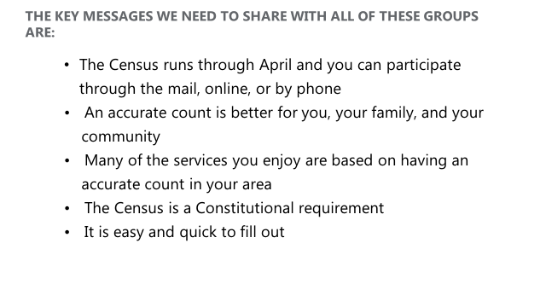

Slide 12
ADDITIONAL EXTENSION OPPORTUNITIES
Form a core Census assistance team in your Extension Office with all educators
Contact the Complete Count Committee for your community or county
Obtain materials/slides from Dr. Larry Sanders to present an awareness slide show in your area
Consider a newspaper column on this subject

Slide 13
What’s in it for Extension?

Slide 14
WHAT’S IN IT FOR EXTENSION?
An inaccurate population count jeopardizes:
Federal “formula” funding for Extension
Funding for services and programs that serve our families, friends, neighbors (e.g., FNEP and SNAP Ed programs; free and reduced lunch & summer lunch programs)
Congressional and state legislative representation
Rural and minority communities historically have not participated fully in the Census. For 2020, online participation is the primary method for participation, but instructions are being mailed to each household. If there are households in your county without a physical address, they will not receive instructions.

Slide 15
WHAT’S IN IT FOR EXTENSION?
Extension benefits from promoting Census participation by:
Reinforcing our reputation as a trusted, science-based source of information
Reaching new audiences (e.g., working alongside of local business organizations)
Increasing awareness of the county office & its services

Slide 16
FAQs
For
Extension

Slide 17
FAQs BY EXTENSION
Are you asking me to be a Census taker
(to go door-to-door and collect data)?
NO!!!

Slide 18
FAQs for EXTENSION
What are you asking of me as an educator?
When appropriate, encourage residents to participate in the Census – be looking for instructions, know how to respond and/or get questions answered.
Provide a designated computer for residents to use for Census participation
De-mythify rumors about the Census through existing communication channels (e.g., monthly newsletter or social media)
Consider participating in your community’s or county’s Complete Count Committee (find yours here: https://www.census.gov/library/visualizations/interactive/2020-complete-count-committees.html)

Slide 19
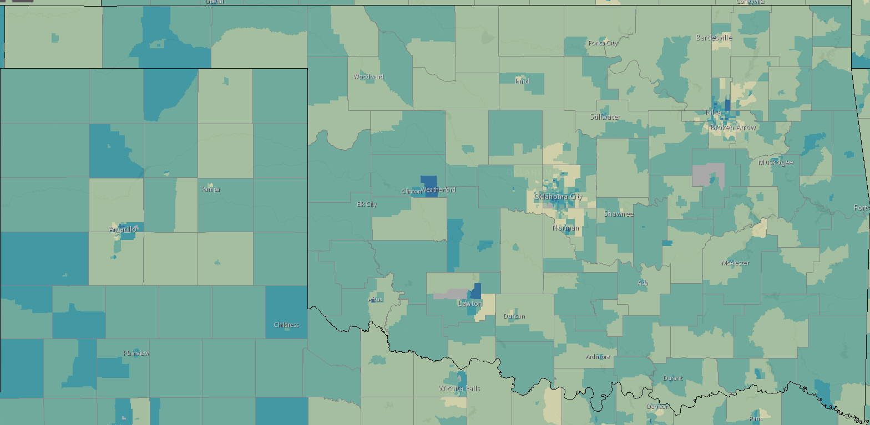
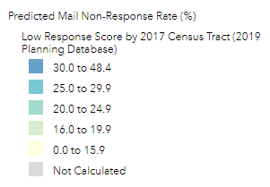
FAQs for EXTENSION
3, What are you asking of me as an educator? (continued)
Post posters in your office and have handouts available (available here: https://2020census.gov/en/partners/outreach-materials.html)
Share handouts in areas with anticipated low responses (identify these here: https://www.census.gov/roam)

Slide 20
FAQs
For the
Public

Slide 21
FAQs for the PUBLIC
Are non-citizens counted in the census?
YES. Everyone counts. The 2020 Census counts everyone living in the country, including non-citizens.
2. Can my answers be shared with law enforcement or used against me?
NO. The law prevents the Census Bureau from sharing your information with law enforcement. Your answers cannot be used to impact your eligibility for government benefits. Your answers are only used to create statistics about our country. The Census Bureau is bound by Title 13 of the U.S. Code to protect your personal information and keep it strictly confidential. That’s every answer, to every question.
3. Can I only take the census online?
NO. The 2020 Census will be available online, by phone, and by mail. Online and phone responses can be completed in 13 languages (English, Spanish, Chinese, Vietnamese, Korean, Russian, Arabic, Tagalog, Polish, French, Haitian, Creole, Portuguese, and Japanese). A paper form will be mailed to every house that hasn’t responded already when we send our fourth mail piece out.
What won’t the Census ask for?
The census will never ask for Social Security numbers, bank or credit card numbers, money or donations, or anything related to political parties.

Slide 22
FAQs for the PUBLIC
5. Does the 2020 Census impact me? YES. The 2020 Census is vital for communities across the United States. Your response shapes decisions about how public funds are spent for things like schools, fire and emergency services, and health care clinics for your community—as well as your congressional representation.
6. Who counts as part of your home? If you are filling out the census for your home, you should count everyone who is living there as of April 1, 2020. This includes anyone who is living and sleeping there most of the time. If someone is staying in your home on April 1, and has no usual home elsewhere, you should count them in your response to the 2020 Census.
Is my information safe?
Your responses to the 2020 Census are safe, secure, and protected by federal law. Your answers can only be used to produce statistics. They cannot be used against you by any government agency or court in any way—not by the FBI, not by the CIA, not by the DHS, and not by ICE.

Slide 23
FAQs for the PUBLIC
8. Once I identify my rural household to the Census Bureau, how will I receive my Census information?
After you have called in to request a unique I.D. if one did not get to your physical location, you should check your physical mail box or doors for delivery.
IT WILL NOT AND SHOULD NOT SHOW UP IN YOUR PO BOX.
IF NOT RECEIVED, CALL TO REQUEST MAILING TO PHYSICAL ADDRESS.

Slide 24
FAQs for the PUBLIC
What is “race”?
The Census Bureau defines race as a person’s self-identification with one or more social groups. An individual can report as
White,
Black or African American,
Asian,
American Indian and Alaska Native,
Native Hawaiian and Other Pacific Islander,
or some other race.
Survey respondents may report multiple races.

Slide 25
FAQs for the PUBLIC
10. What is “ethnicity”?
Ethnicity determines whether a person is of Hispanic origin or not. For this reason, ethnicity is broken out in two categories,
Hispanic or Latino and
Not Hispanic or Latino.
Hispanics may report as any race.
Again, the Census Bureau adheres to strict confidentiality laws that prohibit sharing of respondent information. They do not share respondent answers with immigration, law enforcement, tax collection agencies or any other organization.

Slide 26
FAQs for the PUBLIC
How does the Census keep my information safe?
The Census Bureau is bound by Title 13 of the U.S. Code to keep your information confidential. Employees at the Census Bureau take a life-long oath to protect your personal information. Under Title 13, the Census Bureau cannot release any identifiable information about you, your home, or your business, even to law enforcement agencies. The law ensures that your private data is protected and that your answers cannot be used against you by any government agency or court.
Strict policies and statistical safeguards help protect the confidentiality of your information. Before releasing data products, the Census Bureau verifies that they meet its confidentiality standards.
From the beginning of the data collection process, the Census Bureau follows industry best practices and federal requirements to protect your data. The security of Census Bureau systems is a top priority, and our IT infrastructure is designed to defend against and contain cyberthreats. We continually refine our approach to identifying, preventing, detecting, and responding to these threats.

Slide 27
FAQs for the PUBLIC
12. Will the count be for 2020 only?
No. The count associated with the 2020 Census will not affect just
one year.
It will impact the next decade.
The Census will serve as the base year for population estimates
from 2021-2029.
Federal Funding, economic development & representation will all be affected over the coming decade by the 2020 Census – just as the 2010 Census count is still impacting us now.

Slide 28
FAQs for the PUBLIC
13. How can I get more information, or ask questions, about the 2020 Census?
Online: 2020census.gov
Phone: 800-923-8282 or 972-510-1800

Slide 29
Larry Sanders
Department of Agricultural Economics
O | 405.744.9822
E | larry.sanders@okstate.edu
509 Ag Hall
Agecon.okstate.edu
Census URL:
http://www.agecon.okstate.edu/agpolicy/census.asp

