Slide 1

How to Apply for CEUs
Josh Bushong, Area Extension Agronomist

Slide 2
What are CEUs

Slide 3



Continuing Education Units
ODAFF Certified Pesticide Applicator CEUs
Certified Crop Advisor (CCA) CEUs
Notes:
While we can apply for both for a program, these are not the same. Make sure attendees sign the correct sign-in sheet.
CCA CEU Application: https://www.certifiedcropadviser.org/education-ceus/offer-ceus
CCA CEU Application Guide: https://www.certifiedcropadviser.org/files/certifiedcropadviser/continuing-education/offer-ceus/ceu-application-tutorial-2014.pdf
The OSU contact for CCA CEUs is Dr. Hailin Zhang
The rest of the PPT will be about ODAFF CEUs

Slide 4
ODAFF Categories and CEUs
Each category expires on a set year
No more than ½ of CEUs earned in any 1 yr
CEU’s obtained in at least 3 of the 5 years
CEU’s prorated, based on year certified
Cannot get any CEUs the year you certify
Notes:
The 3 out of 5 years only pertains to applicators that are in the full 5 year cycle.
There reason for mentioning it, is because AG Plant and Private applicators need to start getting CEUs in 2021.

Slide 5
Category Cycles & CEU Calculations
Category | Cycle Expires | CEU per Year | 5-year Total CEU | Max CEU in any 1 year
Ag Plant | 2023 | 4 | 20 | 10
Private | 2023 | 4 | 16* | 10
Aerial | 2023 | 1 | 5 | 2
Seed Treatment | 2025 | 1 | 5 | 2
Fumigation | 2025 | 2 | 10 | 5
* Private Applicators not allowed to get CEU’s till 2020, but next certification cycle will be same as Ag Plant.
Notes:
Private applicators were not allowed to get CEUs until 2020. Delayed roll-out on ODAFF’s part.
All categories expire Dec 31st of the year listed, regardless of when applicator became certified.
CEU/year doesn’t mean you need that many every year, just to calculate what the total amount is needed.
Max CEU is set regardless of when applicator became certified. Based on ~1/2 total for 5 yr cycle.

Slide 6
Prorated Chart – # of CEUs Needed
Category | Certified 5 years |  | Certified 4 years |  | Certified 3 years |  | Certified 2 years |  | Certified 1 year
 | Year Cert. | # CEU | Year Cert. | # CEU | Year Cert. | # CEU | Year Cert. | # CEU | Year Cert. | # CEU
Ag Plant | 2018 | 20 | 2019 | 16 | 2020 | 12 | 2021 | 8 | 2022 | 4
Private | 2018 | 16* | 2019 | 16 | 2020 | 12 | 2021 | 8 | 2022 | 4
Aerial | 2018 | 5 | 2019 | 4 | 2020 | 3 | 2021 | 2 | 2022 | 1
Seed Treatment | 2020 | 5 | 2021 | 4 | 2022 | 3 | 2023 | 2 | 2024 | 1
Fumigation | 2020 | 10 | 2021 | 8 | 2022 | 6 | 2023 | 4 | 2024 | 2
* Private Applicators not allowed to get CEU’s till 2020.
Notes:
New Exams for the new category cycles are usually available in the fall (Sept/Oct) on expiration years.
There was a compete CEU Chart on ODAFF webpage, I can’t find it on the new webpage.

Slide 7
Private Applicator Recertification
Retest
$65 Exam
License included
Travel to testing site
Proctored exam
CEU’s
$20 re-license fee
Commit 20+ hours
Multiple meetings
Long-term commitment
Notes:
Now 2 options to recertify as a Private applicator
First time to ever allow Private applicators the option to get CEUs
This is the MAIN reason for this presentation, need to start getting CEUs in 2021.
Meetings that offer category 1a Ag Plant CEUs will automatically apply for Private Applicators.

Slide 8
Check CEUs and Current Certifications
kellysolutions.com/OK/applicators/login.asp
Currently not able to check Private CEUs
ODAFF is in a transition phase to add it
Notes:
Keep track of you own CEU records. Meeting host, date, and location at least.
Legibly add your info to sign-in sheets.

Slide 9
Offering CEUs

Slide 10
Why Should OCES Offer CEUs?
New need, Private Applicators
Potential audience increase
Add more content to a program
Could be made into an entire program

Slide 11
Who can Offer ODAFF CEUs?
Anyone offering an educational program!
OCES
Chemical Companies
Co-ops / Elevator Associations
Farm / Feed Stores
Notes:
Could open opportunities to host joint programs with ag businesses in your county.

Slide 12
Where can ODAFF CEUs be Offered?
In-state or adjacent Out-of-state
Apply for ODAFF CEUs if you are part of the program and know OK Pesticide Applicators plan to attend

Slide 13
Who Approves ODAFF CEUs?
ODAFF Pesticide Program
Plant Industry & Consumer Services Div.
OSU Pesticide Safety Education Program
Notes:
Currently Megan Parker with ODAFF and Kevin Shelton with OSU.

Slide 14
What Qualifies for an ODAFF CEU?
Laws & Regulations
Pesticides (formulation, labeling, handling, etc.)
Application Equip/Calib.
Pests & IPM
ID of Hazardous Areas
Drift Prevention
Endangered Species
Groundwater Protection
Worker Protection
Notes:
9. Worker Protection will only apply to categories Ag Plant, Nursery/Greenhouse, and Forestry.
Pesticides include insecticides, herbicides, fungicides, rodenticides, etc.
When planning your program, keep in mind the audience you plan to target.

Slide 15
How long is a ODAFF CEU?
1 CEU = 1 hour of approved Program
50 minute minimum
Add talks together to get needed length
2-30 minute talks
3-20 minute talks
Notes:
Typically, ODAFF will always keep it to whole numbers. Rarely will they grant 0.5 CEUs.
Since CCA CEUs can be 0.5, some get confused why ODAFF doesn’t do it too.
The whole program doesn’t have to be about getting CEUs, maybe 1hr for CEU out of a 3hr program for example.

Slide 16
Reoccurring Meetings?
No problem
Enter first date/location on submission form
Add other dates/locations after submission
Up to 5 years after date of approval
Notes:
Up to 5 years, or end of current cycle.
Attendees can only get credit once even if they attend the same meeting somewhere else.

Slide 17
Appeal the # of assigned CEUs?
Three-person review committee
OSU
ODAFF
Certified applicator
Notes:
Very rarely needed, but an option

Slide 18
Applying for ODAFF CEUs

Slide 19
Applying for ODAFF CEUs
Online submission process only
Emailed approval or checked online
At least 2 weeks in advance
6+ weeks if event will be advertised
Retroactive approval is an option, not ideal
Notes:
If you are getting close to your meeting and haven’t got an email, sometimes it will show up first on KellySolutions. So you can check it to see if you’ve been approved.
There is a blank sign-in sheet on the ODAFF webpage you can use if you haven’t got approved prior to your meeting.

Slide 20
Webpage to Apply for ODAFF CEU
kellysolutions.com/OK/applicators/courses
Notes:
Third party hosting site for ODAFF.

Slide 21
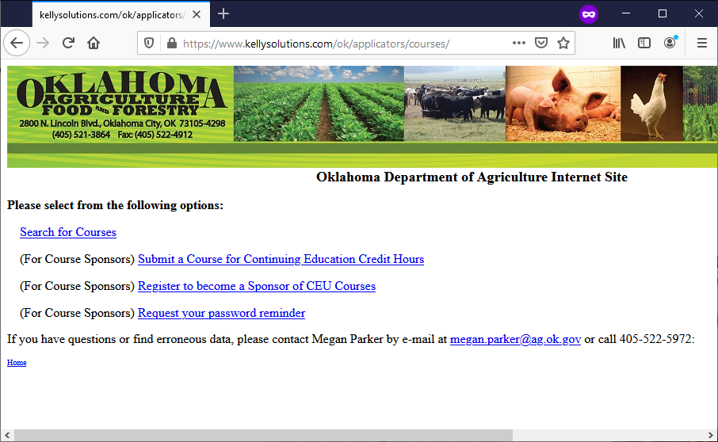
Webpage to Apply for ODAFF CEU
Notes:
kellysolutions.com/OK/applicators/courses

Slide 22
Register to Become a Sponsor
Every OCES office should have their own
“Garfield County Extension”
Keep # and Password in known location
Transferable to new educators
Call/email ODAFF to see if account exists
Notes:
When checking with ODAFF about potential previous accounts. You might provide who the previous couple of educators were for your county.

Slide 23
Creating a Sponsor Account
Notes:
First thing to do is become a sponsor.

Slide 24
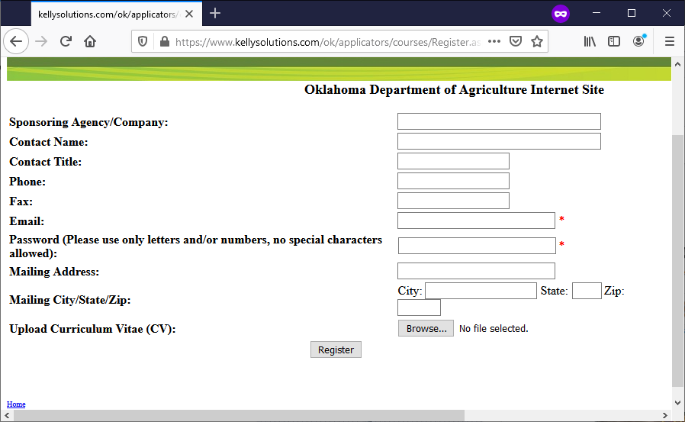
Notes:
Sponsoring Agency/Company: ex “Garfield County Extension”
CV probably not needed but helps. Resume might be a substitute?

Slide 25
Submitting a Course

Slide 26
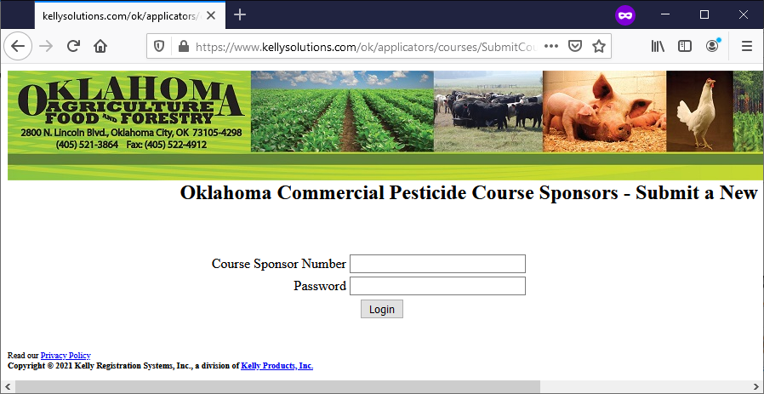
Logging in to Account
Notes:
After clicking on “Submit a Course” you will be brought to the sign-in page first.

Slide 27
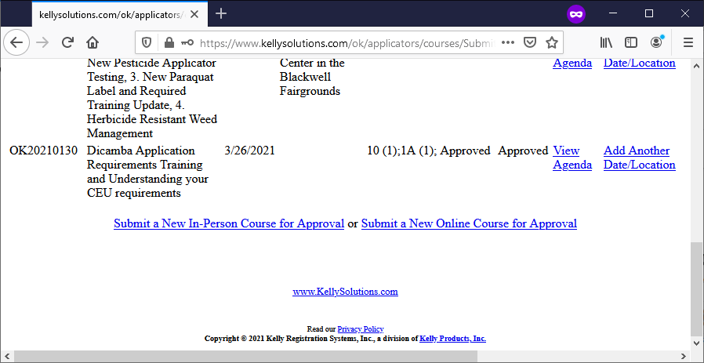
Submitting a new Course
Notes:
After logging in, you see all your previous courses.
Scroll to the bottom to Submit a New Course.

Slide 28
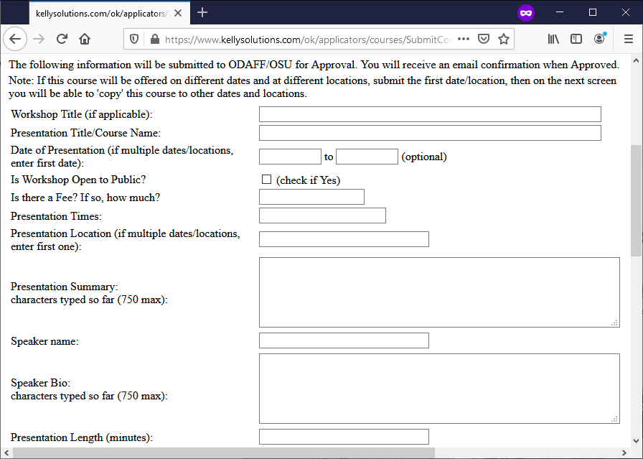
Notes:
Be brief but detailed. When reviewing this, they want it to be about pesticides/application/etc not agronomics.
If adding multiple talks together to get to a whole CEU number, be careful about the character limit in some boxes. Also, I usually number the presentations & speakers.

Slide 29
Info Needed
Meeting title
Presentation titles
Date of presentation
Open to Public?
Is there a fee?
Presentation times
Presentation location
Presentation summary
Speaker name
Speaker bio
Presentation length (m)
Categories
Notes:
Summary of previous slide.

Slide 30
Listing Topics
Character limits
List all topics that might get approved
Description of the content
Relative value for meeting ODAFF standards

Slide 31
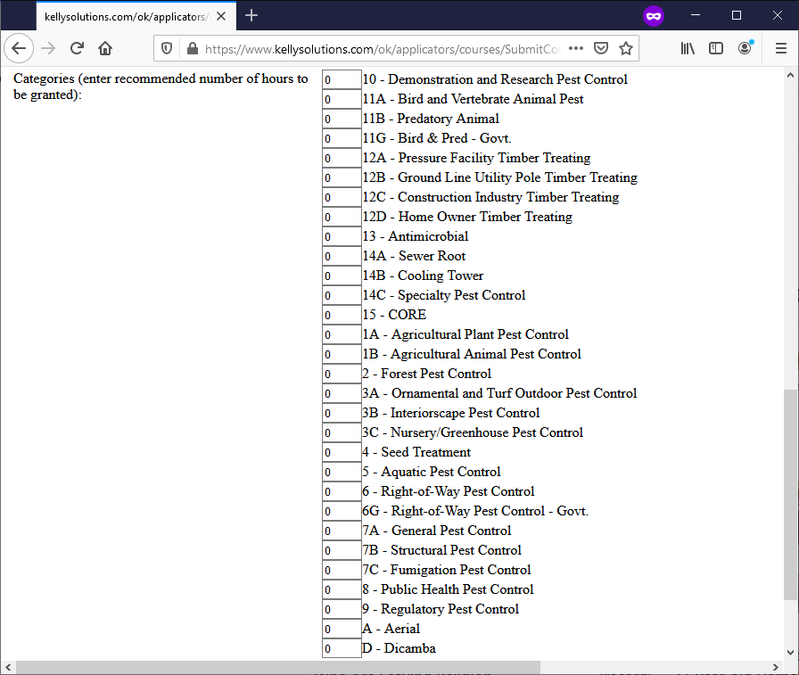
Notes:
Don’t select 15-Core, it’s on there by mistake.
I usually do 10-Demo & Research and 1A-Ag Plant for the programs I do.
1A-Ag Plant currently automatically gets approved from Private Applicators.
Private Applicators maybe added in the future.
If it’s a broad topic like Sprayer Calibration, several categories could be selected. Ex: If an farmer attendee also sprays for the county, they would be very pleased to see Right-of-Way being offered.

Slide 32
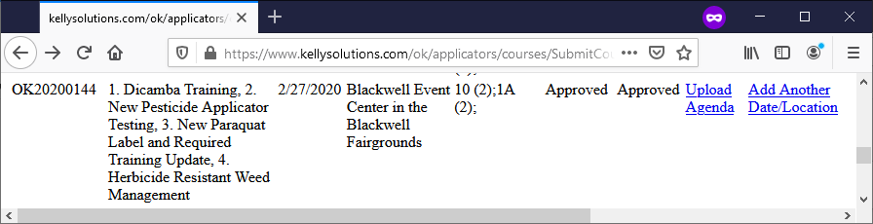
Upload Agenda, add Date/Location
Notes:
Uploading an Agenda with start/end times for each speaker is always a great addition. Even if that document isn’t used to advertise for the event or shared publicly.

Slide 33
Once Approved
Emailed approval letter & sign-in sheet
Ask attendees to write legibly
Print not cursive
OK not to have C.A. #, just don’t guess!
Use DL # Instead
Notes:
Approval isn’t an all or nothing. They might approve it, but with fewer CEUs or categories.
ODAFF once told me the Certified Applicator # (CA #) isn’t needed if they can read the name and phone number, but Kevin Shelton said he was told to substitute your Driver’s License # (DL #) instead.

Slide 34
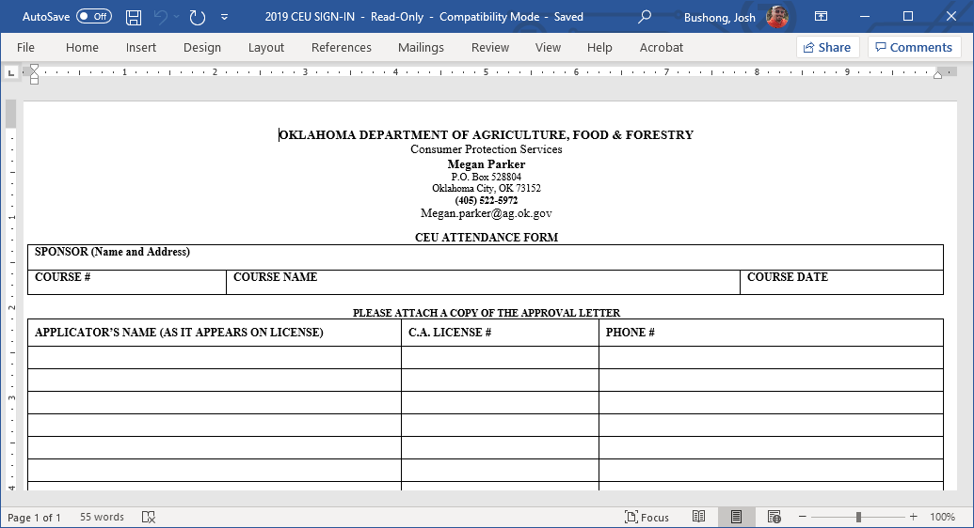
Notes:
Example of a blank ODAFF CUE sign-in sheet. Also available on the ODAFF webpage.
Print/bring enough copies for the anticipated attendance. Only 21 slots per page.

Slide 35
Sending in Documents
Megan.Parker@ag.ok.gov
Email documents promptly after meeting
Attach copies/scans of sign-in sheets, approval letter, and agenda
ODAFF posting CEUs can take awhile
Notes:
At the very least just email the sign-in sheets, but including the other documents helps them confirm what the course was.
We always recommend applicators keep track of their own CEU, and contact ODAFF if there are any discrepancies.

Slide 36
ODAFF Contacts
Megan Parker, Pesticide Prog. Admin.
405-522-5972
Megan.Parker@ag.ok.gov
Debbie Mandrell, CPS Division, CEU contact
405-522-5949
Debbie.Mandrell@ag.ok.gov

Slide 37
Visit OSU
Pesticide Safety Education Program
for more information
pested.okstate.edu
Notes:
Tons of useful links for applicators.

Slide 38






Josh Bushong
Area Extension Agronomist
O | 580.237.7677
C | 405.361.6941
E | josh.bushong@okstate.edu
316 E. Oxford | Enid, OK 73701
oces.okstate.edu/nwareaextension
nwosuext
NW_OSU_Ext
Extension Experience

