Slide 1
APPROVED DICAMBA FORMULATIONS
FOR USE IN THE ROUNDUP READY® XTEND CROP SYSTEM
New information for 2021
2021
APPLICATION REQUIREMENTS
TRAINING AND EDUCATION
Provided by Bayer
Notes:
***The Notes section contains the script for the CBT for your reference as a trainer***
Welcome to the 2021 application requirements web-based training for approved dicamba formulations for use in the Roundup Ready Xtend Crop System. Dicamba-specific training is required before the use of any approved dicamba formulations.
Please note that new registrations were issued in October, 2020 for these products and the new labels contain significant new or modified requirements. These are highlighted in green on the screen. Take special note of these new or modified requirements.

Slide 2

Certificate of Completion
Success Kits will include:
XtendiMax® Herbicide with VaporGrip® Technology label
Sample recordkeeping form
Links to resources
Application requirements summary
Success Kits will also be emailed to provided address
For in-person training make sure you check out before leaving
The certificate will be emailed to you within 24-48 hours
It will come from dicamba.training@bayer.com
Didn’t get the email? Try this first:
Check your SPAM or junk email box
Turn off pop-up blockers
Still missing the email?
Call 1-844-RRXTEND between 8:00 a.m. and 5:00 p.m. central time, weekdays
We will confirm your email and resend the certificate

Slide 3

General label information
FOR RETAIL SALE TO AND USE ONLY BY CERTIFIED APPLICATORS
Refer to specific state and local labeling/rulemaking for possible additional labeling information or for certification process.
ALL APPLICATORS MUST COMPLETE ANNUAL DICAMBA TRAINING PROVIDED BY:
State-Provided Mandatory Training
State-Authorized Provider
Registrant Provided Training
OR
OR
Notes:
Dicamba formulations approved for use in the Roundup Ready Xtend Crop System are Restricted Use Pesticides. Restricted Use Pesticides are for retail sale to and use only by Certified Applicators and only for those uses covered by the Certified Applicator’s certification. These dicamba formulations are NOT to be used by uncertified persons working under the supervision of a certified applicator, except that uncertified persons may transport containers.
This web-based training is not a substitute for the state-specific Certified Applicator training, which is required to purchase and use Restricted Use Pesticides.
The use of Restricted Use Pesticide products containing dicamba also requires that each applicator complete dicamba-specific applicator training prior to applying this product in the 2021 growing season and each growing season thereafter.
This dicamba applicator training is designed to satisfy the federal requirement for mandatory dicamba training. Certain states require that an applicator complete training by the state for dicamba applications in these states. This web-based training will not fulfill the required state-specific training, but can be taken as a supplemental training.
Please check with the state pesticide regulatory agency where applications will be made for training and application requirements imposed by that state.

Slide 4
APPROVED FORMULATIONS OF DICAMBA COVERED BY THIS TRAINING
The application requirements in this training apply to all labeled uses of these products and any future dicamba products labeled for use in the Roundup Ready® Xtend Crop System.
Some slides contain language from XtendiMax® label; other product label language may vary. Always read and follow the specific product label.
To be used by certified applicators only; NOT to be used by uncertified persons working under the supervision of a certified applicator, except that uncertified persons may transport containers.
These labels expire 12/20/2025.
AS OF DECEMBER 2020
The following formulations of dicamba are approved for use in the Roundup Ready® Xtend Crop System and are covered by this training:
XtendiMax® herbicide with VaporGrip® Technology (Bayer)
Tavium® Plus VaporGrip® Technology herbicide (Syngenta)
Engenia® Herbicide (BASF)
Future dicamba products approved for over the top use in the Roundup Ready® Xtend Crop System
Notes:
This training is provided by Bayer and is designed to fulfill federal label application requirements for all uses of the following formulations of dicamba and any future dicamba products labeled for over the top use in the Roundup Ready Xtend Crop System:
Bayer’s XtendiMax herbicide with VaporGrip Technology
Syngenta’s Tavium Plus VaporGrip Technology herbicide
BASF’s Engenia Herbicide
The application requirements in this training apply to all labeled uses of these products. Some information in this training contains direct language from the XtendiMax label. Other product label language may vary. It is important to always read and follow the specific product label for the product you are applying. Again, the operator of the sprayer applying these products must be a Certified Applicator and must have completed required dicamba applicator training.

Slide 5
Product Labels
* Website addresses are extensions of each product label and are subject to change. Certified Applicators are required to visit these website addresses no more than 7 days prior to application of respective product. The information is not a substitute for reading and following all product labelling.
ALWAYS FOLLOW ALL LABELING FOR PRODUCT BEING APPLIED
XtendiMax® Herbicide with VaporGrip® Technology (Bayer)
www.xtendimaxapplicationrequirements.com
Stewardship: www.syngenta-us.com/herbicides/tavium-application-stewardship
Tank Mix: www.TaviumTankMix.com
Tavium® Plus VaporGrip® Technology herbicide (Syngenta)
Stewardship: www.engeniastewardship.com
Tank Mix: www.engeniatankmix.com
Engenia® Herbicide (BASF)

Slide 6
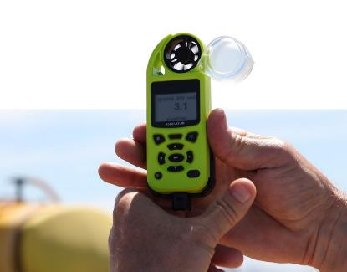
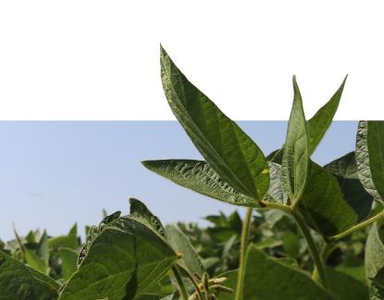
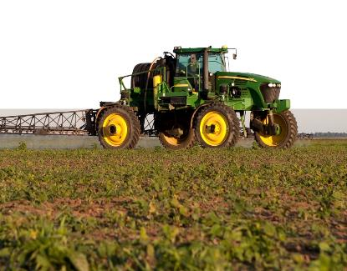
AGENDA
Topics covered in this training
LABEL REQUIREMENTS
KEEPING PESTICIDES ON-TARGET
WEED RESISTANCE MANAGEMENT
SUCCESS KITS VIA EMAIL
2021
Season
Notes:
Topic areas within this training include:
Label Requirements
Keeping Pesticides on-target
Weed Resistance Management

Slide 7
USE Restrictions
DO NOT APPLY THIS PRODUCT:
DO NOT TANK
MIX WITH:
DO NOT MAKE APPLICATION:
Aerially.
Through any type of irrigation equipment. Do not treat irrigation ditches or water used for crop irrigation or domestic purposes.
To crop under stress due to environmental factors, herbicide injury, mechanical damage, insect pressure, etc.
Products not found on the application requirements website.
Products containing ammonium sulfate (AMS).
If rain that may exceed soil field capacity and result in runoff is expected in the next 48 hours (For prevention of potential runoff when excessive rain may occur).
Without including required Drift Reduction Adjuvant (DRA) and Volatility Reduction Adjuvant (VRA) as listed on the application requirements website.
Approved dicamba formulations may ONLY be applied to crops with Roundup Ready 2 Xtend® Technology or XtendFlex® Technology up to and including June 30 for soybeans and July 30 for cotton.
Notes:
The following highlighted restrictions are requirements of the label:
Do not apply these products aerially.
Do not apply through any type of irrigation equipment. Do not treat irrigation ditches or water used for crop irrigation or domestic purposes.
Do not apply to crops under stress due to lack of moisture, hail damage, flooding, herbicide injury, mechanical injury, insects, or widely fluctuating temperatures, as crop injury may result.
Do not tank mix with products not found on the application requirements website.
Do not apply without including a required drift reduction adjuvant (DRA) and volatility reduction adjuvant (VRA) as listed on the application requirements website.
Do not tank mix with products containing ammonium sulfate (AMS). AMS can greatly increase the volatility potential of dicamba, even in small quantities.
Do not make applications of these products if rain that may exceed soil field capacity and may result in soil runoff is expected within 48 hours. This restriction is to avoid potential dicamba runoff when excessive rain may occur.
Do not apply these products after June 30 in dicamba-tolerant soybeans or July 30 in dicamba-tolerant cotton.

Slide 8
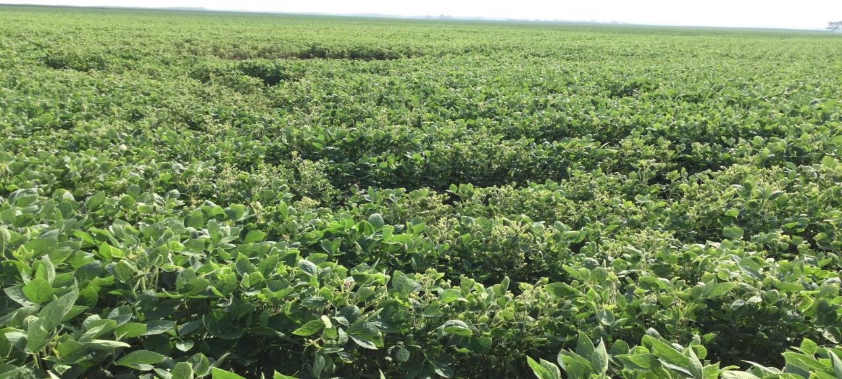

CROP SYMPTOMOLOGY DUE TO RUNOFF
Image from 2018, Iowa.
2020
Season

Slide 9
Record Keeping Requirements

Slide 10
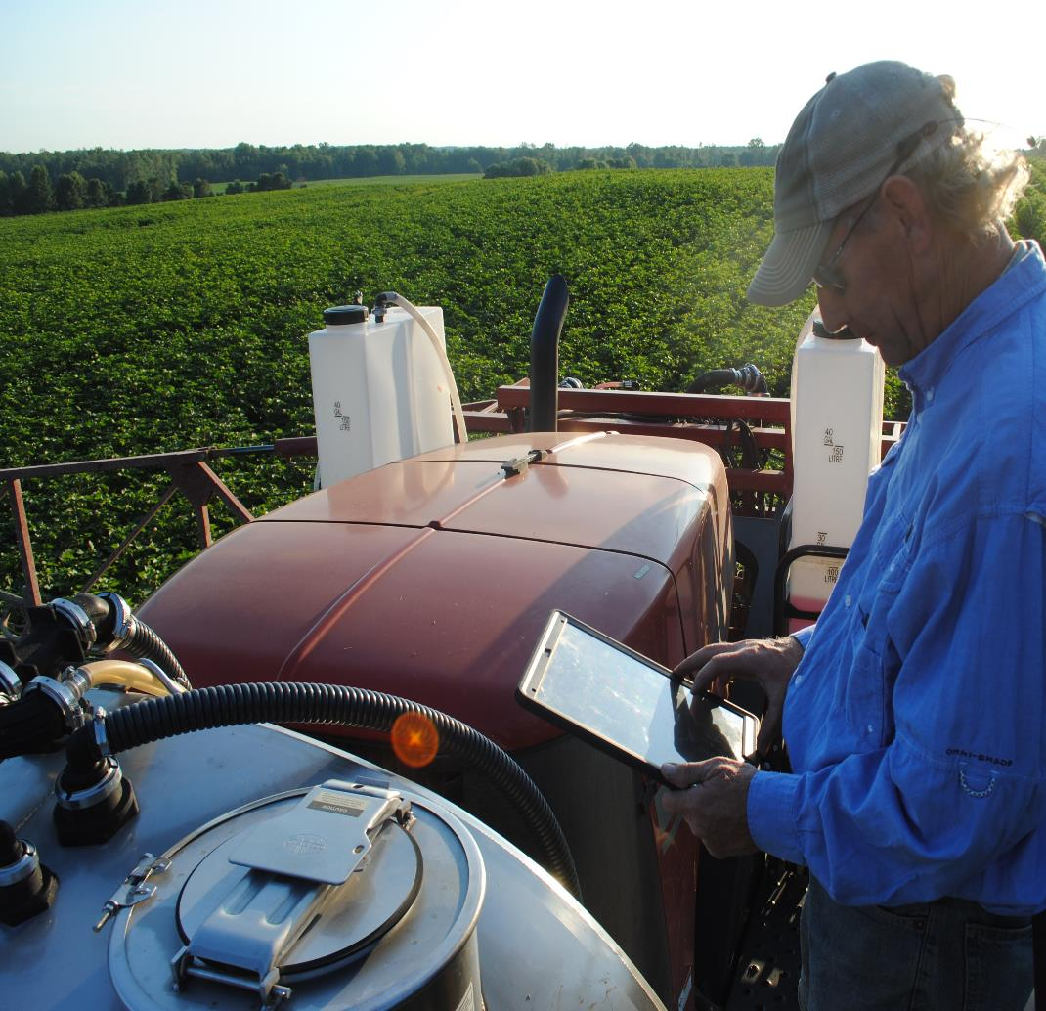
Record Keeping
Requirements
Required for each application of these products.
The certified applicator must keep required documentation for a period of two years; records must be generated as soon as practical but no later than 72 hours after application.
e.g., if 10 fields are sprayed, 10 sets of records are required, including if the same field is sprayed twice
Copies of receipts for required VRA and DRA purchases are required and the amounts used in each tank load must be recorded.
Records must be made available to State Pesticide Control Official(s), USDA and EPA upon request.
2020
Season
Notes:
Record keeping is required for each application of these products. For example, if 10 fields are being sprayed, 10 sets of records are required, or if the same field is sprayed twice, there must be two sets of records for that field.
The certified applicator must keep required documentation for a minimum of two years after application. Records must be generated as soon as practical, but no later than 72 hours after application. Upon request, records must be made available to State Pesticide Control Officials, USDA and EPA.
New for 2021 is the requirement to keep copies of receipts for the required Volatility Reduction Adjuvants and Drift Reduction Adjuvants. Additionally, the amount of VRA and DRA used in each tank load needs to be recorded on the Record Keeping form.

Slide 11
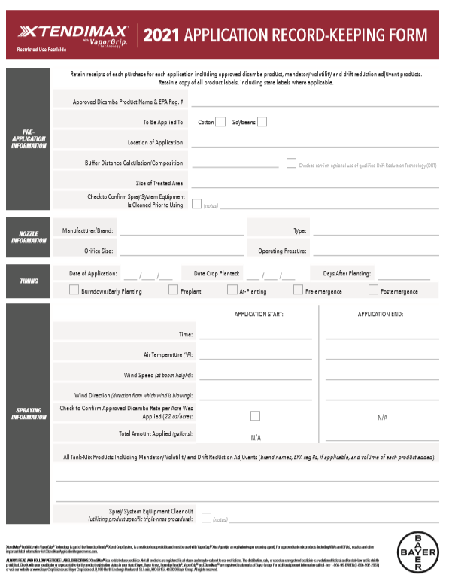

Record Keeping
Requirements
14 categories for record keeping requirements
Link for the XtendiMax record keeping form will be shared via email
Record keeping form available online:
www.xtendimaxapplicationrequirements.com
Roundup Ready Xtend Spray App for Apple and Android
Support for label and other application requirements resource materials, weather forecasting, recordkeeping
2020
Season
Notes:
There are 14 categories of record keeping requirements, which include materials and amounts applied, application timing and conditions, crop and area treated, equipment utilized, buffers used and surrounding sensitive crops verification.
Dicamba product manufacturers and state extension services have developed recordkeeping forms to help applicators comply with the record keeping requirements. A link to the Bayer recordkeeping form will be emailed to participants that complete this training. The form can also be found on the XtendiMax Application Requirements website.
The Roundup Ready Xtend Spray App provides support for label and other application requirements, resource materials, weather forecasts and recordkeeping. The Spray App may be found in the Google Play Store or the Apple App Store.

Slide 12
types of OFF-TARGET MOVEMENT*
WIND
Physical movement of spray particles during spray application
PARTICLE DRIFT
PHYSICAL DRIFT
TARGET CROP
SENSITIVE CROP
Off-target movement from herbicide residue remaining in sprayer components
CONTAMINATED SPRAYER
SPRAYER
CONTAMINATION
SENSITIVE CROP
Movement of an herbicide as a gas or vapor after spray application.
VOLATILIZATION
VOLATILITY
TARGET CROP
SENSITIVE CROP
*Movement through surface runoff or soil is another form of off target movement. Applicators should be aware of weather forecasts and avoid applications if rainfall that may exceed field capacity is expected in the next 48 hours.
Notes:
These three types of OTM will be covered in more depth in the following section.
Physical drift is the downwind movement of spray particles during the application. Physical drift can be minimized by following the required application parameters.
Dicamba residues remaining in handling and application equipment could contaminate sprays that are made to sensitive crops and result in dicamba symptoms.
Volatility is the movement of an herbicide in the gas or vapor phase. It is imperative that ONLY labeled dicamba formulations and tank-mix partners are used in the Roundup Ready Xtend Crop System to help minimize product volatility. A VRA must be included in the spray solution for every application of these dicamba formulations to further reduce the potential for off-target movement from volatility.

Slide 13

Spray Drift Management
Do not allow herbicide solution to mist, drip, drift, or splash onto desirable vegetation because severe injury or destruction to desirable broadleaf plants could result.
Season
2020
Season
2020
Notes:
Keeping these dicamba products on target during application is important.
Do NOT allow herbicide solution to mist, drip, drift, or splash onto desirable vegetation because severe injury or destruction to desirable broadleaf plants could result.
The most common types of off-target movement include physical drift of spray particles, spray equipment contamination and volatility.

Slide 14
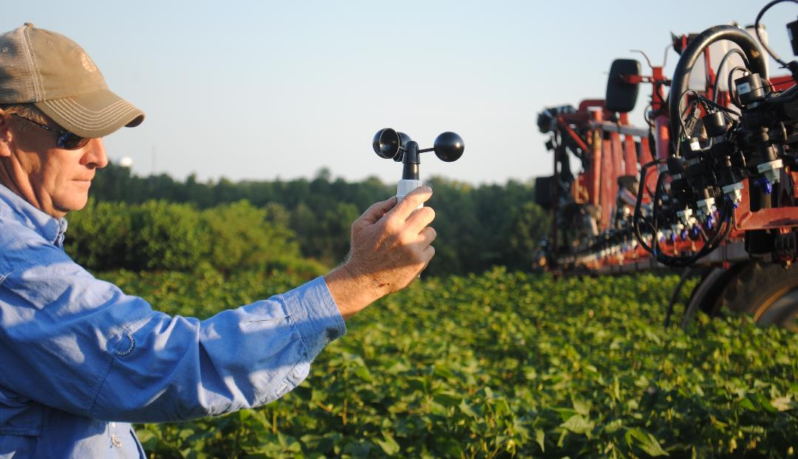
Application Equipment and Techniques
Keeping track of the wind speed and direction
Measure wind speed at boom height with an anemometer. Recommended 2 minute sustained average. (Federal Aviation Administration, 2012)
It is important for the applicator to be aware that wind direction may vary during the application. If wind direction shifts such that the wind is blowing toward adjacent non-dicamba tolerant sensitive crops, the applicator must STOP the application.
Notes:
Understanding wind speed and direction is critical in preventing spray drift onto sensitive crops and certain plants. The wind speed should be measured in the field of application at boom height at the start and at the end of the application using an anemometer. Only apply when wind speed at boom height is between 3 and 10 miles per hour during application.
It is important for the applicator to be aware that wind direction may vary during the application. If wind direction shifts such that the wind is blowing toward adjacent dicamba-sensitive crops, the applicator must stop the application.
Wind speed and direction must be recorded in the record keeping form for the start and completion of each application. Additional wind recordings are suggested during the application to ascertain that wind speed remains within label requirements and that wind direction has not shifted toward a dicamba-sensitive crop.

Slide 15

Application Equipment and Techniques
ONLY USE
approved nozzles within the pressure ranges listed on the application requirements website
DO NOT USE
any nozzle and pressure combination not specifically listed on the label or the specific product website
e.g. www.xtendimaxapplicationrequirements.com
Applicators are required to consult the application requirements website no more than 7 days before application for a complete list of nozzles, VRAs, DRAs, drift reduction technology (DRT) and other herbicides, pesticides, and additives approved for use with these products
2020
Season
Notes:
Minimizing physical drift potential also requires proper application equipment and techniques. The label requires the use of only approved nozzles within specified pressure ranges. Approved nozzle and operating pressure combinations have been tested and meet established parameters for minimizing small, driftable spray droplets.
In addition, approved tank-mix additives, including other herbicides and pesticides, have been tested and, along with approved nozzles and pressure ranges, are listed on each product’s application requirements website.
Applicators are required to consult the application requirements website for the dicamba product they are spraying no more than 7 days before application to determine if the nozzles, spray parameters and tank-mix partners are label approved.

Slide 16
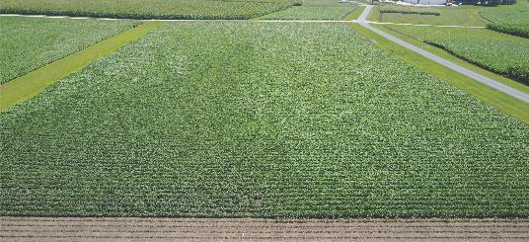
Demonstration on importance of proper nozzles
Nozzle Tip Impact on Drift
APPLICATION PARAMETERS
14 DAT | 15GPA | 40 PSI
BOOMHEIGHT 24 INCHES
2018 MONMOUTH, IL
3-9 MPH
WIND
400 FT
VISIBLE CROP
SYMPTOMOLOGY
DIRECTION OF TRAVEL DURING APPLICATION
XR11004 (NOT APPROVED)
TTI11004 (APPROVED)
Notes:
A 2018 demonstration at the Learning Center in Monmouth, IL
The choice of nozzles is critical to on-target applications. Unapproved nozzles can lead to unacceptable off-target movement due to increased driftable small droplets.
This photo shows the results of a demonstration trial where an unapproved nozzle on the left was compared to an approved nozzle on the right. The drift plume for the approved nozzle is only a fraction of that from the unapproved nozzle.
It is important to monitor operating pressure throughout the application. The pressure in the boom must be within the required pressure range.

Slide 17
Application Equipment and Techniques
SPRAY BOOM HEIGHT
WIND SPEED
GROUND SPEED
Maximum boom height is 24 inches from target crop or pest canopy
Apply when wind speeds are between 3 - 10 mph
Do not exceed a ground speed of 15 mph
Provided the applicator can maintain the required nozzle pressure, it is recommended that tractor speed is reduced to 5 mph at field edges
It is important for the applicator to be aware that wind direction may vary during the application. If wind direction shifts such that the wind is blowing toward adjacent non-dicamba tolerant sensitive crops, the applicator must STOP the application.
Notes:
In addition to approved nozzles operated within the required pressure ranges, other equipment and environmental parameters are important to help minimize off-target movement potential.
The boom height must not exceed twenty-four inches above the target crop or pest canopy. Use the minimum boom height appropriate for spray pattern overlap based on nozzle selection and spacing, according to manufacturer recommendations, or 24 inches above canopy, whichever is smaller.
Apply these products only when wind speed at the boom height is between 3 and 10 miles per hour.
Do not exceed a ground speed of 15 miles per hour. Provided the applicator can maintain the required nozzle pressure, it is recommended that sprayer speed be reduced to 5 mph at field edges.

Slide 18
Application Equipment and Techniques
SPRAY VOLUME
TEMPERATURE INVERSION
APPLICATION TIMING
HYGIENE
Require minimum 15 gallons of spray solution per acre
Use 20 gallons per acre or greater when treating dense weed canopy/vegetation
DO NOT APPLY this product during a temperature inversion
Apply this product only between one hour after sunrise and two hours before sunset
Failure to properly clean the entire system can result in inadvertent contamination of the spray system
Notes:
Use a minimum of 15 gallons of spray volume per acre. Consider using 20 gallons per acre or greater when treating dense weed canopies.
Do not apply these products during a temperature inversion. The potential for off-target movement increases during a temperature inversion. Temperature inversions occur when denser cool air forms near the soil surface in the absence of solar radiation. Inversions may begin to form as the sun sets and often continue into the morning.
The label requires that these products only be applied between one hour after sunrise and two hours before sunset to avoid timings when temperature inversions are likely.
Ensure the spray system used to apply dicamba is cleaned before and after making the application. Failure to properly clean the entire system can result in inadvertent contamination of the spray system.

Slide 19
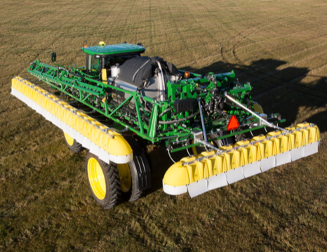
OPTIONAL USE OF DRIFT REDUCTION TECHNOLOGY (DRT)
May be used to reduce off-target movement of spray particles.
Example: Hooded/shielded spray boom.
Qualified DRT and approved nozzles are listed on the application requirements websites.
e.g. www.xtendimaxapplicationrequirements.com
Applications using qualified DRT may benefit from reduced restrictions, such as decreased downwind buffer distance.
Refer to the application requirements websites for a complete list of approved nozzles, operating pressures, drift reduction technologies and required buffer distance.
2020
Season
Notes:
New for 2021 is the use of Drift Reduction Technology (DRT), which consists of hooded or shielded spray booms. This technology may be used to help reduce off-target movement of spray particles.
Applications using a qualified DRT may benefit from reduced restrictions, such as a decreased downwind buffer distance. Only drift reduction technology and approved nozzles listed on the product application requirements website qualify for reduced restrictions.

Slide 20
SPRAY SYSTEM CLEANOUT
Dicamba contamination may cause injury to non-dicamba-tolerant soybeans and other sensitive crops and certain plants
THE EQIVALENT OF A THIMBLE FULL OF FORMULATED DICAMBA PRODUCT IN A 1,000 GALLON SPRAY SOLUTION
HOW MUCH
DICAMBA CAN
CAUSE SYMPTOMOLOGY IN SOYBEANS?
Notes:
The second form of potential off-target movement is through dicamba contamination in equipment. Proper cleaning of mixing, handling, transport and spray equipment is vital to avoid spray solution contamination and potential crop injury in subsequent applications to dicamba sensitive crops and certain plants.
It only takes small amounts of dicamba residue to cause a crop response in dicamba-sensitive crops. For example, the equivalent of a thimble full of dicamba in a 1,000-gallon spray tank applied over non-dicamba tolerant soybeans is enough to cause visual symptoms.

Slide 21
Mixing, handling, transport and spray equipment cleanout considerations
TANKS
VALVES/LINES/HOSES
SCREENS/BOOMS/NOZZLES
Drain unused spray mix before cleanout
Ensure all surfaces are cleaned for each rinse
Drain all rinse water between each rinse.
All valves should be cycled during cleaning Flush loading ports Clean flowmeters & associated lines/hoses
Clean all in-line strainers and suction filters
Clean all nozzles and screens
Flush dead ends and end caps
Flush unused nozzle bodies, pressure check valves and nozzle turrets
Refer to the dicamba product label for a complete listing of required sprayer cleanout procedures.
Consider using dedicated equipment for dicamba products.
All rinse water must be disposed of as per state and local guidelines.
Notes:
All mixing, handling, transport and spray equipment must be thoroughly cleaned before and immediately after using a dicamba product using a triple rinse procedure. See the label of the dicamba product used for specific cleaning instructions.
Good general cleaning practices include draining unused spray before cleaning, ensuring that all surfaces of tanks are cleaned for each rinse and ensuring that all rinse water is drained between each rinse.
All valves should be cycled during cleaning, loading ports flushed and flowmeters, lines and hoses cleaned.
Clean all in-line strainers, suction filters, boom nozzles and screens and flush boom dead ends and end caps. Also, flush unused nozzle bodies, pressure check valves and nozzle turrets.
All rinse water must be disposed of in compliance with local, state, and federal requirements.

Slide 22

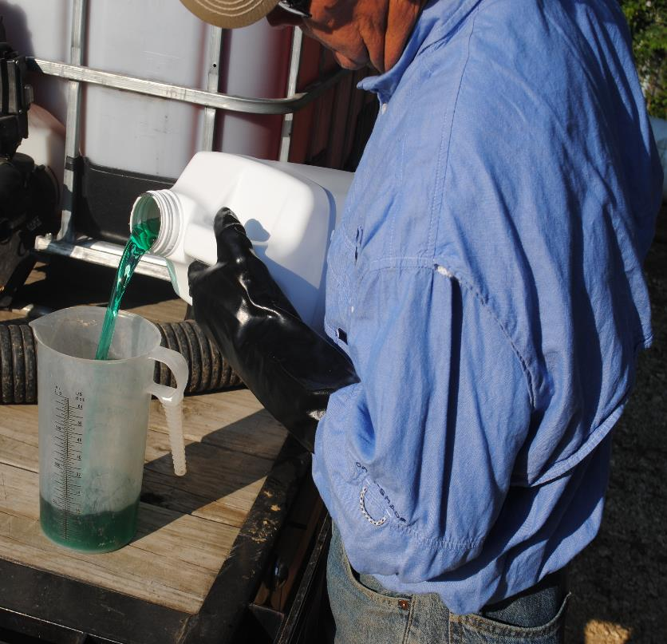
TANK Mix partners may impact volatility and off-target movement potential
All applications of this product require the inclusion of a volatility reduction adjuvant (VRA), such as a VaporGrip® Xtra Agent
product or an approved VRA equivalent. The inclusion of a drift reduction adjuvant (DRA) is also required, unless otherwise indicated at www.xtendimaxapplicationrequirements.com.
2020
Season
Notes:
The third form of potential off-target movement is through volatilization of dicamba after an application.
Only low-volatility formulations of dicamba labeled for use in the Roundup Ready Xtend Crop System may be used. Unapproved tank-mix partners may increase volatility and increase the potential for off-target movement. For this reason, only products that are listed on the application requirements website may be used with these products.
All applications of these products require the inclusion of a volatility reduction adjuvant (VRA) such as a VaporGrip Xtra Agent product or an approved VRA equivalent.
The inclusion of a drift reduction adjuvant (DRA) is also required, unless otherwise indicated on the application requirements website. When certain tank mix partners are used a DRA may not be required.

Slide 23
Impact of volatility reduction agent and dicamba formulation
*External Bayer Humidome Study (2019-2020). Relative volatility data normalized where Xtendimax plus Roundup Powermax plus VaporGrip Xtra Agent equals one (1).
All applications of this product require the inclusion of a volatility reduction adjuvant (VRA), such as a VaporGrip® Xtra Agent
product or an approved VRA equivalent. The inclusion of a drift reduction adjuvant (DRA) is also required, unless otherwise indicated on www.xtendimaxapplicationrequirements.com.
RELATIVE DICAMBA VOLATILITY*
1
3.3
0.3
CLARITY®
HERBICIDE
PLUS
BUCCANEER
PLUS®
XTENDIMAX®
WITH VAPORGRIP®
TECHNOLOGY
TAVIUM®
WITH
VAPORGRIP®
TECHNOLOGY
XTENDIMAX®
WITH VAPORGRIP®
TECHNOLOGY*
TAVIUM®
WITH
VAPORGRIP®
TECHNOLOGY
ENGENIA®
HERBICIDE
ENGENIA®
HERBICIDE
TANK MIXED WITH ROUNDUP POWERMAX®
TANK MIXED WITH ROUNDUP POWERMAX® AND
LABELED VAPORGRIP XTRA AGENT
Notes:
The addition of an approved VRA further reduces the potential volatility of these already low-volatility dicamba products.
This chart shows the relative volatility of several dicamba formulations and tank mix partners as determined in humidome studies.
The left bar shows the relative volatility of an unapproved dicamba formulation and a common glyphosate formulation, Clarity and Buccaneer Plus.
The next three bars show the relative volatility of three approved low-volatility formulations of dicamba when tank mixed with Roundup PowerMAX.
The last three bars show the relative volatility of these same three tank mixtures with the addition of VaporGrip Xtra Agent, a labeled VRA.
The use of a VRA is a new requirement for 2021 and beyond. All applications of these dicamba products must include an approved VRA, such as a VaporGrip Xtra Agent product, or another approved VRA equivalent. Consult the applicable application requirements website to get a list of approved VRAs for the dicamba product being used.

Slide 24
TANK MIXING INSTRUCTIONS
Product websites
All applications of this product require the inclusion of a volatility reduction adjuvant (VRA), such as a VaporGrip® Xtra Agent
product or an approved VRA equivalent. The inclusion of a drift reduction adjuvant (DRA) is also required, unless otherwise indicated on www.xtendimaxapplicationrequirements.com.
Approved tank mix partners and Required VRAs and DRAs are included on the application requirements websites
Applicator must check the list of approved products no more than 7 days before applying
XtendiMax® Herbicide with VaporGrip® Technology (Bayer)
www.xtendimaxapplicationrequirements.com
Engenia® Herbicide (BASF)
TANK MIX PARTNERS
Stewardship: www.engeniastewardship.com
Tank Mix: www.engeniatankmix.com
Websites show approved nozzles, pressure ranges, VRAs, DRAs, tank mixes, and Drift Reduction Technologies (DRTs).
Tavium® Plus VaporGrip® Technology herbicide (Syngenta)
www.TaviumTankMix.com
Notes:
Use only approved tank mix partners and additives, including herbicides, other pesticides and VRAs and DRAs, when applying these dicamba products. Approved products have been tested and found to not adversely affect off-target movement potential of dicamba.
The inclusion of an approved DRA is required for all applications of these products, unless otherwise indicated on the application requirements website.
Approved tank-mix partners and additives are included on each product application requirements website. Applicators must check the list of approved products on the website for the dicamba product being used no more than seven days prior to applying.
Follow the tank mix order recommended for the specific DRA used. Improper mixing order could result in chemical incompatibility in the spray tank, poor spray pattern at the nozzle and could lead to poor weed control.
The spray solution should be agitated after each component is added to the tank to ensure proper mixing.

Slide 25

Protecting Adjacent Sensitive Crops AND CERTAIN PLANTS
Season
2020
Season
2020
Notes:
To protect adjacent sensitive crops and certain plants, the applicator must determine the location of any surrounding sensitive crops and certain plants by consulting sensitive crop registries, visiting with neighbors and surveying the surrounding area.

Slide 26
PROTECTION OF ADJACENT sensitive CROPS AND CERTAIN PLANTS
DO NOT SPRAY
DO NOT APPLY this product when the wind is blowing toward adjacent sensitive crops and certain plants; this includes NON-DICAMBA TOLERANT SOYBEAN AND COTTON.
Sensitive crops and/or certain plants include, but are not limited to, tomatoes and other fruiting vegetables (EPA crop group 8), fruit trees, cucurbits (EPA crop group 9), grapes, beans, flowers, ornamentals, peas, potatoes, sunflower, tobacco and other broadleaf plants, including if these plants are in a greenhouse.
DICAMBA-TOLERANT CROP
APPROVED APPLICATION
SENSITIVE CROP AND
CERTAIN PLANTS
WIND
Contact with foliage, green stems, or fruit of crops, or any desirable plants that do not contain a dicamba tolerance gene or are not naturally tolerant to dicamba, could result in severe plant injury or destruction.
Notes:
Do not apply these products when the wind is blowing toward adjacent sensitive crops and certain plants, including non-dicamba tolerant soybeans and cotton.
Do not allow contact with foliage, green stems, or fruit of crops, or any desirable plants that do not contain a dicamba tolerance gene or are not naturally tolerant to dicamba. Contact could result in severe plant injury or destruction.
To the extent consistent with applicable law, the applicator is responsible for avoiding off-target spray drift.

Slide 27
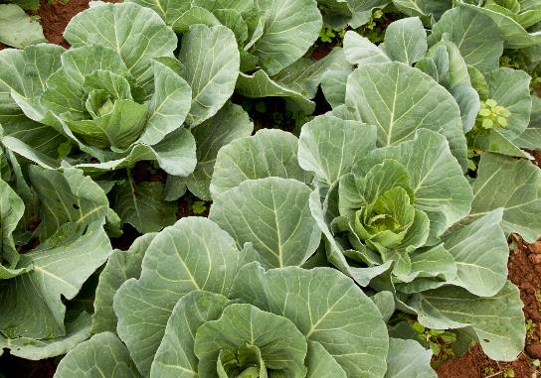





confirm and document adjacent SENSITIVE CROPS AND CERTAIN PLANTS
Take time to know Your neighbors and your surroundings
Confirm sensitive crops and certain plants
Preseason consult with neighboring growers on all sides
Susceptible/sensitive crop registry, website, app, etc.
Follow-up prior to application to determine if there are any changes in intentions
Document in the application records that a sensitive crop registry (registry name and date) was consulted AND that adjacent areas were surveyed for sensitive crops and certain plants prior to application
*
*Registry examples; consult your state authority for other crop registries. Contact Bayer at 844-RRXTEND for questions.
Notes:
Before making an application, consult a sensitive crop registry, such as FieldWatch or an applicable state/federal registry. Record the registry and date consulted in your record keeping form.
Also, survey adjacent areas and confirm the type of plants and crops surrounding the field prior to application. From this survey, include in your record keeping the adjacent plants and crops and/or areas surrounding the field of application and the date the survey was conducted.

Slide 28
Additional Examples of Dicamba Sensitive Crops
VISUAL SYMPTOMOLOGY SCALE FOR DICAMBA
LOWER
MODERATE
SEVERE
EXTREME
Broccoli
Collards
Cabbage
Kale
Mustard
Pecan
Turnip
Cantaloupe
Canola*
Cucumber
Peach
Peanut
Squash
Cotton
Pepper
Tomato
Watermelon
Grapes*
Lima Bean
Southern Pea
Snap Bean
Soybean
Sweet potato*
Tobacco*
>1/75X
1/75-1/300X
1/300-1/800X
< 1/800X
Herbicide Rate of Visually Detectable Symptomology: For relative comparison, tomato, squash, and watermelon response to glyphosate for visual symptomology would be in the “lower” category.
Information adapted from Dr. Stanley Culpepper, University of Georgia Cooperative Extension. Categories indicate sensitivity of listed plants to glyphosate exposure; not the degree of symptomology *Data from literature; all other data generated in over 72 UGA field experiments | Source: GA-018*.

Slide 29
Protection of Adjacent Sensitive Crops and certain plants
Wind Direction?
It is important for the applicator to be aware that wind direction may vary during the application. If wind direction shifts such that the wind is blowing toward adjacent non-dicamba tolerant sensitive crops, the applicator must STOP the application.
DICAMBA
TOLERANT
SOYBEANS
CORN
WIND
NON-DICAMBA TOLERANT SOYBEANS
DICAMBA
TOLERANT CROP
APPROVED APPLICATION
SPRAY
DICAMBA
TOLERANT
SOYBEANS
Application Field
Dicamba Tolerant Crop
No Crop
CORN
CORN
Sensitive Crop
Notes:
In this example, the purple Roundup Ready 2 Xtend soybean field is to be sprayed. The wind is blowing from east to west and a survey of the area shows that the downwind field is another Roundup Ready 2 Xtend soybean field, so it is okay to spray.

Slide 30
Protection of Adjacent Sensitive Crops and certain plants
Wind Direction?
DICAMBA
TOLERANT
SOYBEANS
CORN
WIND
NON-DICAMBA TOLERANT SOYBEANS
DICAMBA
TOLERANT CROP
DO NOT SPRAY
DICAMBA
TOLERANT
SOYBEANS
Application Field
Dicamba Tolerant Crop
No Crop
CORN
CORN
Sensitive Crop
Notes:
Wind direction can change during the application. In this example the wind has shifted and is now blowing out of the northwest and toward multiple planted fields, including non-dicamba tolerant soybeans. Because there is a dicamba sensitive crop downwind, the application can not be made at this time.

Slide 31
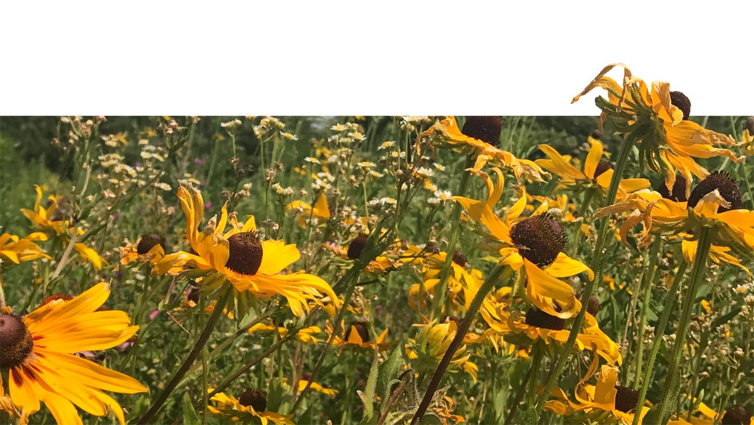
Buffer Requirement
Season
2020
Season
2020
Notes:
Once the applicator has determined that there are no adjacent downwind sensitive crops and/or certain plants and that an application can be made, the applicator must consider the placement of the downwind buffer. A downwind buffer is required for all applications.

Slide 32
BUFFER DISTANCE REQUIREMENT
downwind adjacent areas
The applicator must always maintain a downwind buffer between the last treated row and the nearest downwind field edge (in the direction the wind is blowing).
240 feet for open-boom sprayers
110 feet when using qualified Drift Reduction Technology (certain hooded/shielded broadcast sprayers) as listed on product specific websites
When using qualified Drift Reduction Technology; certified applicator is required to visit www.xtendimaxapplicationrequirements.com no more than 7 days prior application to confirm approved equipment and application limitations/directions for specific Drift Reduction Technology employed.
Downwind buffer is not intended for protection of downwind sensitive crops and certain plants
Season
2020
Season
2020
Notes:
The applicator must always maintain a 240-foot downwind buffer when applying these dicamba products using broadcast open-boom equipment. The use of qualified Drift Reduction Technology, or DRTs, can reduce downwind buffer requirements to 110 feet. A list of qualified DRTs is available on the application requirements website for the dicamba product being sprayed.
The downwind buffer must be infield unless certain areas exist adjacent to the treated field.

Slide 33
BUFFER COMPOSITION REQUIREMENT
Areas that may be included in buffer distance composition
DICAMBA-TOLERANT CROP APPROVED APPLICATION
DOWNWIND
ADJACENT AREA
Roads, paved or gravel surfaces, mowed grassy areas adjacent to field, and areas of bare ground from recent plowing or grading that are contiguous with the treated field.
Planted agricultural fields containing: corn, dicamba-tolerant cotton, dicamba-tolerant soybean, sorghum, proso millet, small grains, sugarcane and other crops for which dicamba has a post-emergent approved use.
If the applicator intends to include such crops as dicamba-tolerant cotton and/or dicamba-tolerant soybeans in the buffer distance composition, the applicator must confirm the crops are in fact dicamba tolerant.
Agricultural fields that have been prepared for planting.
Areas covered by the footprint of a building, silo, or other man-made structure with walls and/or roof.
WIND
Buffer Distance
FIELD EDGE
Season
2020
Season
2020
Notes:
The following areas may be included in the buffer distance composition when directly adjacent and downwind to the treated field edge:
Roads, paved or gravel surfaces, mowed grassy areas adjacent to the field, and areas of bare ground from recent plowing or grading that are contiguous with the treated field.
Planted agricultural fields containing: corn, dicamba tolerant cotton, dicamba tolerant soybean, sorghum, proso millet, small grains, sugarcane and other crops for which Dicamba has a post-emergent approved use.
Agricultural fields that have been prepared for planting.
Areas covered by the footprint of a building, silo, or other man-made structure with walls and/or roof.
The buffer distance composition may be made up of a combination of the buffer areas. For example, the buffer composition may consist of 140 feet of infield buffer combined with 100 feet of road and mowed grassy area adjacent to the field.

Slide 34
BUFFER REQUIREMENT
downwind adjacent areas
Wind Direction?
DICAMBA
TOLERANT
SOYBEANS
CORN
WIND
NON-DICAMBA TOLERANT SOYBEANS
BUFFER*
SPRAY
DICAMBA
TOLERANT CROP
APPROVED APPLICATION
Buffers
DICAMBA
TOLERANT
SOYBEANS
BUFFER*
Application Field
Dicamba Tolerant Crop
No Crop
CORN
CORN
Sensitive Crop
*BUFFER COMPOSITION IS 240’. MAY BE REDUCED WHEN UTILIZING QUALIFIED DRT.
Notes:
In this example, the wind is out of the southeast and is blowing toward dicamba tolerant soybeans and corn. The adjacent 240 feet of these fields may be used as the buffer distance composition, so an infield buffer is not required.
If using approved Drift Reduction Technology, the same area could be used for the buffer distance composition, but the required buffer distance could be reduced to 110 feet.

Slide 35
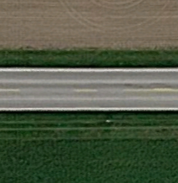
Buffer Requirement
downwind adjacent areas
Wind Direction?
DICAMBA
TOLERANT
SOYBEANS
WIND
CORN
NON-DICAMBA TOLERANT SOYBEANS
SPRAY
180’ DICAMBA
TOLERANT SOYBEANS
DICAMBA TOLERANT CROP
APPROVED APPLICATION
60’ ROAD AND
MOWED DITCH
Buffers
DICAMBA
TOLERANT
SOYBEANS
BUFFER*
Application Field
Dicamba Tolerant Crop
No Crop
CORN
CORN
Sensitive Crop
*BUFFER COMPOSITION IS 240’. MAY BE REDUCED WHEN UTILIZING QUALIFIED DRT.
Notes:
In this field, the wind is out of the east. The adjacent area to the west includes 60 feet of asphalt roadway and mowed ditches, which can be included in the buffer distance composition. For open boom spray technology, the adjacent 180 feet of dicamba tolerant soybeans can comprise the remainder of the required 240 feet of downwind buffer. If using Drift Reduction Technology, the adjacent 50 feet of dicamba tolerant soybeans can serve as the remainder of the required 110-foot downwind buffer.

Slide 36
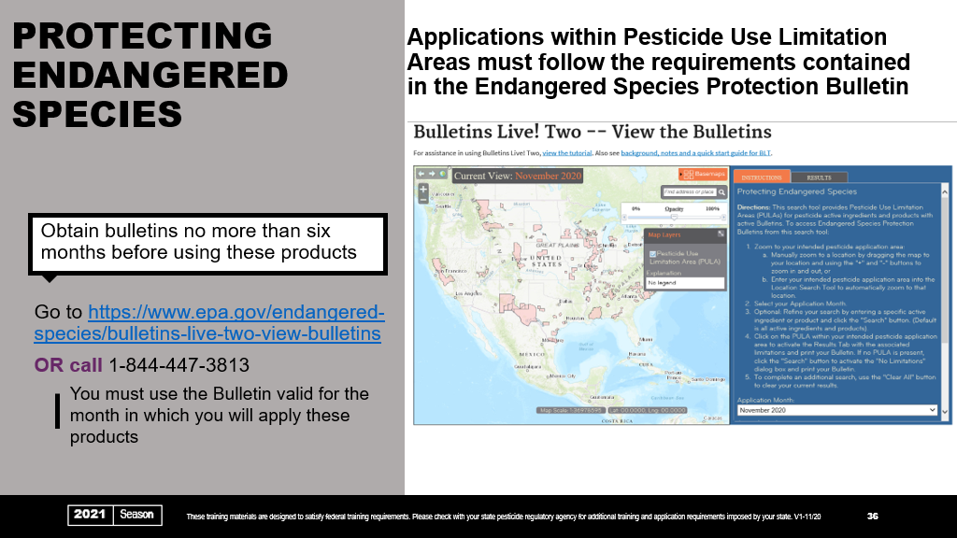
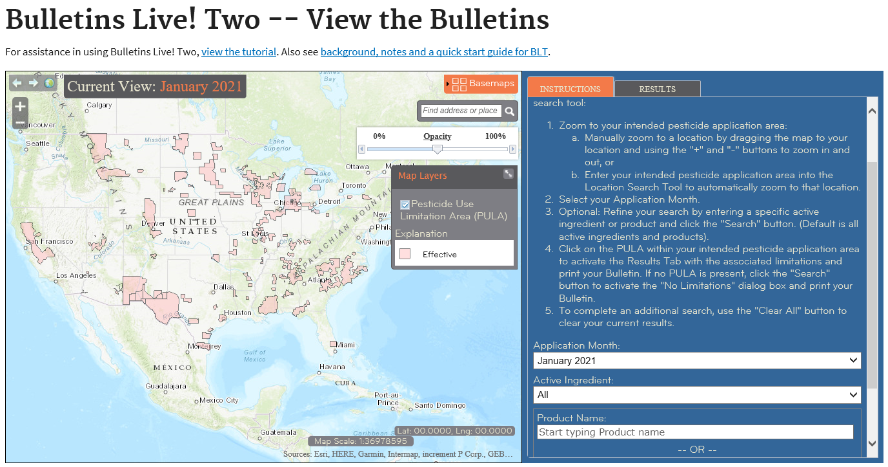
Notes:
An important component of these product labels addresses the protection of endangered species. Use of these products in a manner inconsistent with their labeling may pose a hazard to endangered or threatened species.
Areas of concern for endangered or threatened species are called Pesticide Use Limitation Areas. When using these products within Pesticide Use Limitation Areas, the applicator must follow the measures contained in the EPA’s Endangered Species Protection Bulletin.
Bulletins must be obtained no more than six months before using these products.
Consult the Bulletins Live Two website or call 1-844-447-3813.
The applicator must use the Bulletin valid for the month and for the county in which the application will be made.

Slide 37
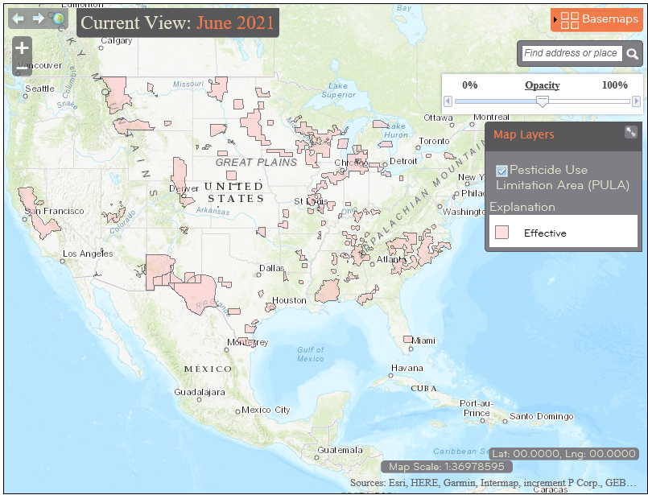
Instructions
Obtaining a Bulletin
1
Zoom in or search to locate your field
Satellite image available in basemaps if needed
1
Notes:
To obtain a bulletin from the Bulletins Live Two website, begin by locating your field. You can either manually zoom in to your field or search by entering the field street address or GPS coordinates.

Slide 38
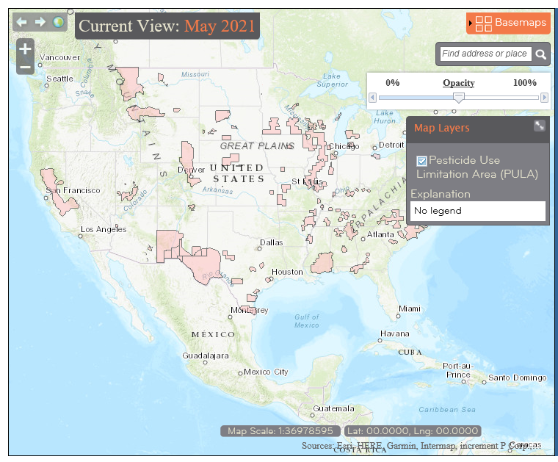
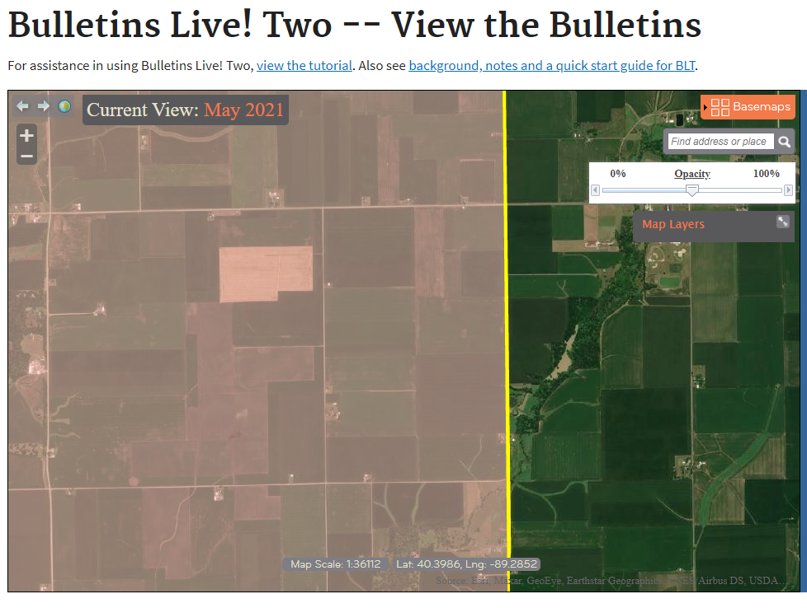
Instructions
Obtaining a Bulletin
1
Zoom in or search to locate your field
Satellite image available in basemaps if needed
If your field is pink, click on the area (if not colored, No ESA Limitation)
Outline of area should highlighted
1
2
2
Notes:
If your field is not colored pink, it is not within a Pesticide Use Limitation Area and no additional buffer requirements or application limitations exist with respect to endangered or threatened species. You do not need to proceed any further on this website, but you must note on your record keeping form the date you consulted the Bulletins Live Two website.
If your field is pink, it is within a Pesticide Use Limitation Area. Click on the area.

Slide 39
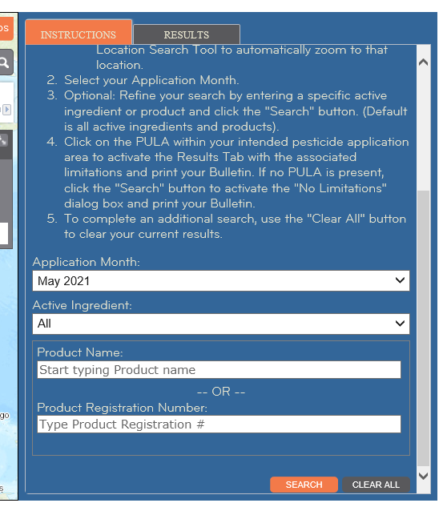
Instructions
Obtaining a Bulletin
1
Zoom in or search to locate your field
Satellite image available in basemaps if needed
If your field is pink, click on the area (if not colored, No ESA Limitation)
Outline of area should highlighted
Designate application month, e.g. “May 2021”
Search
2
3
3
Notes:
To obtain the appropriate bulletin for the application, enter the month in which the application will be made and the product name or registration number. Under the Instructions tab, select the month and the name or registration number of the product you plan to apply. For XtendiMax herbicide with VaporGrip Technology, enter the name of the product or the registration number 264-1210.
Select search to proceed.

Slide 40
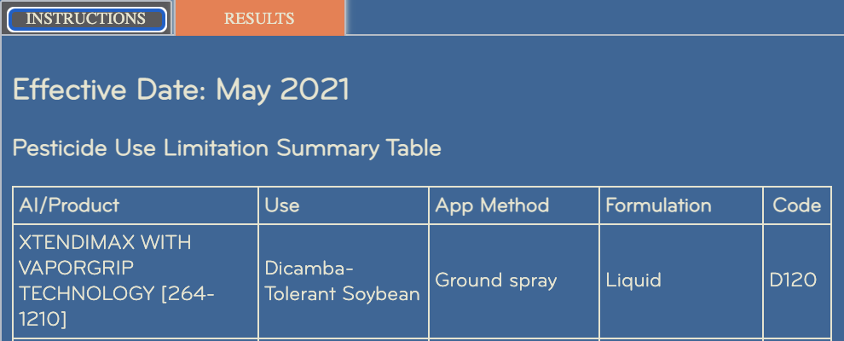
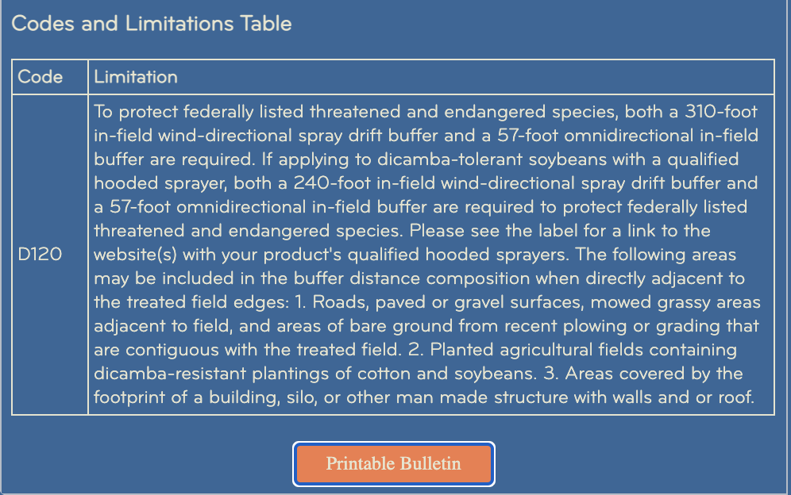
Instructions
4
Obtaining a Bulletin
1
Zoom in or search to locate your field
Satellite image available in basemaps if needed
If your field is pink, click on the area (if not colored, No ESA Limitation)
Outline of area should highlighted
Designate application month e.g. “May 2021”
Search
Look to the right at Results*
If dicamba products are listed, See Limitations
2
3
4
*All approved pesticides for applications in the PULA will be listed. This example only shows XtendiMax for illustration purposes.
Notes:
Click the “results” tab and product information and uses will be displayed along with codes and limitations table. If your field is within a Pesticide Use Limitation Area, you must follow all the requirements and use limitations listed.
The website will be updated as additional information is provided to the EPA, and use limitations may change, so it is required that the site be consulted no more than six months before application of these dicamba products.

Slide 41
Buffer requirements summary
County requiring Omnidirectional buffer
To protect federally listed threatened and endangered species, both a 310-foot in-field wind-directional spray drift buffer and a 57-foot omnidirectional in-field buffer are required.
If applying with a qualified hooded sprayer, both a 240-foot in-field wind-directional spray drift buffer and a 57-foot omnidirectional in-field buffer are required to protect federally listed threatened and endangered species. Please see the label for a link to the website(s) with your product's qualified hooded sprayers.
The following areas may be included in the buffer distance composition when directly adjacent to the treated field edges:
Roads, paved or gravel surfaces, mowed grassy areas adjacent to field, and areas of bare ground from recent plowing or grading that are contiguous with the treated field.
Planted agricultural fields containing dicamba-resistant plantings of cotton and soybeans.
Areas covered by the footprint of a building, silo, or other man-made structure with walls and or roof.
Notes:
Pesticide Use Limitation Areas require that fields include a 310-foot downwind buffer and a 57-foot omnidirectional buffer on the remaining sides of the field. If applying these products to dicamba-tolerant soybeans with qualified drift reduction technology, including qualified hooded sprayer, the downwind buffer may be reduced to 240 feet.
Certain areas directly adjacent to the treated field exist may be included as part of the buffer distance composition, including the following:
Roads, paved or gravel surfaces, mowed grassy areas adjacent to the field and areas of bare ground from recent plowing or grading that are contiguous with the treated field.
Planted agricultural fields containing dicamba-resistant plantings of cotton and soybeans.
Areas covered by the footprint of a building, silo, or other man-made structure with walls or a roof.

Slide 42
Buffer protection
County requiring Omnidirectional buffer
Wind Direction?
DICAMBA
TOLERANT
SOYBEANS
CORN
WIND
NON-DICAMBA TOLERANT SOYBEANS
IN-FIELD BUFFER*
SPRAY
DICAMBA TOLERANT CROP
APPROVED APPLICATION
Buffers
DICAMBA
TOLERANT SOYBEANS
BUFFER*
Application Field
Dicamba Tolerant Crop
No Crop
CORN
CORN
Sensitive Crop
*BUFFER COMPOSITION IS 310’ DOWNWIND (MAY BE REDUCED WHEN UTILIZING QUALIFIED DRT) WITH 57’ OMNIDIRECTIONAL.
Notes:
This is an example of required buffers where the field is in a county with a Pesticide Use Limitation Area for the use of these products. The wind is out of the east, so a 310-foot downwind buffer is required on the west side of the sprayed field. In addition, the omnidirectional 57-foot buffer is required on the remaining sides of the field.
The downwind buffer is in the adjacent field of Roundup Ready 2 Xtend Soybeans, which is an area that can be used as buffer. The remaining omnidirectional buffers are within the sprayed field since the adjacent fields do not contain crops that can be used as buffer in a Pesticide Use Limitation Area.

Slide 43
Buffer protection
County requiring Omnidirectional buffer
Wind Direction?
DICAMBA
TOLERANT
SOYBEANS
CORN
NON-DICAMBA TOLERANT SOYBEANS
WIND
SPRAY
IN-FIELD BUFFER*
DICAMBA TOLERANT CROP
APPROVED APPLICATION
Buffers
DICAMBA
TOLERANT
SOYBEANS
BUFFER*
Application Field
Dicamba Tolerant Crop
No Crop
CORN
CORN
Sensitive Crop
*BUFFER COMPOSITION IS 310’ DOWNWIND (MAY BE REDUCED WHEN UTILIZING QUALIFIED DRT) WITH 57’ OMNIDIRECTIONAL.
Notes:
In this example, the wind is out of the north, so a 310-foot downwind buffer is required on the south side of the field with 57-foot omnidirectional buffers required on the remaining sides.
To the west, the neighboring Roundup Ready 2 Xtend Soybean field can be used for the buffer. The buffers on the remaining sides of the field must be in the sprayed field.

Slide 44
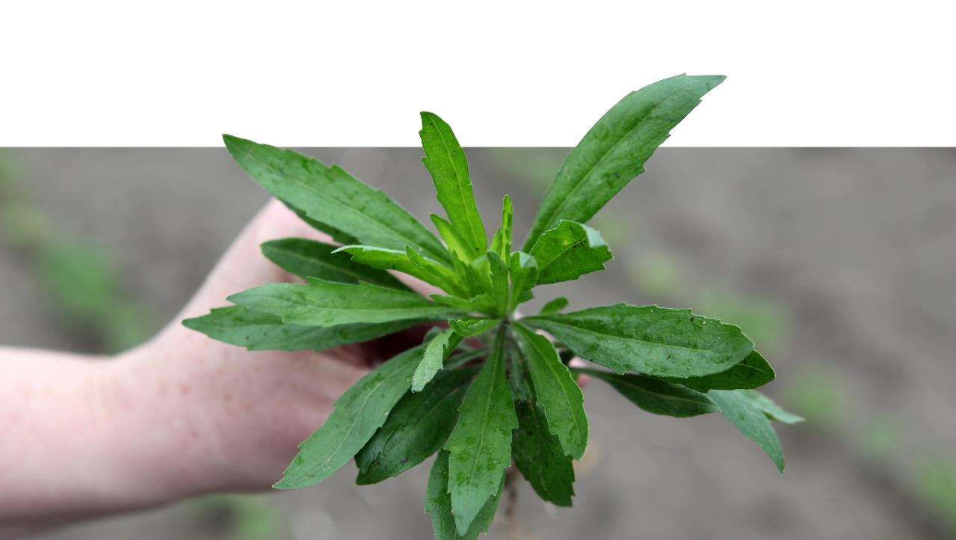
WEED resistance Management training
Season
2020
Season
2020
Notes:
As cases of weed resistance to herbicides continue to escalate, it is critical that strategies be implemented to delay further resistance development. Effective strategies will extend the usefulness of currently effective herbicides and extend options for effective weed control programs.

Slide 45
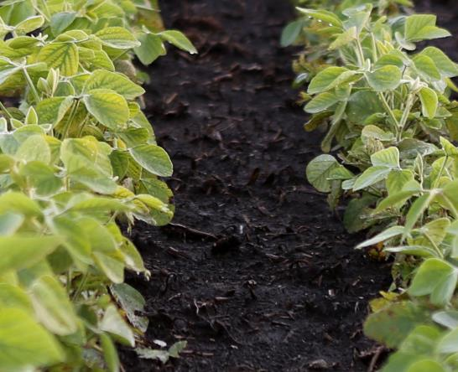

Principles of weed resistance management
Long-term herbicide resistance management requires more than weed control aimed at minimizing yield loss in a single year
Adopt a multi-year approach
Knowing existing resistance
Crop rotation
Effective herbicide resistance management combines:
Proper scouting (before and after applications)
System approach to chemical application
Multiple Sites of Action
Overlapping residuals
Ensure effective chemical applications
Timely applications (< 4 inch weeds)
Long-term
Strategy
2020
Season
Notes:
While dicamba provides excellent broadleaf weed control, a long-term strategy is required for effective weed resistance management. This includes a multi-year approach that encompasses knowing existing resistance and the inclusion of crop rotation so that alternative herbicide programs are used.
Effective herbicide resistance management combines both cultural and herbicide options for weed control and include the following actions:
Proper scouting before application is needed to identify weeds present and to time treatments when weeds are at the appropriate size. Scout after application to determine the effectiveness of the treatment and plan mitigating measures for any uncontrolled weeds.
Herbicide programs need to include multiple sites of action and timely overlapping residuals used at the recommended rates.
Postemergence herbicides like dicamba are most effective when applied at the recommended rate to weeds that are 4-inches tall or less.

Slide 46
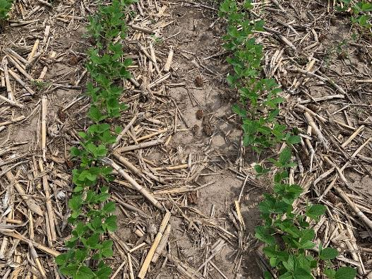
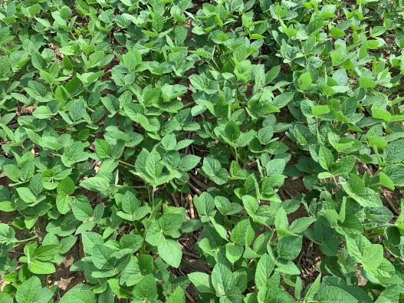
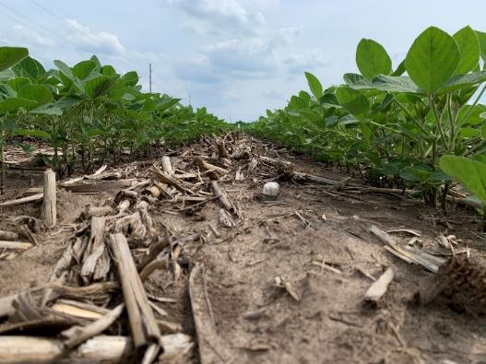
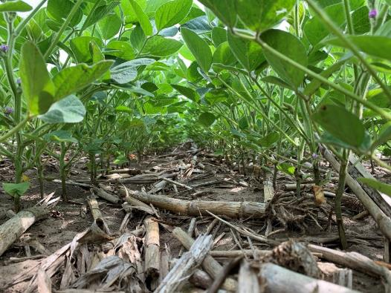
Principles of weed resistance management
Use Cultural As Well As Chemical Practices for Weed Management
Crop rotation
Cover crops/crop residue
Sound agronomic practices to increase crop competition
Row spacing (example left)
Pest management
Soil health
COMBINE TACTICS TO BE MOST EFFECTIVE
*University of Wisconsin, R. Werle, 2020. 140K population, planted same day.
2020
Season
Notes:
Adoption of certain cultural practices may enhance weed management.
Crop rotation provides increased herbicide options. In addition, alternative crops may provide increased competition for light and moisture, reducing weed pressure.
The use of cover crops and crop residue has been shown to be effective for delaying the emergence of weeds while improving soil health.
Narrower row spacings can provide more rapid canopy closure, shading the soil and increasing crop competition.
Additionally, effective pest management aids in healthy crop growth, which enables better crop competition that suppresses weed growth.

Slide 47
Principles of weed resistance management
Multiple sites of action that are effective against the most troublesome weeds
Choosing effective site of action is key
Knowing if herbicide is active preemergence, postemergence, or both is important to understand
Whenever practical, Multiple Sites of Action should be applied in the same application for PRE and POST weed control
https://iwilltakeaction.com/uploads/files/2020-take-action-herbicide-classification-chart.pdf
Notes:
Proactively implementing diversified weed control strategies to minimize selection for weed populations resistant to one or more herbicides is a best practice. A diversified weed management program should include the use of herbicides with different sites of action that are all effective against the most troublesome weeds.
When practical, multiple sites of action should be used in both the pre and post herbicide application timings.
For more information and educational resources designed to help manage herbicide resistance and adopt good weed management practices, go to the United Soybean Board’s Take Action Herbicide-Resistance Management website at iwilltakeaction.com

Slide 48
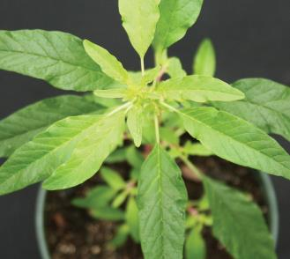
Weed Examples
COMMON WATERHEMP
Amaranthus rudis
SEEDS/PLANT
250K
2
4
5
9
14
27
ALS INHIBITORS | SYNTHETIC AUXINS | PHOTOSYSTEM II INHIBITORS | EPSP SYNTHASE INHIBITOR | PPO INHIBITORS | HPPD INHIBITORS
KNOWN RESISTANCE
1
2
3
3
4
5
6
7
8
9
10
13
14
15
22
27
SITE OF ACTION | ACCASE INHIBITORS | ALS INHIBITORS | MICROTUBULE INHIBITORS | SYNTHETIC AUXINS | PHOTOSYSTEM II INHIBITORS | LIPID SYNTHESIS INHIBITOR (not ACCase) | EPSP SYNTHASE INHIBITOR | GLUTAMINE SYNTHETASE INHIBITOR | DITERPENE BIOSYNTHESIS INHIBITOR | PPO INHIBITORS | LONG-CHAIN FATTY ACID INHIBITORS | PHOTOSYSTEM I ELECTRON DIVERTER | HPPD INHIBITORS
PRODUCT EXAMPLES (Trade Name®) | Assure II, Select Max | Classic, Pursuit | Prowl H₂O, Treflan | 2,4-D, Clarity®, quinclorac | atrazine, metribuzin, Basagran, Linex | Far-Go | Roundup, (glyphosate) | Liberty® | Command | Flexstar, Cobra® | Dual, Harness | Gramoxone®, (paraquat) | Callisto, Laudis
Notes:
Why is it so critical to have a diversified weed management program? Many weed species have become resistant to multiple sites of action, as shown in this common waterhemp example. Not only is common waterhemp a prolific seed producer, but it has shown resistance to six sites of action. This leaves only a few herbicides that will control this weed species.
If resistance to dicamba is suspected, weed escapes should be treated with an herbicide having a site of action other than Group 4, removed using non-chemical methods, or both to remove the escapes. The goal is to prevent reproduction of the escaped weeds to mitigate the spread of herbicide-resistant weeds.
Additionally, the use of cultural control methods is important in a weed management program to delay development or spread of resistant weed biotypes.
NOTE: hide this slide if presenting is an area where Palmer amaranth is prominent.

Slide 49
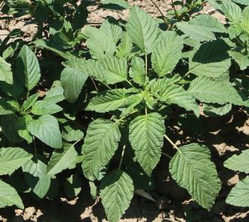
Weed Examples
PALMER AMARANTH
Amaranthus palmeri
SEEDS/PLANT
600K
2
3
5
9
14
27
ALS INHIBITORS | MICROTUBULE INHIBITORS | PHOTOSYSTEM II INHIBITORS | EPSP SYNTHASE INHIBITOR | PPO INHIBITORS | HPPD INHIBITORS
KNOWN RESISTANCE
1
2
3
4
5
6
7
8
9
10
13
14
15
22
27
SITE OF ACTION | ACCASE INHIBITORS | ALS INHIBITORS | MICROTUBULE INHIBITORS | SYNTHETIC AUXINS | PHOTOSYSTEM II INHIBITORS | LIPID SYNTHESIS INHIBITOR (not ACCase) | EPSP SYNTHASE INHIBITOR | GLUTAMINE SYNTHETASE INHIBITOR | DITERPENE BIOSYNTHESIS INHIBITOR | PPO INHIBITORS | LONG-CHAIN FATTY ACID INHIBITORS | PHOTOSYSTEM I ELECTRON DIVERTER | HPPD INHIBITORS
PRODUCT EXAMPLES (Trade Name®) | Assure II, Select Max | Classic, Pursuit | Prowl H₂O, Treflan | 2,4-D, Clarity®, quinclorac | atrazine, metribuzin, Basagran, Linex | Far-Go | Roundup, (glyphosate) | Liberty® | Command | Flexstar, Cobra® | Dual, Harness | Gramoxone®, (paraquat) | Callisto, Laudis
Notes:
Why is it so critical to have a diversified weed management program? Many weed species have become resistant to multiple sites of action, as shown in this Palmer amaranth example. Not only is Palmer amaranth a prolific seed producer, but it has shown resistance to six sites of action. This leaves only a few herbicides that will control this species.
If resistance to dicamba is suspected, weed escapes should be treated with an herbicide having a site of action other than Group 4, removed using non-chemical methods, or both. The goal is to prevent reproduction of the escaped weeds to mitigate the spread of herbicide-resistant weeds.
NOTE: hide this slide if presenting is an area where common waterhemp is prominent.

Slide 50
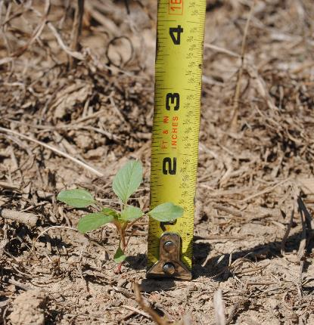
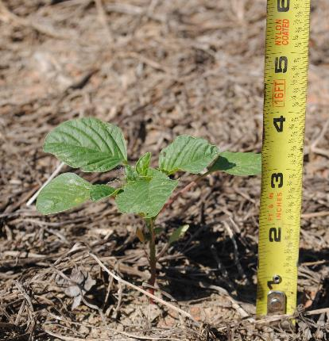
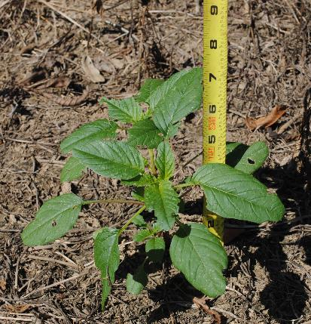
Effective Applications
Weed Height
*2018. Tennessee. Palmer Pigweed
FOR BEST RESULTS, SPRAY WEEDS THAT ARE 4 INCHES OR SHORTER
Notes:
Dicamba has both pre and post weed control activity, but the primary use is as a postemergence treatment. For these dicamba products, post applications should be made when the weeds are 4 inches or less in size. For optimum effectiveness of any herbicide, applications should follow label recommendations for weed height.

Slide 51
Applications of low-volatility formulations of dicamba
Weed Resistance Management
Use LABELED RATE for in-crop applications (0.5 lb ae/A)
Consider ENVIRONMENTAL FACTORS for applications
BRAND | RATE
XtendiMax® Herbicide with VaporGrip® Technology (Bayer) | 22 fl oz/A
Engenia® Herbicide (BASF) | 12.8 fl oz/A
Tavium® Plus VaporGrip® Technology herbicide (Syngenta) | 56.5 fl oz/A
4 hour rainfast period
Drought and cold stress can reduce effectiveness
Spray while weeds are actively growing
+
Approved VRA,
and DRA if required*
* see product label website for approved tank-mix
(eg www.xtendimaxapplicationrequirements.com )
* In-crop labeled rate
Notes:
The applications of these dicamba products provide best performance when used at the labeled rate of one-half pound acid equivalent per acre. Consult the specific product label for the product volume that will deliver this rate.
All of these products require the addition of an approved VRA. An approved DRA is also required unless otherwise indicated on the product application website.
Weeds are best controlled when they are actively growing, less than 4-iches tall and not under drought or cold stress. Rainfall within 4 hours of application may reduce effectiveness by washing the herbicide off the weed foliage.

Slide 52
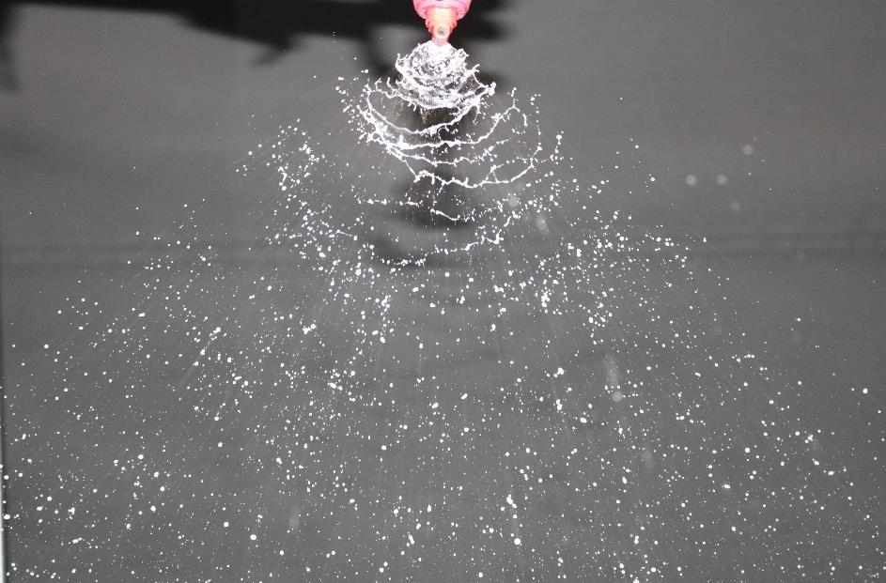
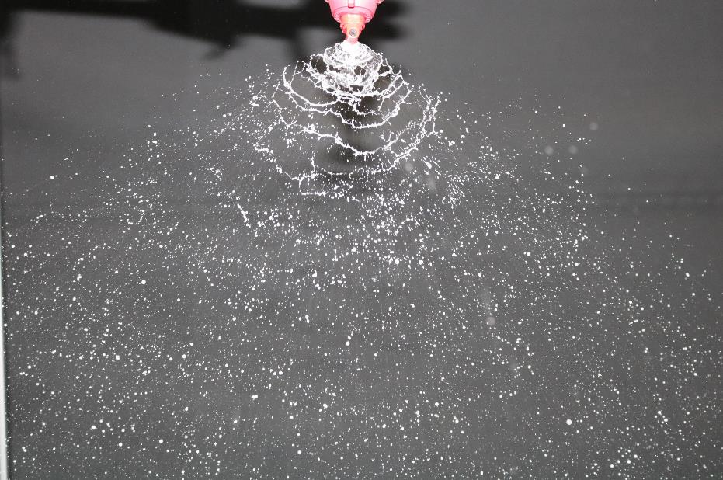
Pressure IMPACT ON WEED COVERAGE
Spray pressure should balance weed coverage and production of fine spray particles
1
Both pressures shown below are within approved range; yet higher PSI improves coverage
2
Ensure appropriate sprayer ground speed and operating pressure
30 PSI - INCOMPLETE PATTERN
60 PSI - FULL PATTERN
Approved Dicamba + Approved Glyphosate + Approved DRA (0.5% v/v) + Approved VRA Applied at 15 GPA
Notes:
Application pressure influences both the spray droplet size and the spray pattern. It is recommended that a higher pressure within the recommended range be used when spraying dicamba to get full coverage of the herbicide on weeds.

Slide 53
CROP SPECIFIC RESTRICTIONS
In the Roundup Ready® Xtend Crop System
Approved dicamba formulations may be applied to crops with Roundup Ready 2 Xtend® Technology or XtendFlex® Technology up to and including June 30 for soybeans and July 30 for cotton.
PRE-EMERGENT/BURNDOWN:
IN-CROP:
Apply 0.5 lb ae/acre in single application
Two applications maximum before crop emergence
Apply 0.5 lb ae/acre in single application
Two applications maximum after emergence
Maximum seasonal use rate allowance for dicamba products is 2 lbs ae/acre.
Refer to specific product labels for product rates and growth stage timings for crop response concerns; e.g. R1 for soybeans with XtendiMax.
Notes:
New for 2021, the cutoff dates for making approved dicamba applications on Roundup Ready 2 Xtend Technology or XtendFlex Technology are June 30 for soybeans and July 30 for cotton.
The use rate for a single application is 0.5 pounds acid equivalent per acre for both pre and post emergence applications. A maximum of two applications can be used pre and two applications post emergence with a maximum seasonal use rate of 2 pounds acid equivalent per acre.
Refer to specific product labels for rates and growth-stage limitations.

Slide 54
Example of Good Weed Management System
Soybean
Roundup Ready 2 Xtend® Soybeans*
Overlapping residual herbicides are important along with multiple sites of action
TIMING | PRACTICE | EXAMPLE RECOMMENDATION**
Before Planting | Burndown or Start Clean with Tillage | Roundup PowerMAX® Herbicide (32 oz) + XtendiMax® Herbicide with VaporGrip® Technology (22 oz) + labeled Drift Reduction Adjuvant (DRA) + labeled Volatility Reduction Adjuvant (VRA)
At Planting | Pre
Post 1 Over-the-top | Post 1 < 4” weeds and within 20-30 days after PRE Application
Post 2 Over-the-top | Post 2 | Cobra® Herbicide (10 oz) + COC (1% v/v) to control any weed escapes prior to R6
Valor® EZ Herbicide (2 oz), Valor® XLT Herbicide (3 oz), Fierce® Herbicide (3 oz) or Warrant® Herbicide (3-4 pt) + metribuzin (0.25 lb)
Roundup PowerMAX® Herbicide (32 oz) + XtendiMax® Herbicide with VaporGrip® Technology (22 oz) + labeled DRA + labeled VRA
Warrant® Herbicide (3-4 pt) or Warrant® Ultra Herbicide (50 oz)
*Check with your local dealer or representative or U.S. EPA and your state pesticide regulatory agency for the product registration status and additional restrictions in your state. **Contact your local retailer, company representative or extension service for specific regional weed management recommendations.
Notes:
What might an effective weed management program look like? This example demonstrates the principles of effective weed management in soybeans.
Start with a weed-free field at planting, which can be achieved using tillage or burndown herbicides, such as Roundup PowerMAX and one of the approved dicamba formations.
Use a residual herbicides such as Warrant, Valor or Fierce applied preemergence to the crop and weeds.
The first postemergence treatment of Roundup PowerMax and an approved dicamba formulation should be applied no later than 20 to 30 days after the pre-treatment to control weeds that are 4 inches or less in size. A second overlapping residual herbicide should also be applied at this time.
Hide this slide if not in a soybean growing region

Slide 55
Example of Good Weed Management System
Soybean
XtendFLEX® Soybeans*
Overlapping residual herbicides are important along with multiple sites of action
TIMING | PRACTICE | EXAMPLE RECOMMENDATION**
Before Planting | Burndown or Start Clean with Tillage | Roundup PowerMAX® Herbicide (32 oz) + XtendiMax® Herbicide with VaporGrip® Technology (22 oz) + labeled Drift Reduction Adjuvant (DRA) + labeled Volatility Reduction Adjuvant (VRA)
At Planting | Pre
Post 1 Over-the-top | Post 1 < 4” weeds and within 20-30 days after PRE Application
Post 2 Over-the-top | Post 2 | Liberty® Herbicide (29 oz) to control any weed escapes up to R1 growth stage
Valor® EZ Herbicide (2 oz), Valor® XLT Herbicide (3 oz), Fierce® Herbicide (3 oz) or Warrant® Herbicide (3-4 pt) + metribuzin (0.25 lb)
Roundup PowerMAX® Herbicide (32 oz) + XtendiMax® Herbicide with VaporGrip® Technology (22 oz) + labeled DRA + labeled VRA
Warrant® Herbicide (3-4 pt) or Warrant® Ultra Herbicide (50 oz)
*Check with your local dealer or representative or U.S. EPA and your state pesticide regulatory agency for the product registration status and additional restrictions in your state. **Contact your local retailer, company representative or extension service for specific regional weed management recommendations.
Notes:
What might an effective weed management program look like in XtendFlex Soybeans? This example demonstrates the principles of effective weed management in soybeans.
Start with a weed-free field at planting, which can be achieved using tillage or burndown herbicides, such as Roundup PowerMAX and one of the approved dicamba formations.
Use a residual herbicides such as Warrant, Valor or Fierce applied preemergence to the crop and weeds.
The first postemergence treatment of Roundup PowerMax and an approved dicamba formulation should be applied no later than 20 to 30 days after the pre-treatment to control weeds that are 4 inches or less in size. A second overlapping residual herbicide should also be applied at this time.
Liberty herbicide is an option for post control in XtendFlex soybeans and cotton.
Hide this slide if not in a soybean growing region

Slide 56
Example of Good Weed Management System
Cotton
Cotton with XtendFlex® Technology*
Overlapping residual herbicides are important along with multiple sites of action
TIMING | PRACTICE | EXAMPLE RECOMMENDATION**
Before Planting | Early Burndown or Start Clean with Tillage | Roundup PowerMAX® II Herbicide (32 oz) + 2,4-D (16-32oz) or dicamba (0.25-0.5 lb)
At Planting | Pre
Post | Post 1 < 4” weeds and within 14-18 days after planting
Post | Post 2 32-39 days after planting | Roundup PowerMAX® II Herbicide (32 oz) + XtendiMax® Herbicide with VaporGrip® Technology (22 oz) + labeled DRA + labeled VRA or Liberty® Herbicide (32 oz)
Post | Lay-by hooded sprayer
Gramoxone® SL 2.0 Herbicide (2-4 pt) + Warrant® Herbicide (3 pt) + diuron (1.5 pt)
Roundup PowerMAX® II Herbicide (32 oz) + XtendiMax® Herbicide with VaporGrip® Technology (22 oz) + Warrant® Herbicide (3 pt) + labeled Drift Reduction Adjuvant (DRA) + labeled Volatility Reduction Adjuvant (VRA)
Diuron (1.5 pt) + Roundup PowerMAX® II Herbicide (32 oz) or MSMA (2 lbs ai)
*Check with your local dealer or representative or U.S. EPA and your state pesticide regulatory agency for the product registration status and additional restrictions in your state. **Contact your local retailer, company representative or extension service for specific regional weed management recommendations.
Notes:
Hide if not in a cotton growing region

Slide 57
Weed management in buffer area
Weed management in buffer areas should be unique to each situation, options include:
Glufosinate in XtendFlex® soybeans/cotton
PPO or other herbicide options
Use higher labeled rates of residual herbicides and additional SOA in possible buffer areas
XtendiMax may be applied in certain downwind buffer areas used in a previous application
Wait for change in wind direction, determine new buffer distances and adhere to all other application requirements (including endangered species restrictions)
Contact your Bayer technical or sales representatives for local recommendations
Notes:
Weed control in the in-field buffer areas are unique to each situation depending on the crop, adjacent crops and surrounding non-crop areas.
Glufosinate is an option in XtendFlex cotton or XtendFlex soybean.
Using higher labeled rates of residual herbicides with multiple sites of action could provide weed control, but must be implemented early in the season.
Another option might be to wait until wind direction changes for XtendiMax herbicide with VaporGrip Technology application in the downwind buffer area.
We recommend contacting your technical or sales representatives for local recommendations specific to your situation.

Slide 58
Applications of low-volatility formulations of dicamba
Contact the appropriate company if you:
Experience poor performance on labelled weeds or suspect weed resistance
Have off-target movement inquiries
Have crop response inquiries
Have questions about sensitive crop registries
XtendiMax
Tavium
Engenia
1-844-RRXTEND
www.roundupreadyxtend.com
1-866-796-4368
www.syngenta-us.com
www.engeniaquestions.com
Notes:
If you have weed escapes, off target movement or a crop response after an application of these dicamba products, contact the appropriate company for follow-up action. An example would be the 1-844-RRXTEND number for XtendiMax herbicide with VaporGrip Technology from Bayer. If you have questions about the buffer requirement or need information about the sensitive crop registries, you can get that information at these same numbers.

Slide 59
Certificate of Completion
Make sure you check out before leaving in-person meetings
The certificate will be emailed to you within 24-48 hours
It will come from dicamba.training@bayer.com
Didn’t get the email? Try this first:
Check your SPAM or junk email box
Turn off pop-up blockers
Still missing the email?
Call 1-844-RRXTEND between 8:00 a.m. and 5:00 p.m. central time, weekdays
We will confirm your email and resend the certificate
Notes:
FINAL SLIDE – Slide that allows user to enter name, state of application and email address and click send
This completes the Bayer-provided dicamba application requirements training. Follow the instructions on the screen to print the documentation that you have completed this training. Please retain your documentation with your spray records.
Thank you for your time and dedication to the proper application and stewardship of these and all agricultural technologies.

Slide 60


Disclaimer
Bayer is a member of Excellence Through Stewardship® (ETS). Bayer products are commercialized in accordance with ETS Product Launch Stewardship Guidance, and in compliance with Bayer’s Policy for Commercialization of Biotechnology-Derived Plant Products in Commodity Crops. Commercialized products have been approved for import into key export markets with functioning regulatory systems. Any crop or material produced from this product can only be exported to, or used, processed or sold in countries where all necessary regulatory approvals have been granted. It is a violation of national and international law to move material containing biotech traits across boundaries into nations where import is not permitted. Growers should talk to their grain handler or product purchaser to confirm their buying position for this product. Excellence Through Stewardship® is a registered trademark of Excellence Through Stewardship. XtendiMax® herbicide with VaporGrip® Technology is part of the Roundup Ready® Xtend Crop System, is a restricted use pesticide and must be used with VaporGrip® Xtra Agent (or an equivalent vapor reducing agent). For approved tank-mix products (including VRAs and DRAs), nozzles and other important label information visit XtendiMaxApplicationRequirements.com. ALWAYS READ AND FOLLOW PESTICIDE LABEL DIRECTIONS. It is a violation of federal and state law to use any pesticide product other than in accordance with its labeling. NOT ALL formulations of dicamba, glyphosate or glufosinate are approved for in-crop use with products with XtendFlex® Technology. ONLY USE FORMULATIONS THAT ARE SPECIFICALLY LABELED FOR SUCH USES AND APPROVED FOR SUCH USE IN THE STATE OF APPLICATION. Contact the U.S. EPA and your state pesticide regulatory agency with any questions about the approval status of dicamba herbicide products for in-crop use with Roundup Ready 2 Xtend® soybeans or products with XtendFlex® Technology. Products with XtendFlex® Technology contains genes that confer tolerance to glyphosate, glufosinate and dicamba. Glyphosate will kill crops that are not tolerant to glyphosate. Dicamba will kill crops that are not tolerant to dicamba. Glufosinate will kill crops that are not tolerant to glufosinate. Contact your seed brand dealer or refer to the Bayer Technology Use Guide for recommended weed control programs. XtendiMax® is a restricted use pesticide. Not all products are registered in all states and may be subject to use restrictions. The distribution, sale, or use of an unregistered pesticide is a violation of federal and/or state law and is strictly prohibited. Check with your local dealer or representative for the product registration status in your state. Roundup PowerMAX®, Roundup Ready 2 Yield®, Roundup Ready®, VaporGrip®, Warrant®, XtendFlex® and XtendiMax® are registered trademarks of Bayer Group. Gramoxone® is a registered trademark of a Syngenta group company. LibertyLink® and the Water Droplet Design® is a trademark of BASF Corporation. Cobra® and Valor® are registered trademarks of Valent U.S.A. Corporation. Some of the product(s) discussed herein are restricted use pesticide(s) and may not be registered in all states. The distribution, sale, or use of an unregistered pesticide is a violation of federal and/or state law and is strictly prohibited. Check with your local dealer or product representative for the product registration status in your state. For additional product information call toll-free 1-866-99-BAYER (1-866-992-2937) or visit our website at www.BayerCropScience.us. Bayer CropScience LP, 800 North Lindbergh Boulevard, St. Louis, MO 63167. ©2020 Bayer Group. All rights reserved.

Slide 61
Appendix

Slide 62
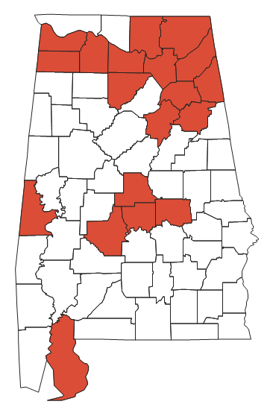
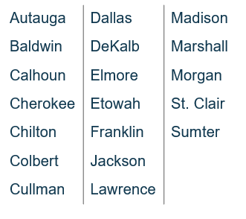
COUNTIES IMPACTED BY ENDANGERED SPECIES REQUIREMENT*
ALABAMA
* = current as of December, 2020

Slide 63
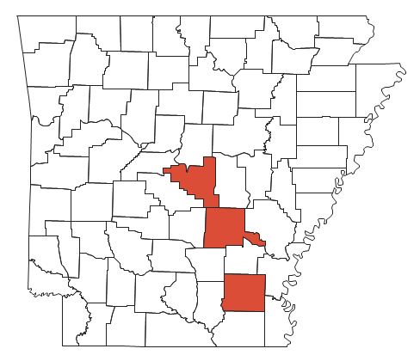
COUNTIES IMPACTED BY ENDANGERED SPECIES REQUIREMENT*
ARKANSAS
Drew
Jefferson
Pulaski
* = current as of December, 2020

Slide 64
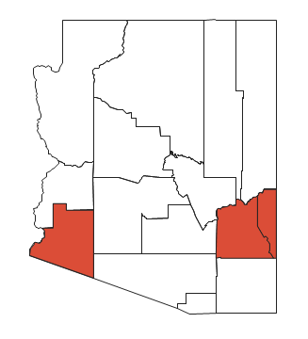
COUNTIES IMPACTED BY ENDANGERED SPECIES REQUIREMENT*
ARIZONA
Graham
Greenlee
Yuma
* = current as of December, 2020

Slide 65
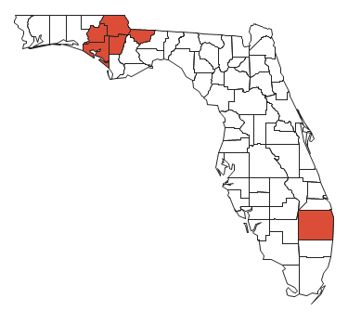
COUNTIES IMPACTED BY ENDANGERED SPECIES REQUIREMENT*
FLORIDA
Bay
Calhoun
Gadsden
Jackson
Palm Beach
Washington
* = current as of December, 2020

Slide 66
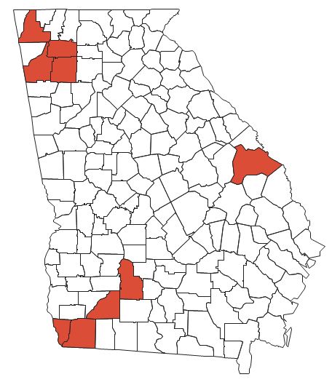
COUNTIES IMPACTED BY ENDANGERED SPECIES REQUIREMENT*
GEORGIA
Bartow | Seminole
Burke | Walker
Decatur | Worth
Floyd
Gordon
Mitchell
* = current as of December, 2020

Slide 67
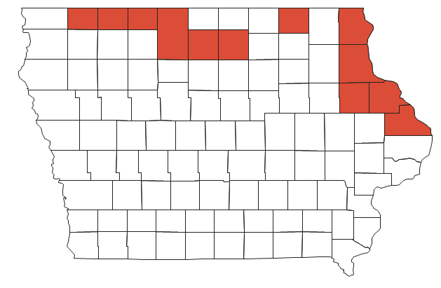
COUNTIES IMPACTED BY ENDANGERED SPECIES REQUIREMENT*
IOWA
Allamakee | Emmet
Cerro Gordo | Hancock
Clayton | Howard
Delaware | Jackson
Dickinson | Kossuth
Dubuque | Osceola
* = current as of December, 2020

Slide 68
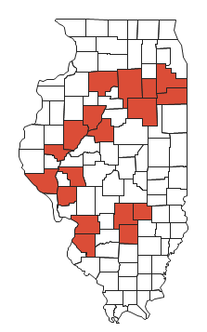
COUNTIES IMPACTED BY ENDANGERED SPECIES REQUIREMENT*
ILLINOIS
Bureau | LaSalle | Schuyler
Effingham | Livingston | St. Clair
Fayette | Madison | Tazewell
Fulton | Marion | Will
Greene | Morgan
Grundy | Peoria
Kankakee | Pike
* = current as of December, 2020

Slide 69
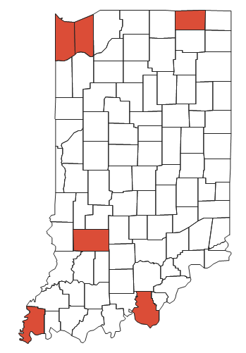
COUNTIES IMPACTED BY ENDANGERED SPECIES REQUIREMENT*
INDIANA
Greene
Harrison
LaGrange
Lake
Porter
Posey
* = current as of December, 2020

Slide 70
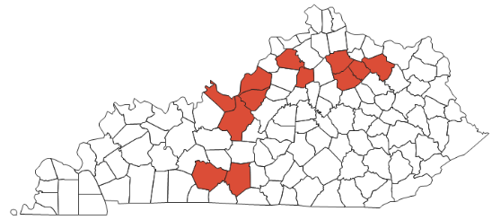
COUNTIES IMPACTED BY ENDANGERED SPECIES REQUIREMENT*
KENTUCKY
Barren | Harrison
Bourbon | Henry
Bullitt | Jefferson
Fleming | Meade
Franklin | Nicholas
Hardin | Warren
* = current as of December, 2020

Slide 71
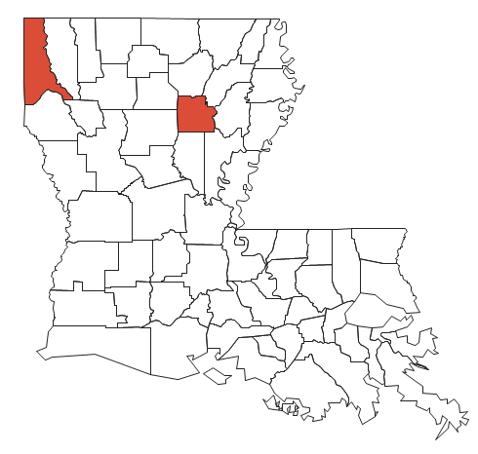
COUNTIES IMPACTED BY ENDANGERED SPECIES REQUIREMENT*
LOUISIANA
Caddo
Caldwell
* = current as of December, 2020

Slide 72
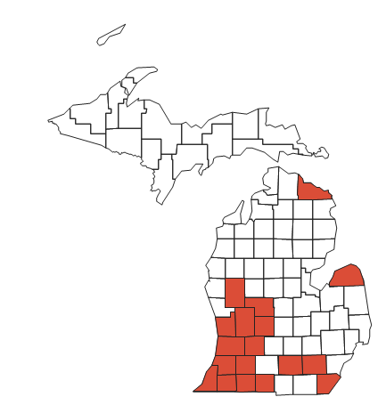
COUNTIES IMPACTED BY ENDANGERED SPECIES REQUIREMENT*
MICHIGAN
Allegan | Ionia | Newaygo
Barry | Jackson | Ottawa
Berrien | Kalamazoo | Presque Isle
Branch | Kent | St. Joseph
Cass | Monroe | Van Buren
Huron | Montcalm | Washtenaw
* = current as of December, 2020

Slide 73
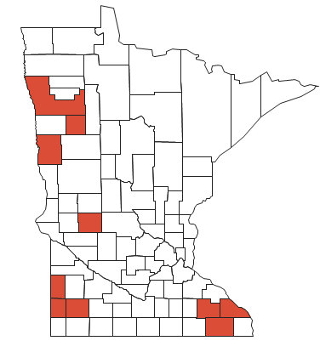
COUNTIES IMPACTED BY ENDANGERED SPECIES REQUIREMENT*
MINNESOTA
Clay | Olmsted
Fillmore | Pipestone
Lincoln | Polk
Mahnomen | Pope
Murray | Winona
* = current as of December, 2020

Slide 74
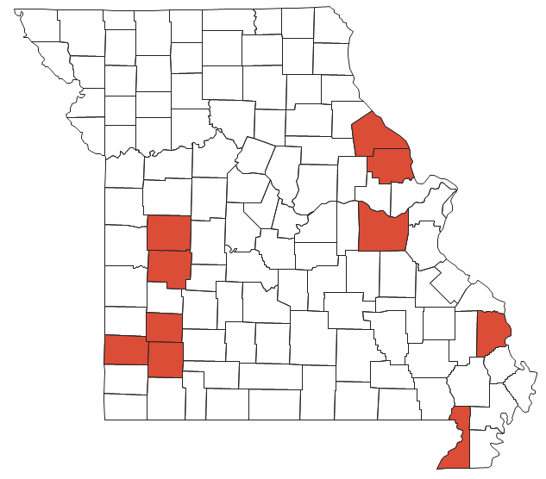
COUNTIES IMPACTED BY ENDANGERED SPECIES REQUIREMENT*
MISSOURI
Cape Girardeau | Jasper Lawrence Lincoln Pike St. Clair
Dade
Dunklin
Franklin
Henry
* = current as of December, 2020

Slide 75
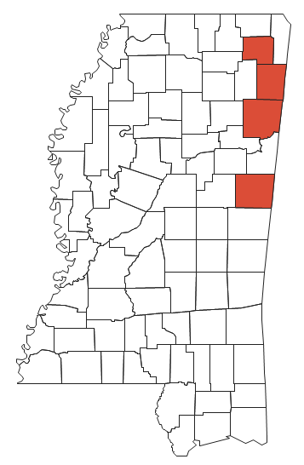
COUNTIES IMPACTED BY ENDANGERED SPECIES REQUIREMENT*
MISSISSIPPI
Itawamba
Monroe
Noxubee
Prentiss
* = current as of December, 2020

Slide 76
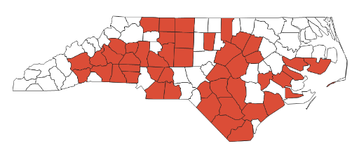
COUNTIES IMPACTED BY ENDANGERED SPECIES REQUIREMENT*
NORTH CAROLINA
Alexander | Caldwell | Franklin | Iredell | Pender | Stokes
Anson | Catawba | Gaston | Johnston | Randolph | Surry
Beaufort | Cleveland | Granville | Lenoir | Robeson | Union
Bladen | Columbus | Guilford | Lincoln | Rockingham | Wake
Brunswick | Craven | Hamett | McDowell | Rowan | Wilson
Buncombe | Cumberland | Henderson | Nash | Rutherford
Burke | Davidson | Hoke | Onslow | Sampson
Cabarrus | Forsyth | Hyde | Orange | Stanly
* = current as of December, 2020

Slide 77

COUNTIES IMPACTED BY ENDANGERED SPECIES REQUIREMENT*
NORTH DAKOTA
Bottineau
McHenry
McLean
Richland
Sargent
Stutsman
Ward
* = current as of December, 2020

Slide 78

COUNTIES IMPACTED BY ENDANGERED SPECIES REQUIREMENT*
NEBRASKA
Buffalo | Lancaster
Custer | Phelps
Gosper | Saunders
Kearney
* = current as of December, 2020

Slide 79

COUNTIES IMPACTED BY ENDANGERED SPECIES REQUIREMENT*
NEW JERSEY
Salem
* = current as of December, 2020

Slide 80

COUNTIES IMPACTED BY ENDANGERED SPECIES REQUIREMENT*
NEW MEXICO
Chaves
Doña Ana
Eddy
* = current as of December, 2020

Slide 81

COUNTIES IMPACTED BY ENDANGERED SPECIES REQUIREMENT*
NEW YORK
Genesee
Madison
Onondaga
* = current as of December, 2020

Slide 82

COUNTIES IMPACTED BY ENDANGERED SPECIES REQUIREMENT*
OHIO
Erie
Ottawa
Portage
* = current as of December, 2020

Slide 83

COUNTIES IMPACTED BY ENDANGERED SPECIES REQUIREMENT*
OKLAHOMA
Osage
* = current as of December, 2020

Slide 84

COUNTIES IMPACTED BY ENDANGERED SPECIES REQUIREMENT*
SOUTH CAROLINA
Aiken | Edgefield | Lexington
Allendale | Florence | Orangeburg
Barnwell | Greenville | Richland
Clarendon | Horry | Spartanburg
Darlington | Lancaster | Williamsburg
* = current as of December, 2020

Slide 85

COUNTIES IMPACTED BY ENDANGERED SPECIES REQUIREMENT*
SOUTH DAKOTA
Brookings | Deuel
Brown | Grant
Clark | Hamlin
Codington | Marshall
Day | Roberts
* = current as of December, 2020

Slide 86

COUNTIES IMPACTED BY ENDANGERED SPECIES REQUIREMENT*
TENNESSEE
Bedford | Grundy | Polk
Bledsoe | Madison | Rutherford
Cheatham | Marion | White
Davidson | Maury | Wilson
Fentress | McNairy
Franklin | Montgomery
* = current as of December, 2020

Slide 87

COUNTIES IMPACTED BY ENDANGERED SPECIES REQUIREMENT*
TEXAS
Cameron | Hays | Mitchell | Starr
Coke | Hidalgo | Nueces | Uvalde
El Paso | Jim Wells | Refugio | Willacy
Fort Bend | Kleberg | Robertson
Harris | Medina | Runnels
* = current as of December, 2020

Slide 88

COUNTIES IMPACTED BY ENDANGERED SPECIES REQUIREMENT*
VIRGINIA
Dinwiddie
Mecklenburg
* = current as of December, 2020

Slide 89

COUNTIES IMPACTED BY ENDANGERED SPECIES REQUIREMENT*
WISCONSIN
Adams | Eau Claire | Monroe | St. Croix
Barron | Grant | Oconto | Vernon
Chippewa | Green Lake | Portage | Waupaca
Clark | Jackson | Richland | Waushara
Columbia | Juneau | Sauk | Wood
Dane | Manitowoc | Shawano
Dunn | Marquette | Sheboygan
* = current as of December, 2020

Slide 90

Weed Examples
COMMON RAGWEED
Ambrosia artemisiifolia
SEEDS/PLANT
50K
2
5
9
14
ALS INHIBITORS | PHOTOSYSTEM II INHIBITORS | EPSP SYNTHASE INHIBITOR | PPO INHIBITORS
KNOWN RESISTANCE
1
2
3
4
5
6
7
8
9
10
13
14
15
22
27
SITE OF ACTION | ACCASE INHIBITORS | ALS INHIBITORS | MICROTUBULE INHIBITORS | SYNTHETIC AUXINS | PHOTOSYSTEM II INHIBITORS | LIPID SYNTHESIS INHIBITOR (not ACCase) | EPSP SYNTHASE INHIBITOR | GLUTAMINE SYNTHETASE INHIBITOR | DITERPENE BIOSYNTHESIS INHIBITOR | PPO INHIBITORS | LONG-CHAIN FATTY ACID INHIBITORS | PHOTOSYSTEM I ELECTRON DIVERTER | HPPD INHIBITORS
PRODUCT EXAMPLES (Trade Name®) | Assure II, Select Max | Classic, Pursuit | Prowl H₂O, Treflan | 2,4-D, Clarity®, quinclorac | atrazine, metribuzin, Basagran, Linex | Far-Go | Roundup, (glyphosate) | Liberty® | Command | Flexstar, Cobra® | Dual, Harness | Gramoxone®, (paraquat) | Callisto, Laudis

Slide 91

Weed Examples
HORSEWEED
Conyza canadensis
SEEDS/PLANT
200K
2
5
7
9
22
ALS INHIBITORS | PHOTOSYSTEM II INHIBITORS | EPSP SYNTHASE INHIBITOR | PHOTOSYSTEM I ELECTRON DIVERTER
KNOWN RESISTANCE
1
2
3
4
5
6
7
8
9
10
13
14
15
22
27
SITE OF ACTION | ACCASE INHIBITORS | ALS INHIBITORS | MICROTUBULE INHIBITORS | SYNTHETIC AUXINS | PHOTOSYSTEM II INHIBITORS | LIPID SYNTHESIS INHIBITOR (not ACCase) | EPSP SYNTHASE INHIBITOR | GLUTAMINE SYNTHETASE INHIBITOR | DITERPENE BIOSYNTHESIS INHIBITOR | PPO INHIBITORS | LONG-CHAIN FATTY ACID INHIBITORS | PHOTOSYSTEM I ELECTRON DIVERTER | HPPD INHIBITORS
PRODUCT EXAMPLES (Trade Name®) | Assure II, Select Max | Classic, Pursuit | Prowl H₂O, Treflan | 2,4-D, Clarity®, quinclorac | atrazine, metribuzin, Basagran, Linex | Far-Go | Roundup, (glyphosate) | Liberty® | Command | Flexstar, Cobra® | Dual, Harness | Gramoxone®, (paraquat) | Callisto, Laudis

Slide 92

Weed Examples
KOCHIA
Kochia scoparia
SEEDS/PLANT
30K
2
4
5
9
ALS INHIBITORS | SYNTHETIC AUXINS | PHOTOSYSTEM II INHIBITORS | EPSP SYNTHASE INHIBITOR
KNOWN RESISTANCE
1
2
3
4
5
6
6
7
8
9
10
13
14
15
22
27
SITE OF ACTION | ACCASE INHIBITORS | ALS INHIBITORS | MICROTUBULE INHIBITORS | SYNTHETIC AUXINS | PHOTOSYSTEM II INHIBITORS | LIPID SYNTHESIS INHIBITOR (not ACCase) | EPSP SYNTHASE INHIBITOR | GLUTAMINE SYNTHETASE INHIBITOR | DITERPENE BIOSYNTHESIS INHIBITOR | PPO INHIBITORS | LONG-CHAIN FATTY ACID INHIBITORS | PHOTOSYSTEM I ELECTRON DIVERTER | HPPD INHIBITORS
PRODUCT EXAMPLES (Trade Name®) | Assure II, Select Max | Classic, Pursuit | Prowl H₂O, Treflan | 2,4-D, Clarity®, quinclorac | atrazine, metribuzin, Basagran, Linex | Far-Go | Roundup, (glyphosate) | Liberty® | Command | Flexstar, Cobra® | Dual, Harness | Gramoxone®, (paraquat) | Callisto, Laudis

