Slide 1
Working with Food Pantries-A Community Health Issue
A 2025 OHCE District Leader Lesson

Slide 2

State Project 2025 State Goals-Take the First Step
Notes:
Our goal is to take the first step to strengthen community well-being for all Oklahomans.

Slide 3
The State Project is about promoting awareness and advocating for education:

Slide 4
· Encourage each county to establish a State Project Chairperson and Committee. · Promote walkability of your community environments. · Increase affordable access to healthy food. · Recognize risk factors that lead to chronic conditions. · Create activities that are guided by state and leader lessons and goals. · Utilize OSU Education Specialists to assist with educational activities to implement action items:

Slide 5
Leader Lesson Objectives
1) Understand the difference between food insecurity & nutrition security
2) Learn about choice pantry systems
3) Assisting pantry directors with resource management
Notes:
1)

Slide 6

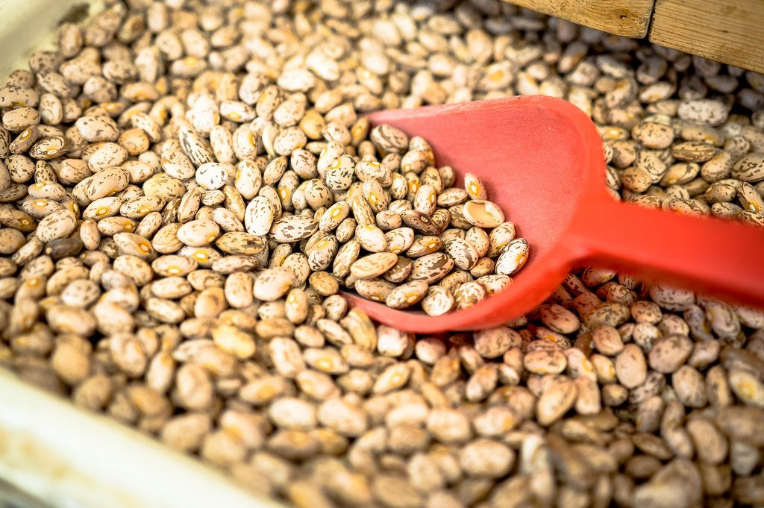
Define Nutrition Security
Food Security: all people at all times have both physical and economic access to sufficient food that meet dietary needs and do not live in hunger
In comparison
Nutrition Security: having consistent access to safe, affordable, and healthy foods with nutrients essential to optimal health and well-being.
This Photo by Unknown Author is licensed under CC BY
Notes:
Although food security is a necessity, nutrition security BUILDS ON food security to further ensure access to foods that are not just calories but NUTRITIONAL calories, to support health and manage or prevent diseases.
An example of food security would be if a person was given a package of microwavable noodles and a can of soda for a meal. Yes, it is technically food, however, there are few elements in that meal to provide the body with sufficient energy and nutrients it needs to sustain healthy functions. Nutrition security is access to a balanced meal full of macro and micro nutrients that sustain and provide nutritional value to the body.

Slide 7
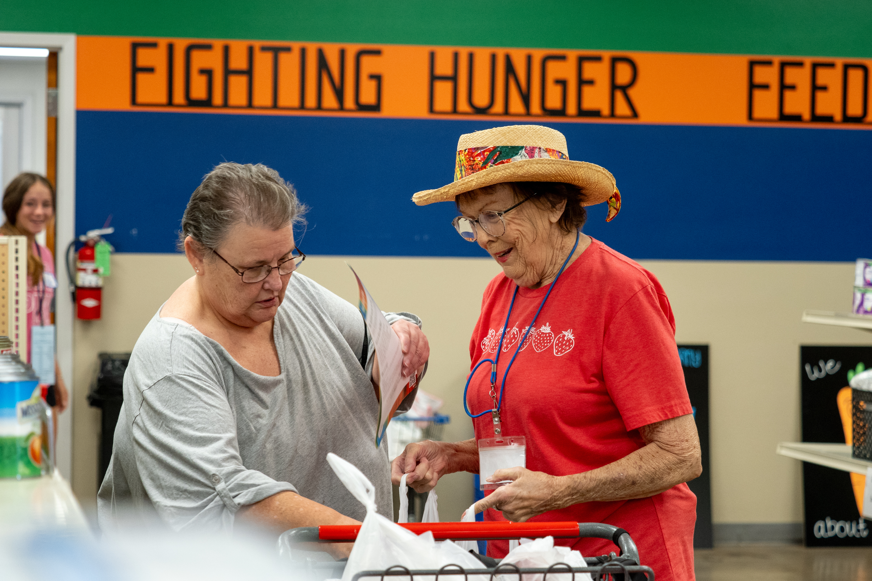
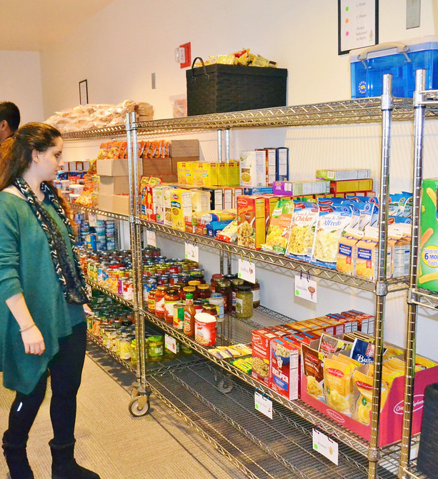
Choice Pantry Systems
Notes:
3) There are many reasons one may need the help of a food pantry. It is difficult for some to admit that they need help. Some may have feelings of embarrassment, shame, and sadness. Choice pantry systems preserve their dignity by giving these individuals or families a choice in what is offered them. They deserve fresh, healthy food just like we all do. They shouldn’t get “the leftovers”. Some people are dealing with food allergies or food intolerances due to many reasons. They may have dental health issues and can’t eat certain foods, they may have sensory issues to particular foods or don’t have a safe way to prepare what is given for example, no kitchen equipment or even a home. Some may simply not have the knowledge or skill as to how to prepare the food item. We see this often. They may also have a chronic disease like CVD or diabetes and need the option of low carbohydrate choices or low-fat choices. The Community Health Extension Program is working with many pantries on Food is Medicine Initiatives to help address the health issue.
Also introducing the pantry director to the assessment tools that can help to guide them into their food orders through a food bank or to look closer at their inventory. For example, looking at canned fruit--- Is it packed in heavy syrup or in its own juice?
Looking at canned vegetables, broth, or soups---Could there be a better option such as no added salt varieties. The assessment tool also looks at proper signage for recipients. Is there signage? Does it promote MyPlate?
Choice pantries reduce food waste as well.
Choice pantries will have glass front refrigerators that pantry recipients can see what is offered. They have shopping carts for them to shop for items they desire. Volunteers assist them with their shopping experience.

Slide 8
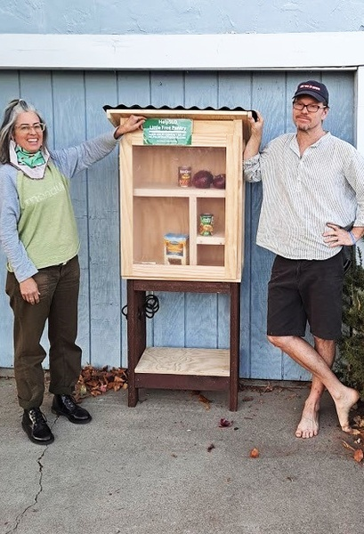
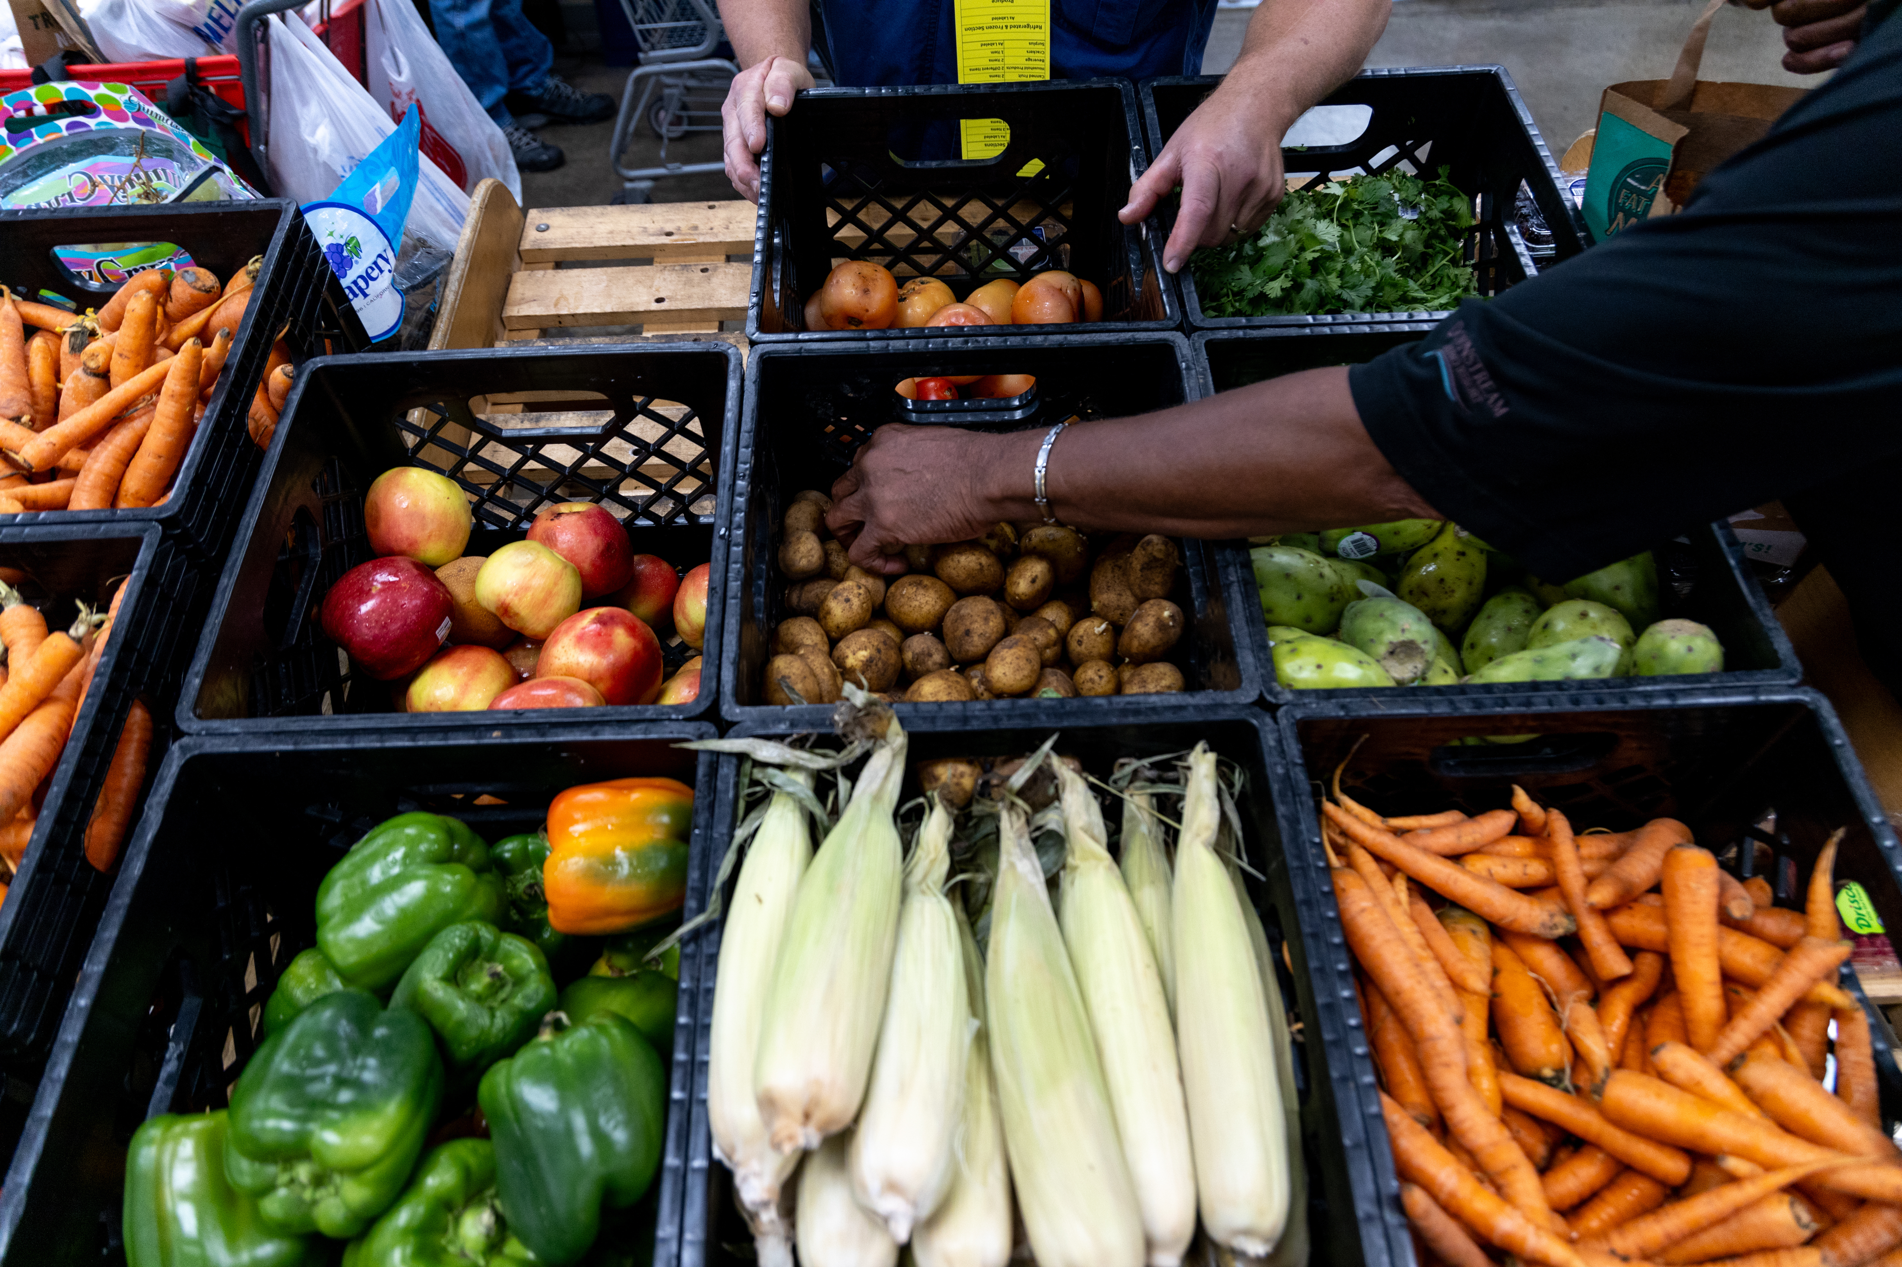
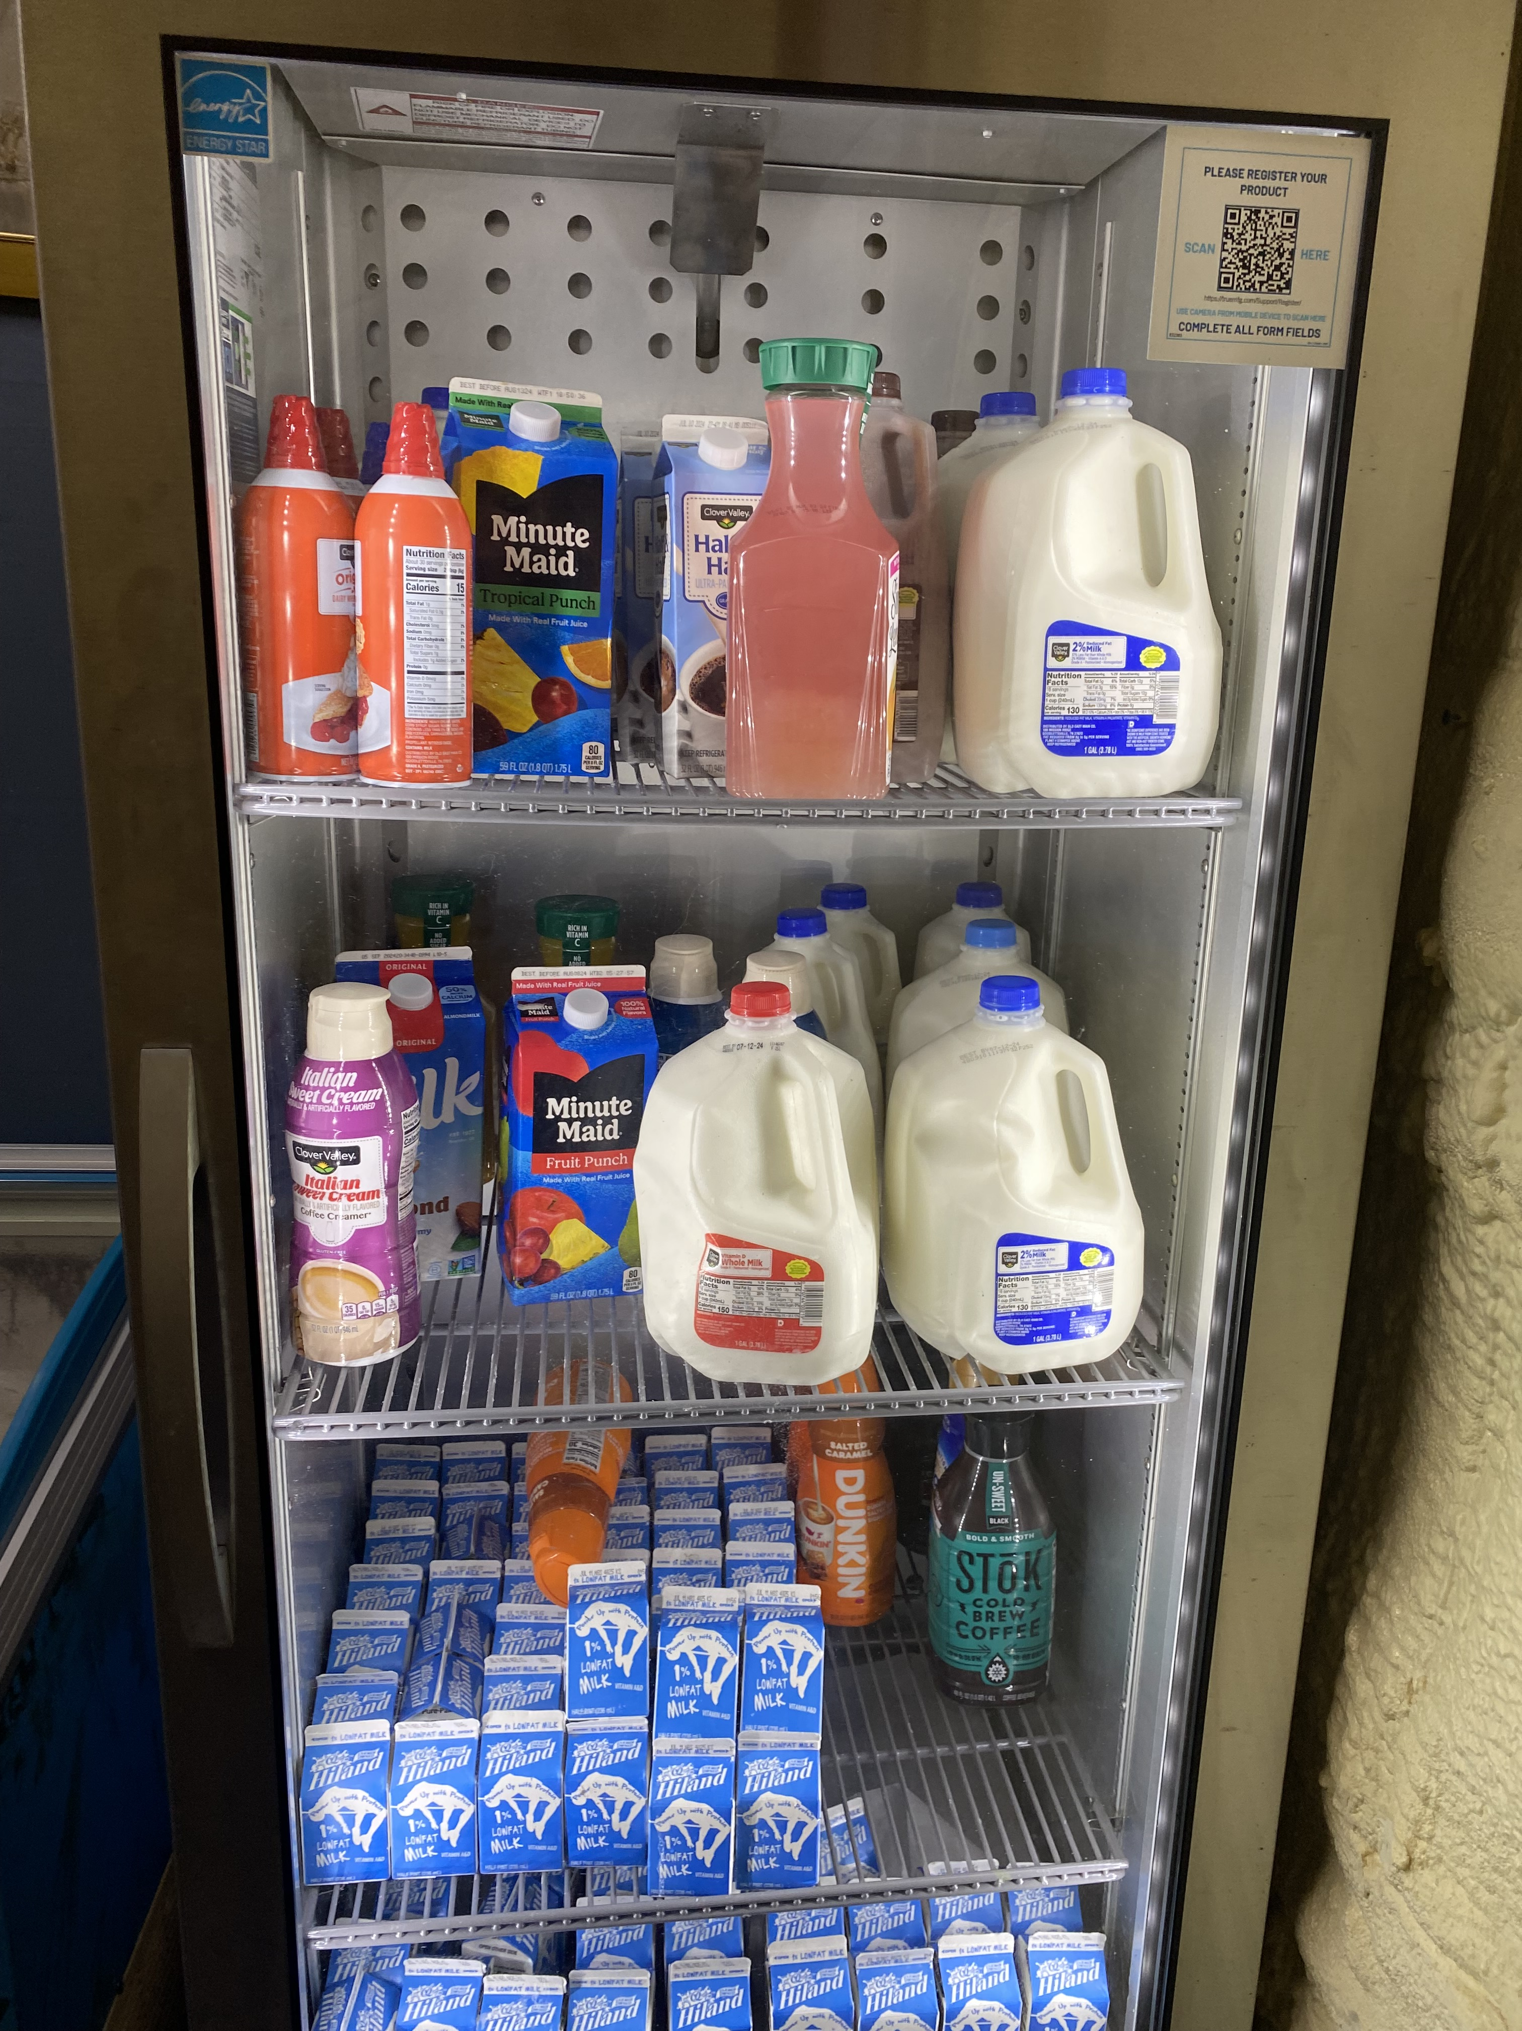
Pantry Resource Management
Notes:
4) The sustainability of a pantry relies on not just in-kind donations, volunteers and adequate space, it relies on finding other resources such as grants and the procurement of produce. Area food banks such as the Food Bank of Eastern OK and the Regional Food Bank don’t always have produce available for directors to purchase. Procuring locally grown sources of produce are key in keeping those items available at the pantry year-round. One way to help would be to consider planting an extra row at your own home. If you are gardener, who doesn’t have a surplus of zucchini in the summer in Oklahoma. Consider donating what you can’t use to your local pantry. If you are thinking of organizing a food drive at your church, school or place of work, consider asking the pantry director what they are in need of the most. Often pantries not only need produce but protein items like eggs, milk or meats.

Slide 9
Suggestions for OHCE Group Activities
*Volunteer at a local food pantry
*Volunteer and or tour at the Food Bank of Eastern Oklahoma or The Regional Food Bank of Oklahoma
*Organize a food drive/spice drive, etc.
*Drive by Fruiting Activity
*Collaborate with FCS Educators to write CNEP PSE grants to assist pantries with equipment needs
*Create a healthy pantry cookbook using common items given to recipients of the pantry
*Research other sources of funding through FCS Educator OCES/OHCE Ambassador Grants

Slide 10
Food Pantry Equation
Understanding Nutrition Security
Advocating for Choice Pantry Systems
Food Pantry Resources

Slide 11
Increased Food Pantry Capacity
Increased Food Pantry Capacity
Notes:
By increasing Food Pantry Capacity, we reduce hunger, we increase hope, and we improve the health and well-being in the lives of all Oklahomans

Slide 12
Resources and Handout Materials
https://www.endhungerinamerica.org/getting-started/client-choice-food-pantries/
Food Equality Initiative.org The Gap: Food Security and Nutrition Security-no link need to search
https://www.hungerfreeok.org/
Pantry Assessment Tool
file:///C:/Users/User/Downloads/Nutrition-Environment-Food-Pantry-Assessment-Tool.pdf
The Unsung Heroes of Food Pantries: What Do Volunteers Do? – EasyHealthyFoods
The Power of Food Pantries: A Lifeline for Struggling Families - Feed America

Slide 13
Contacts
Tammy Perry, Area Health Disparities Specialist NE District
tammy.perry@okstate.edu
Megan Monteith, Ph.D., Area Health Disparities Specialist SW District Megan.monteith@okstate.edu
Kelsey Ratcliff, Area Health Disparities, Specialist SE District Kelsey.ratcliff@okstate.edu
Deana Hildebrand, Ph.D., R.D., Community Health Extension State Program Lead Deana.hildebrand@okstate.edu

Slide 14
USDA Statement

Slide 15
Tammy Perry
Area Health Disparities Specialist NED
O | 918-686-7200
C | 918-577-0498
E | tammy.perry@okstate.edu
3007 Azalea Park Drive
Muskogee, OK 74401

