Slide 1
How Walkable is Your Community?
Megan Monteith, West District
Kelsey Ratcliff, Southeast District
Tammy Perry, Northeast District

Slide 2
Objectives
By the end of the lesson, participants will:
Understand the concept of walkability and its importance for health and community vitality.
Assess the walkability of their community using specific criteria.
Identify areas for improvement and propose actionable steps to enhance walkability.

Slide 3
Walkability

Slide 4
What is Walkability?
Walkability can be defined as (1) the degree to which pedestrians feel safe and able to walk in their community, or (2) The degree to which the built or natural environment enables the mobility of pedestrians.
Whether one wants to walk in a community depends on many factors, such as social norms, perceived safety, personal habits, proximity of desired points to visit, and other factors. Pedestrians could be on foot, in wheelchairs, bicycles, skateboards, and they could be pushing strollers or assisting someone who is mobility challenged. Walkability thus is also influenced by curb cuts, stairs, or other obstacles.
How easy it is to walk to services and amenities in a city.

Slide 5
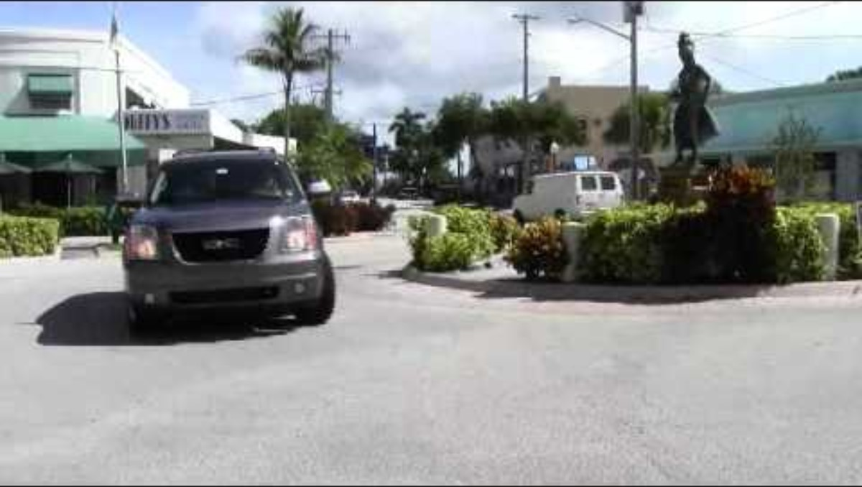
Walkability 101

Slide 6
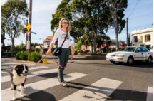
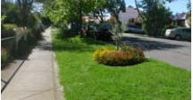
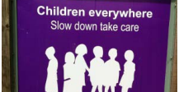
What does “walkable community” mean to you?
Notes:
A walkable community is one where people can easily and safely walk to meet their daily needs—whether it’s to school, work, parks, or stores.
Walkability contributes to better physical and mental health, reduced pollution, and stronger community connections.

Slide 7
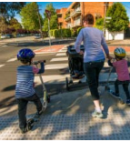
The Importance of Walkability
Health Benefits
Environmental Impact
Economic and Social Benefits
Notes:
Health Benefits:
Encourages physical activity, reducing the risk of chronic diseases like heart disease and diabetes.
Improves mental health through outdoor activity and community engagement.
Environmental Impact:
Reduces reliance on vehicles, lowering emissions and pollution.
Economic and Social Benefits:
Walkable areas attract businesses, increase property values, and promote a sense of community.

Slide 8
Walkability Checklist

Slide 9
How is Walkability Measured?
Walkability is based on the idea that a 30-minute walk is a reasonable distance.
Walkable neighborhoods have a mix of uses, like shops, homes, and schools, close together.
Walkable neighborhoods have sidewalks, crosswalks and bike lanes.
Walkable neighborhoods have parking that encourages people to walk.

Slide 10
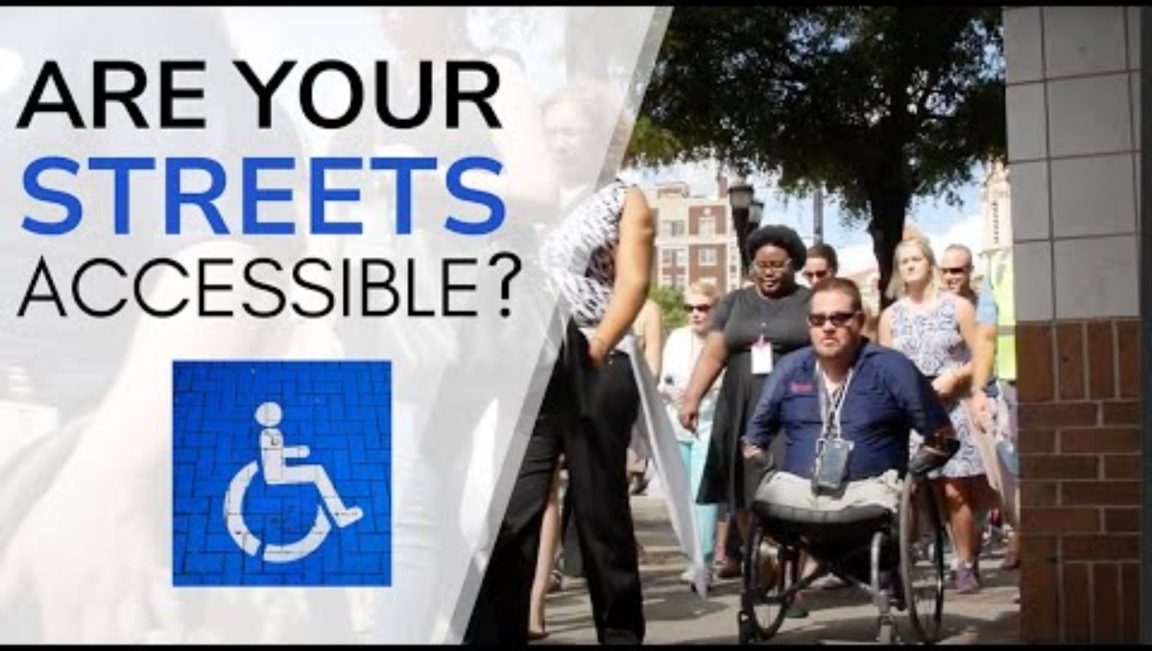
Walkability Audit

Slide 11
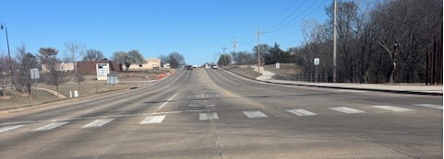
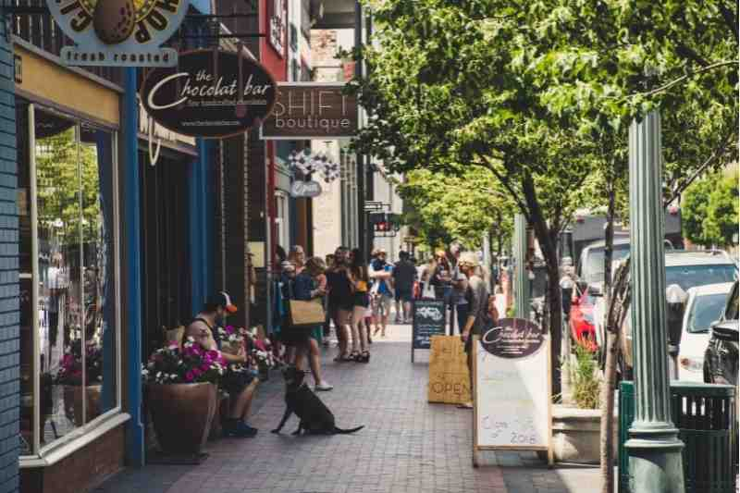
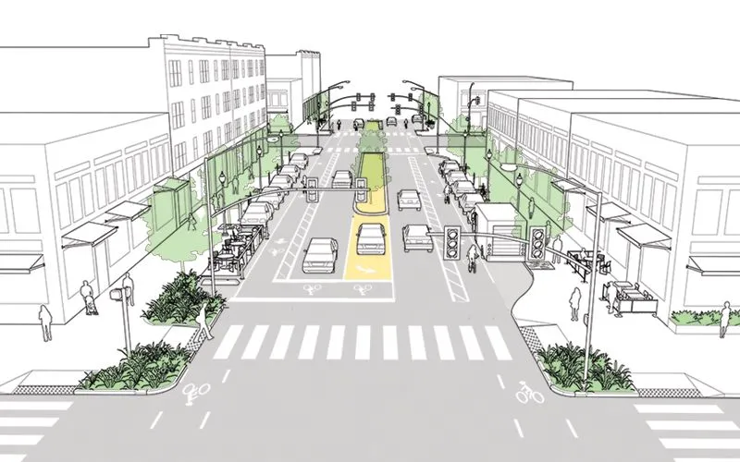
Walkability Audit part 2

Slide 12
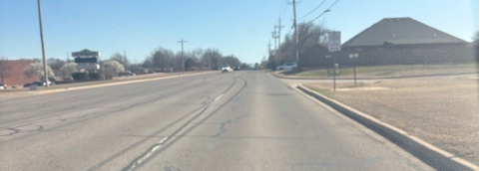
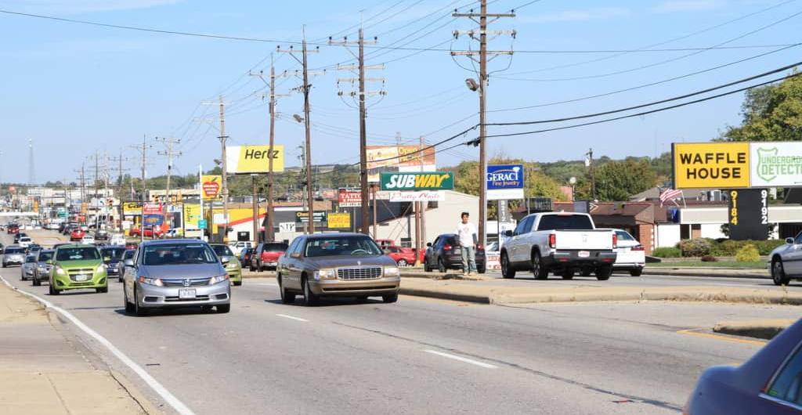
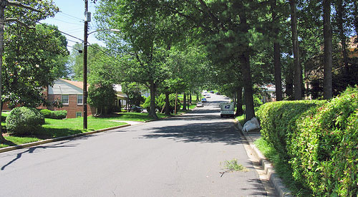
Walkability Audit part 3

Slide 13
Improving Walkability

Slide 14
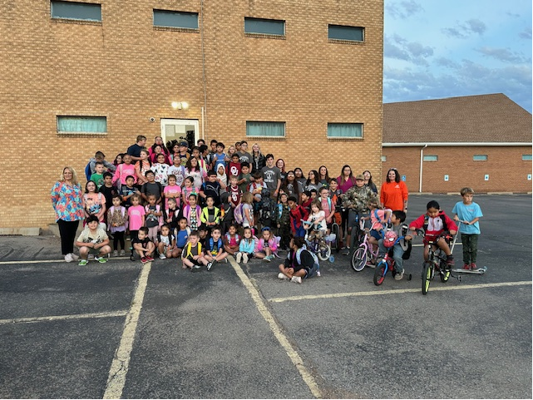
Walk and Roll to School Day
Walk/Bike & Roll to School Day events connect with many issues that communities care about, like creating safer and more walkable routes to school; building a sense of community or school spirit; and inspiring families to use their feet for the school commute more often.
Walk/Bike & Roll to School Day events can help encourage communities to implement policy or engineering changes that make it safer to walk and bike to school. In 2021, 65% of Walk to School Day event organizers indicated that their event led to planned or already completed policy or engineering changes (the highest percentage reported since 2014). Nearly 40% of Walk & Roll to School Day organizers used their event to draw attention to road safety needs in their communities

Slide 15
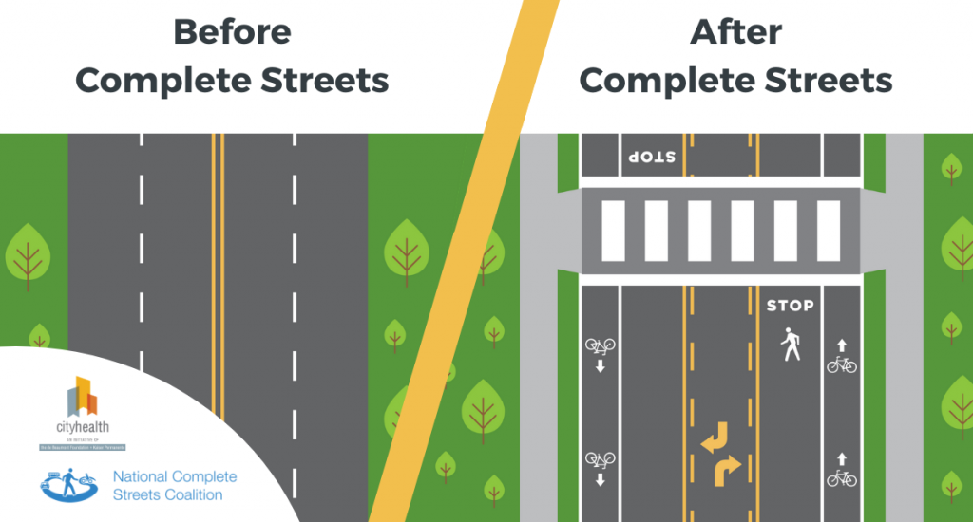
Complete streets principles take into account the needs of all road users – pedestrians, bicyclists, transit users, children, the disabled and elderly, not just motorists.
Complete Streets
Notes:
Complete Streets is an approach to planning, designing and building streets that enables safe access for all users, including pedestrians, bicyclists, motorists and transit riders of all ages and abilities. While Complete Streets are a process and approach to street design, there is no singular design prescription for Complete Streets. Each one is unique and responds to its community context. A complete street may include: sidewalks, bike lanes (or wide paved shoulders), special bus lanes, comfortable and accessible public transportation stops, frequent and safe crosswalks, median islands, accessible pedestrian signals, curb extensions, narrower travel lanes, roundabouts, and more.

Slide 16
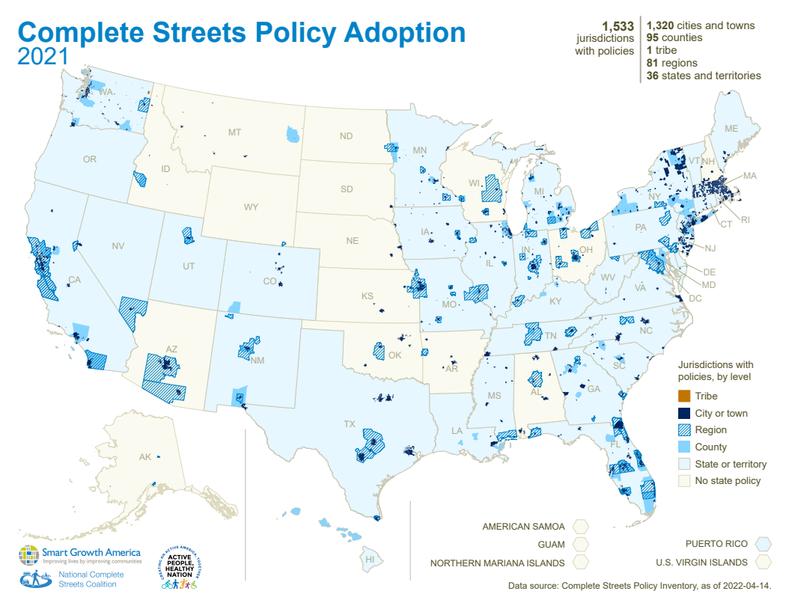
Complete Street Policy Adoption

Slide 17
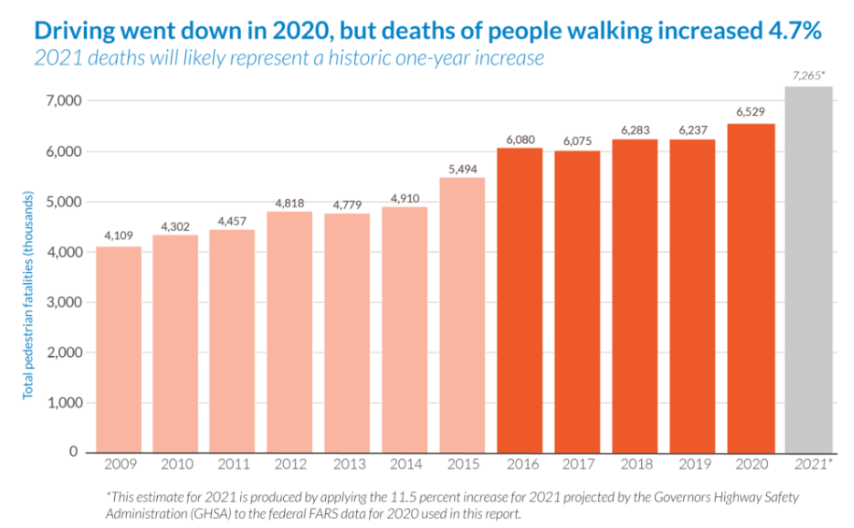
Why do we need complete streets?
Notes:
For one, we are in the midst of a historic, alarming increase in the numbers of people struck and killed while walking, which has been on a steady rise since 2009, reaching levels not seen in more than 30 years. Speed is the number one culprit in these fatalities. Speed is also the best predictor of whether or not a collision will result in an injury or a death. One of the best ways to reduce speeds and speeding is through a different approach to street design that prioritizes safety above all else, but especially over vehicle speed.

Slide 18
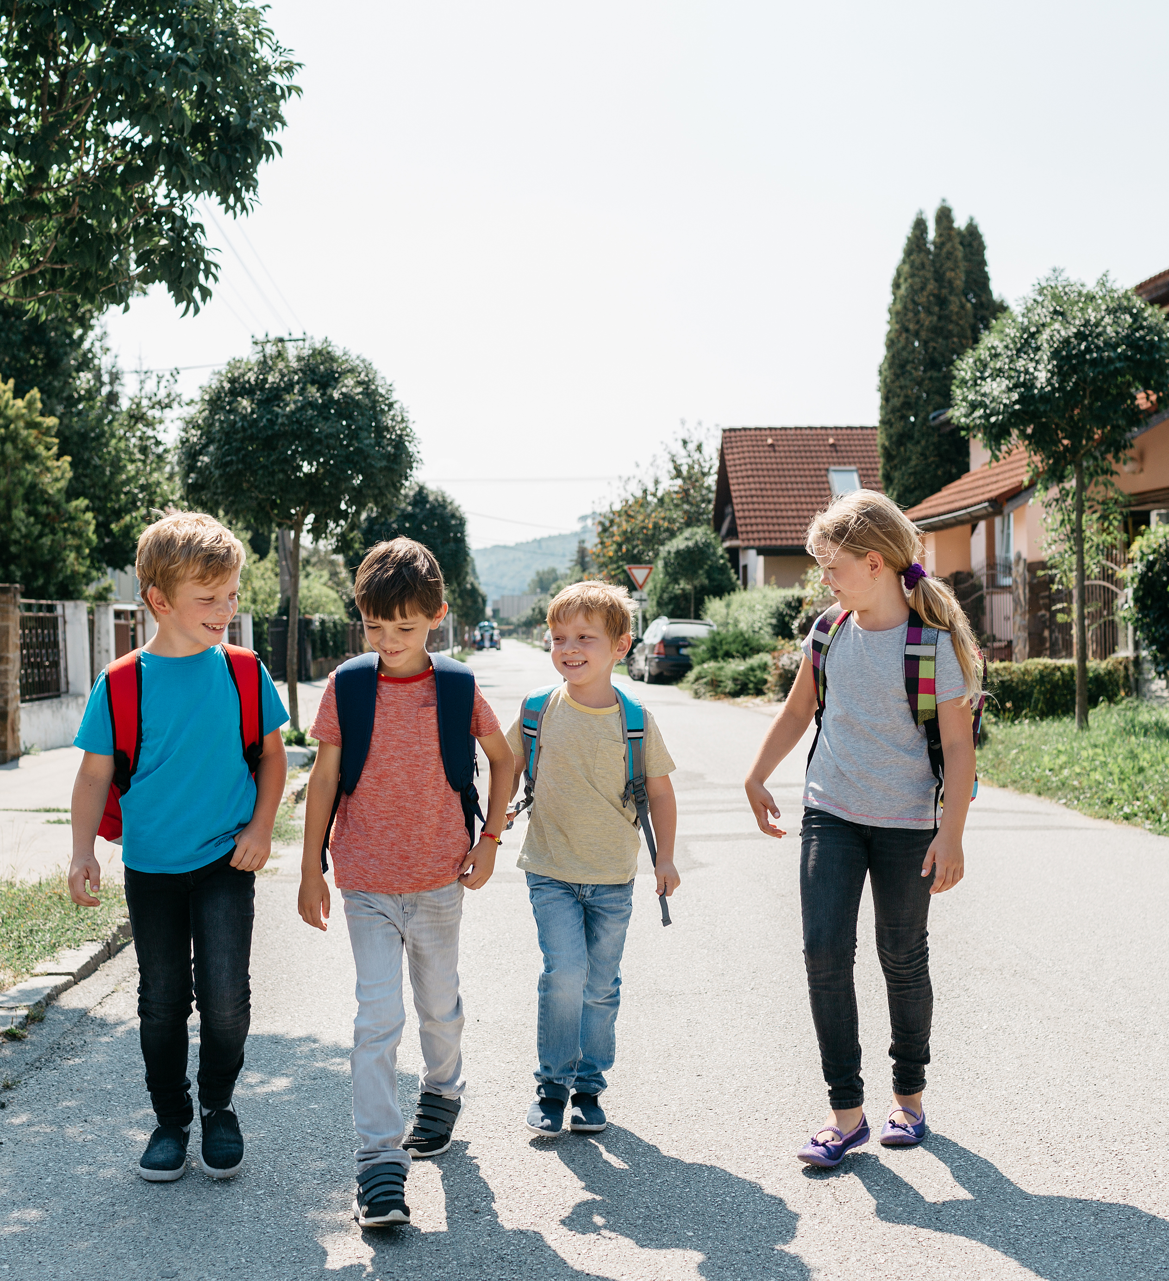
Half of all kids walked or biked to school in 1969. Now it’s less than 15 percent, but that number is going back up thanks to the rise of Safe Routes to Schools programs.
Safe Routes to Schools
Notes:
Safe Routes to School is a movement that aims to make it safer and easier for students to walk and bike to school. Since 2005, Safe Routes to School programs have benefited more than 14,000 schools in all 50 states.

Slide 19
Safe Routes to School, cont.
Increased walking and biking to school.
Safer students.
Lower transportation costs for school districts and families.
Reduced student absences and tardiness.
Reduced traffic congestion.
Healthier students.
Improved academic performance.
Clean air and fewer asthma attacks.
Notes:
Increased walking and bicycling to school
Studies have shown an increase in walking and biking to school through Safe Routes to School projects and programs.
A study of 801 schools in Washington DC, Florida, Texas, and Oregon showed an average 25 percent increase in walking and bicycling to school over a five-year period associated with education and encouragement programs, and an average 18 percent increase associated with infrastructure improvements. This means that a school that combines infrastructure improvements with education and encouragement programs is likely to see increases in walking or biking of up to 43 percent.¹
A study of 53 schools in four states (Fl, MS, WA, and WI) found that schools with Safe Routes to School funded projects increased walking and bicycling to school by 37 percent.²
Safer students
Safe Routes to School addresses traffic dangers and improves safety for students.
A New York City study found a 44 percent decline in pedestrian injury among school children in areas with Safe Routes to School projects, compared to no change in locations without. The costs savings associated with injury reduction would achieve an overall net societal benefit of $230 million over a projected 50-year period.³
A study of 47 schools in California found that Safe Routes to School infrastructure improvements resulted in a 75 percent reduction in collisions involving people of all ages walking and bicycling.⁴
Lower transportation costs for school districts and families
Safe Routes to school provides low-cost options for students to get to and from school, reducing the amount of money needed for personal vehicle use and busing.
Transportation is the second highest household expense in the United States. Driving a newer sedan costs an average annual amount of $8,946 ($0.60 per mile).⁵
Approximately 55 percent of children in the US are bused to school, and $21.5 billion is spent nationall each year on school bus transportation, an average of $854 per child transported per year.⁶ School districts currently spend $100 million to $500 million annually to bus children for just one or two miles due to hazardous conditions. Improving walking conditions near schools could reduce this cost substantially, by decreasing the need for school bus service for students who live close enough to walk or bike to and from school.⁷
Reduced student absences and tardiness
Lack of transportation can be a barrier to getting to school on time or at all, especially for students in disadvantaged communities.
A Walking School Bus study in Springfield, Massachusetts showed that students participating in the program had a somewhat better attendance rate (approximately 2 percent) than their peers. The study reported that one student who was tardy or absent 22 days in the 2010-11 school year was not late or absent once after joining the program.⁸
Reduced traffic congestion
Neighborhoods are becoming increasingly clogged by traffic. By boosting the number of students walking and bicycling, Safe Routes to School projects and programs reduce traffic congestion.
In 2009, school travel by private vehicle accounted for 10 to 14 percent of all automobile trips made during morning rush hour.⁹
While distance to school is the most commonly reported barrier to walking and bicycling,¹⁰ private vehicles still account for half of school trips between 1/4 and 1/2 mile¹¹—a distance easily covered on foot or bike.
Healthier students
Safe Routes to School supports increased physical activity, helps form healthy habits that can last a lifetime, and decreases the risk of chronic disease and obesity.
Walking one mile to and from school each day is two-thirds of the recommended sixty minutes of physical activity a day.
Children who walk to school have higher levels of physical activity throughout the day.^{12,13}
Improved academic performance
Student health has been linked to academic performance. Walking and biking to school can help ensure students arrive ready to learn.
One study found that after walking for 20 minutes, children responded to test questions with greater accuracy and had more brain activity than children who had been sitting. Children also completed learning tasks faster and more accurately following physical activity.¹⁴
Physically fit children have larger hippocampal volume and basal ganglia, brain components both connected with learning.¹⁵
Clean air and fewer asthma attacks
Safe Routes to School programs can improve air quality by reducing vehicle trips and miles traveled.
Over the last 25 years, among children ages 5 to 14, there has been a 74 percent increase in asthma cases.¹⁶ In addition, 14 million days of school are missed every year due to asthma.¹⁷
One-third of schools are in "air pollution danger zones."¹⁸
Children exposed to traffic pollution are more likely to have asthma, permanent lung deficits, and a higher risk of heart and lung problems as adults.¹

Slide 20
References
Planetizen. (2025). What is walkability? https://www.planetizen.com/definition/walkability#:~:text=Walkability%20refers%20to%20the%20ability,strategy%20for%20fighting%20climate%20change.
National Oceanic and Atmospheric Administration. (2024). Element 4: Create walkable communities with physical and visual access to and along waterfront for public use. https://coastalsmartgrowth.noaa.gov/elements/walkable.html#:~:text=Walkable%20communities%20locate%20a%20mix,and%20walk%20to%20their%20destination.
Smart Growth America. (2025). Complete Streets. https://smartgrowthamerica.org/what-are-complete-streets/
Safe Routes. (2025). https://www.saferoutesinfo.org/

Slide 21
Megan Monteith, DrPH
West District, South Area FCS Area Specialist in Health Disparities
O | 580.255.0510
C | 405.532.3909
E | megan.monteith@okstate.edu
2002 S 13th St
Duncan, OK

Slide 22
Non-Discrimination Statement

