Slide 1
Air frying basics
Making Healthier Meals in Minutes
Christi Evans, MS, RD
Assistant Extension Specialist
Notes:
Welcome everyone and thank you for being here today.
Today we are going to talk about air frying basics and how this appliance can help prepare healthier meals quickly. Air fryers have become extremely popular over the last several years, and many people have one at home but may not be sure how to use it effectively.
In this session we’ll cover:
How an air fryer works
Basic safety tips
Healthier cooking strategies
And a few simple recipes that volunteers can share in their communities.

Slide 2
Non-discrimination statement

Slide 3
What foods have you tried in an air fryer?
Notes:
Before we dive in, I’d like to hear from you.
How many of you have used an air fryer before?
What foods have you tried cooking in it?
(Pause for responses.)
Some common answers I hear are:
French fries
Chicken
Vegetables
Frozen foods
Air fryers are very versatile, so by the end of today you may have a few new ideas to try or share with others.

Slide 4
Session objectives
By the end of this session, participants will:
  Learn how an air fryer works
  Demonstrate proper and safe use of an air fryer
  Identify healthier cooking strategies
  Prepare simple, budget-friendly recipes
Notes:
By the end of this session, you should feel comfortable:
Explaining how an air fryer works
Demonstrating basic operating and safety tips
Identifying ways to make meals healthier using an air fryer
Preparing a few simple, budget-friendly recipes
And thinking about how you might demonstrate this in an Extension program.
The goal is to give you ideas you can share with community members who want easy, healthy cooking methods.

Slide 5
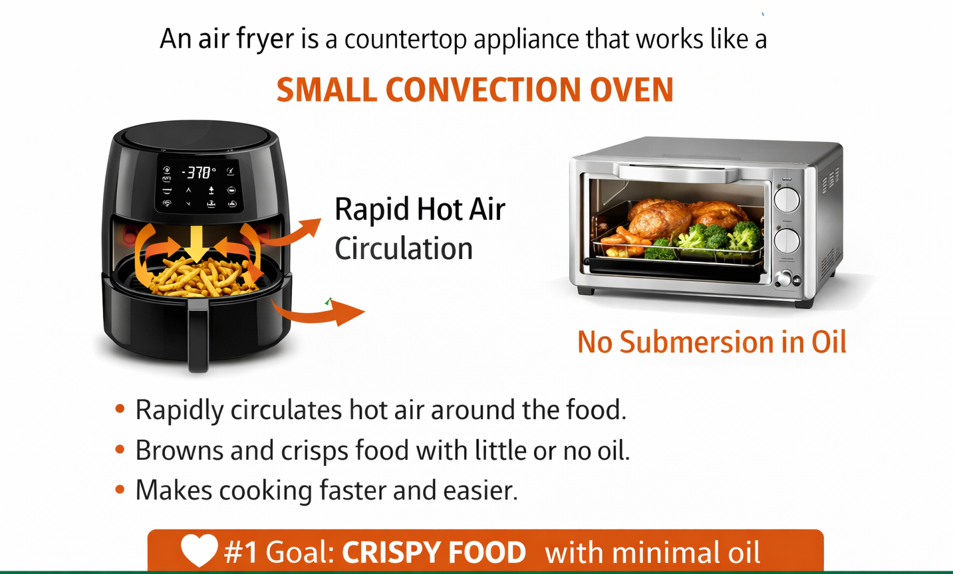
What is an air fryer?
Notes:
An air fryer is essentially a small countertop convection oven.
Instead of frying food in oil, an air fryer circulates very hot air around the food to cook it.
This rapid air movement creates a crispy outer texture, similar to fried foods, but with little to no oil.
Because food is not submerged in oil, air frying can reduce fat and calories compared to traditional deep frying.
Foods prepared correctly in an air fryer often come out with:
A crispy outside
And a tender or juicy inside.

Slide 6
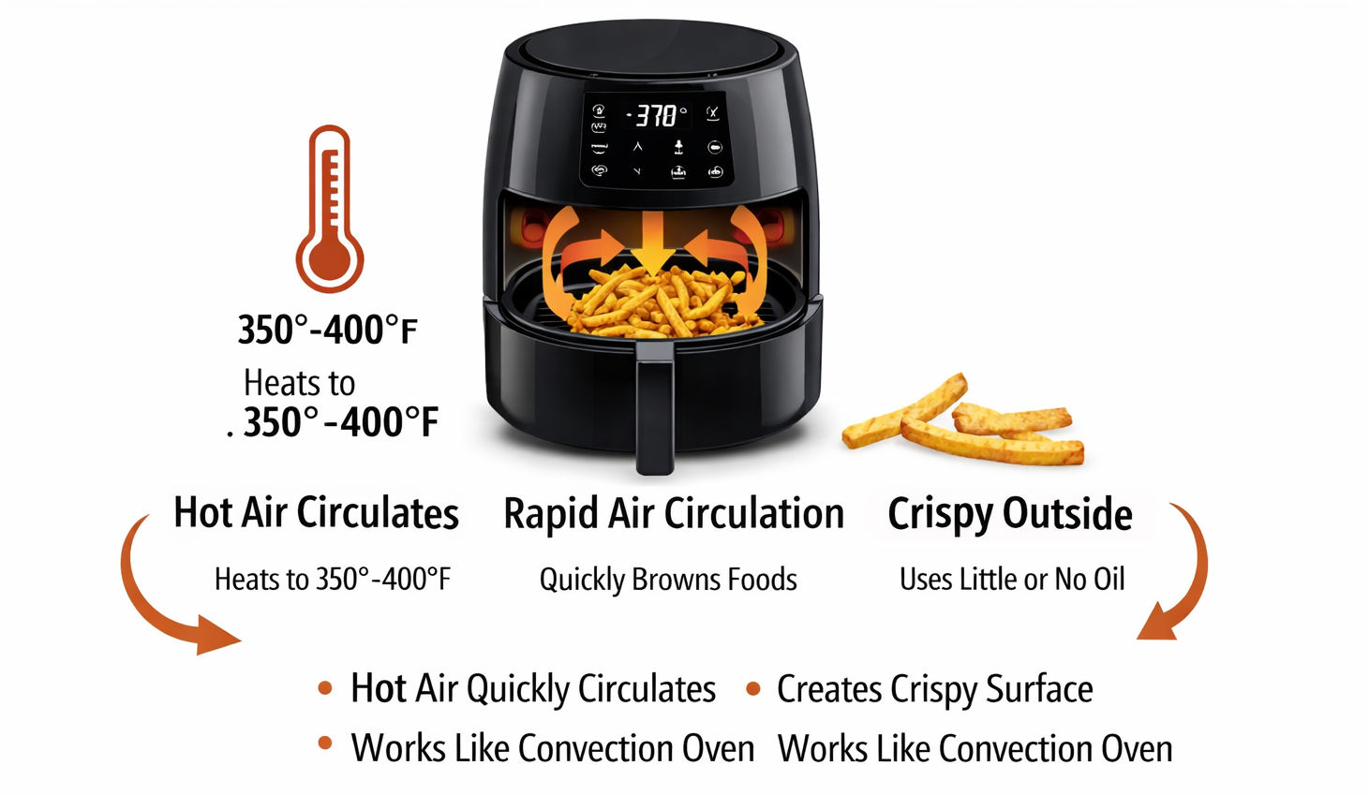
How does an air fryer work?
Notes:
Inside an air fryer there are two key components:
First is the heating element, which produces high heat.
Second is a powerful fan, which circulates hot air rapidly around the food.
This air circulation cooks the food quickly and evenly.
Many air fryers use a basket design, which allows air to flow around the food while grease drips below.
That rapid heat circulation also creates something called the Maillard reaction, which is the chemical reaction responsible for browning and crisping food.
There are also two common air fryer styles:
Basket models
Oven or rack models
Basket models allow you to shake the food to flip it, while rack models may allow multiple trays but require manual flipping.

Slide 7
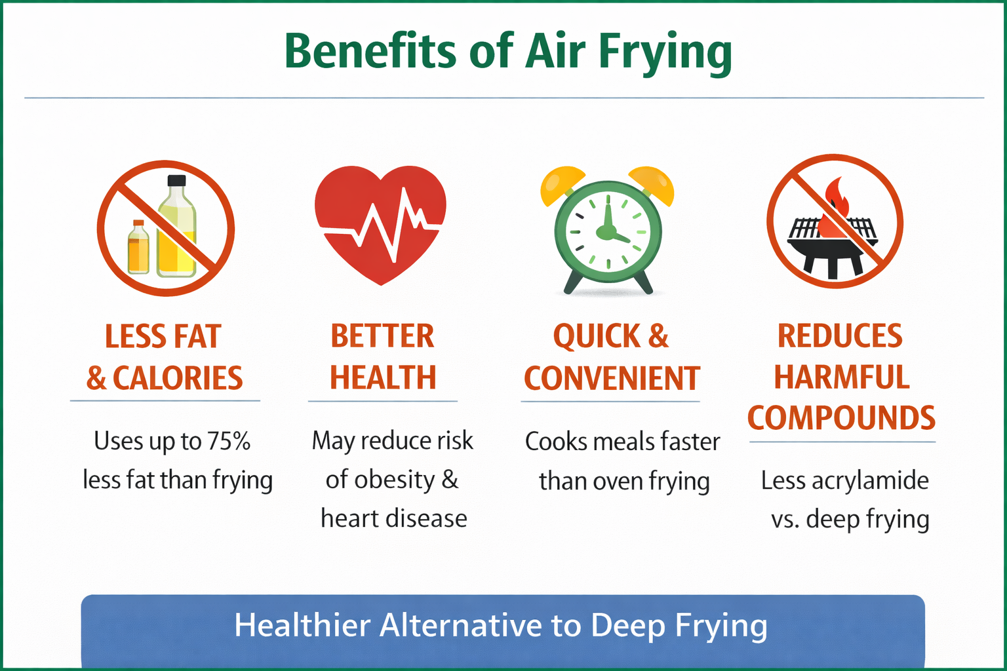
Benefits of air frying
Healthier Alternative to Deep Frying
Uses less oil than deep frying
Lower fat and calorie intake
Quick cooking time
Easy cleanup
Great for small households
Notes:
One of the biggest reasons people like air fryers is that they can be a healthier alternative to deep frying.
Air fryers typically use much less oil, which helps reduce fat and calories.
Other benefits include:
Faster cooking times
Easy cleanup
And they work well for smaller households or quick meals.
For many people, air fryers make it easier to prepare vegetables, lean proteins, and quick meals at home.

Slide 8
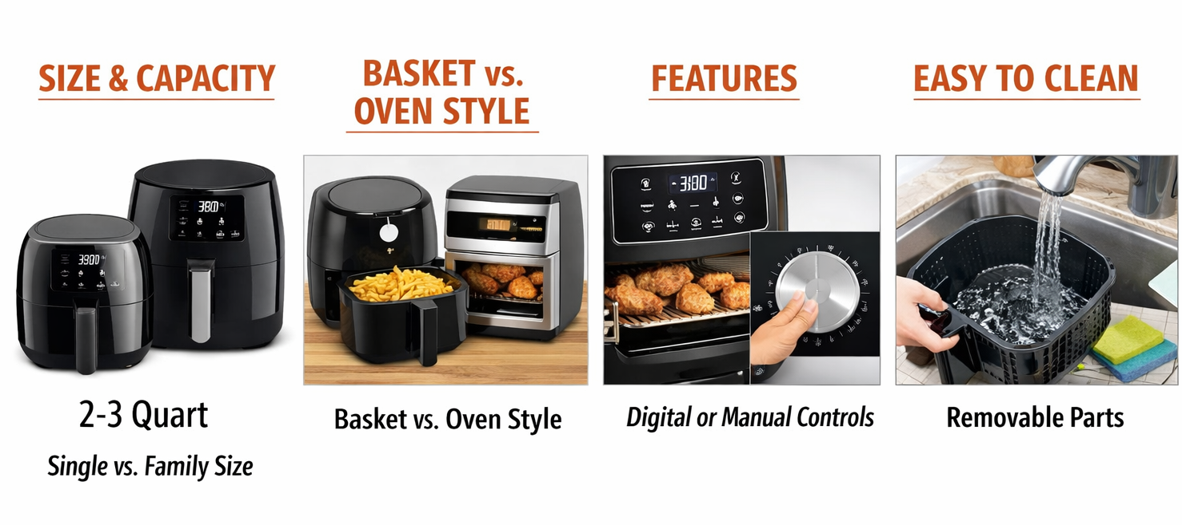
Choosing an air fryer
Notes:
If someone is thinking about buying an air fryer, there are a few factors to consider.
First is size and capacity. Most household models range from 2 to 6 quarts.
Next is controls. Some models use simple manual dials, while others have digital controls and presets.
Also consider:
Temperature range (usually around 180–400°F)
Whether the basket is dishwasher safe
And overall cost.
Many good air fryers are available in the $40 to $150 range, and even basic models work well.

Slide 9
Basic operating steps
Preheat (if recommended)
Lightly coat food with oil (if needed)
Place food in single layer
Set temperature and time
Shake/flip halfway through cooking
Notes:
Using an air fryer is fairly simple.
First, some models recommend preheating, though not all require it.
Next, lightly coat foods with oil if needed. Many foods need only a very small amount of oil.
Place the food in a single layer in the basket. Overcrowding prevents air from circulating properly.
Set the temperature and time.
Finally, many foods benefit from shaking or flipping halfway through cooking to ensure even browning.

Slide 10
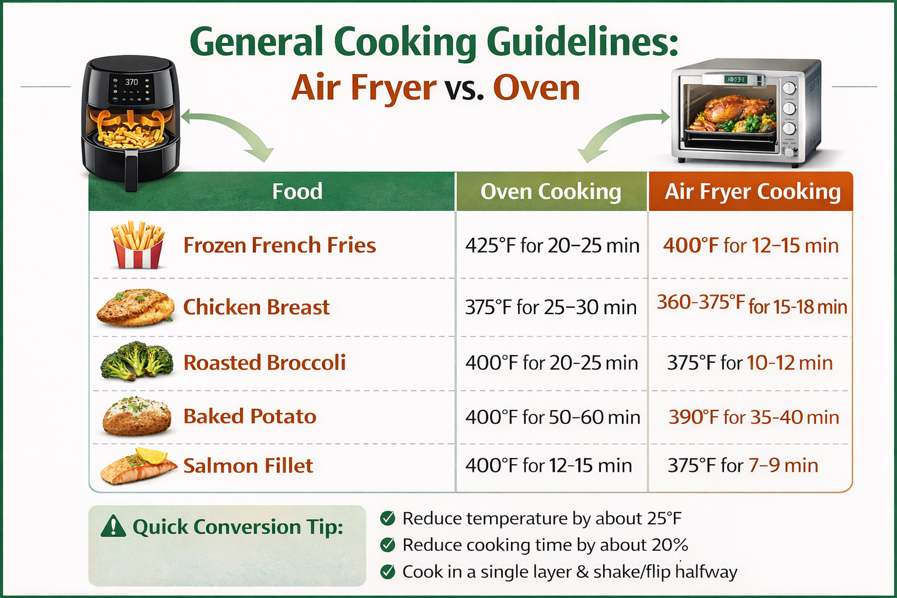
General Cooking Guidelines
Notes:
Most oven recipes can be adapted to the air fryer by lowering the temperature slightly and shortening the cooking time. Because the hot air circulates quickly, food cooks faster and often becomes crispier.
This slide shows a few examples, but a quick conversion from an oven recipe is:
Reduce temperature by about 25°F
Reduce cooking time by about 20%
Cook in a single layer and shake/flip halfway

Slide 11
Food safety tips
Wash hands before handling food
Avoid cross-contamination
Cook foods to recommended internal temperature
  Chicken 165°F
  Ground Meat 160°F
  Fish 145°F
  Beef and pork 145°F, + a 3-minute rest
Refrigerate leftovers within 2 hours of cooking
Clean basket and tray after each use
Notes:
Food safety is still very important when using an air fryer.
Always wash your hands before handling food and avoid cross-contamination between raw and cooked foods.
Use a food thermometer to check internal temperatures.
Safe minimum temperatures include:
Chicken: 165°F
Ground meats: 160°F
Fish: 145°F
Beef and pork: 145°F plus a 3-minute rest
Also remember to refrigerate leftovers within two hours and clean the basket and tray after each use.

Slide 12
Appliance safety tips
Place on heat-resistant surface
Keep away from water
Allow space around air vents
Do not use aerosol cooking sprays
Unplug before cleaning
Notes:
Air fryers are safe appliances, but there are a few important safety reminders.
Place the air fryer on a stable, heat-resistant surface.
Make sure there is space around the vents, because the appliance needs airflow.
Keep the air fryer away from water and unplug it before cleaning.
It is also recommended not to use aerosol cooking sprays, because they can damage the nonstick coating in many air fryer baskets.

Slide 13
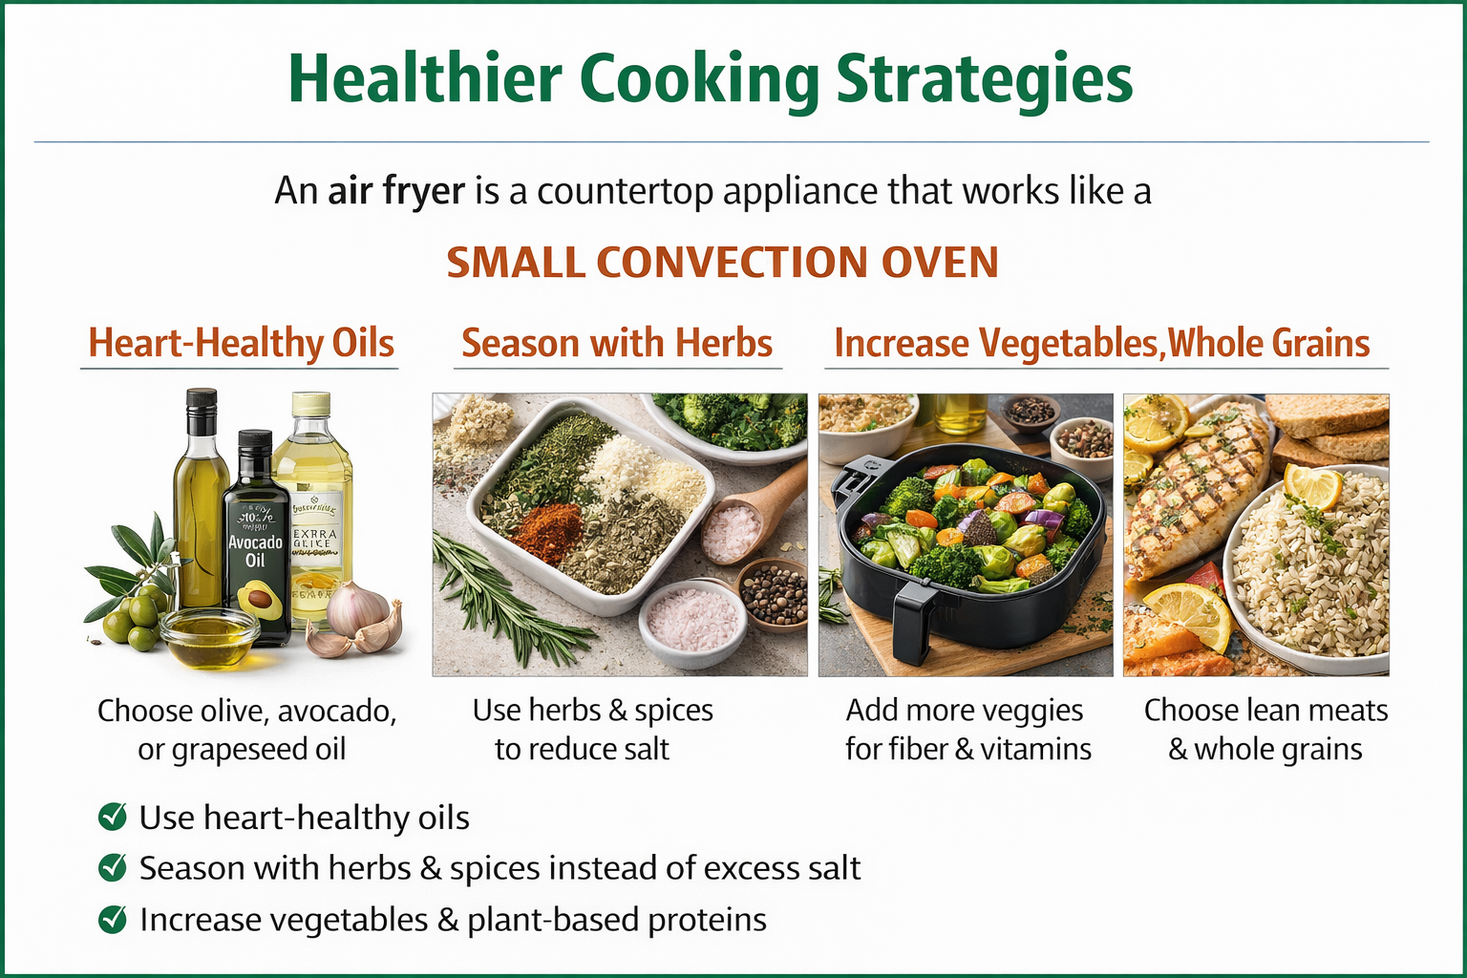
Healthier cooking strategies
Notes:
Air fryers can also support healthier eating habits.
One strategy is using heart-healthy oils, such as olive or avocado oil.
Another is seasoning foods with herbs and spices instead of excess salt.
Air fryers also make it easier to cook vegetables, which can help increase fiber intake.
You can also choose lean proteins and use whole-grain breads or coatings to make meals more balanced.

Slide 14
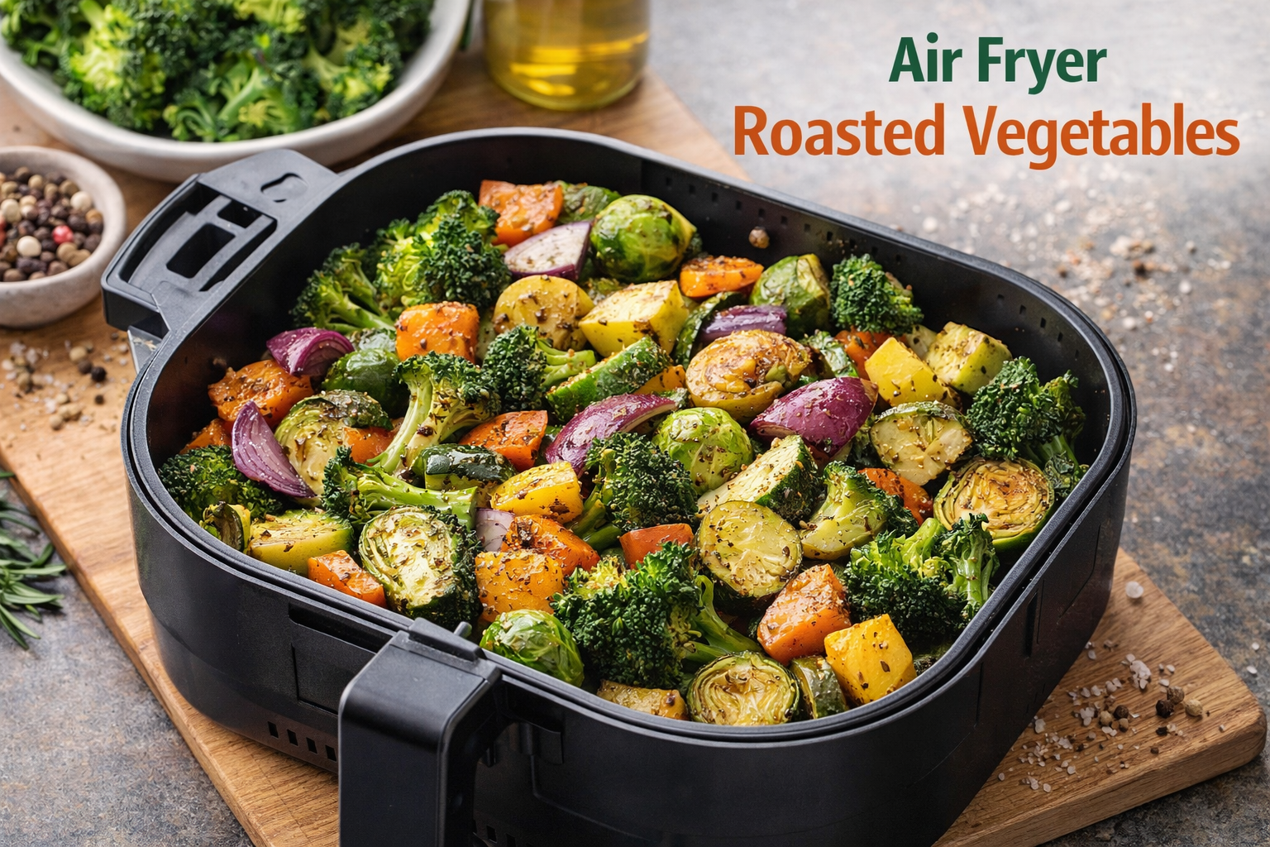
Air fryer Roasted vegetables
Ingredients:
  2 cups mixed vegetables (carrots, zucchini, broccoli)
  1 tablespoon olive oil
  Salt, pepper, garlic powder
Cook at 380°F for 10–15 minutes
Notes:
Roasted vegetables are one of the easiest foods to prepare in an air fryer.
This recipe uses about 2 cups of mixed vegetables, such as broccoli, carrots, or zucchini.
Toss them with about one tablespoon of olive oil and your favorite seasonings.
Cook at 380°F for about 10 to 15 minutes.
This recipe is very flexible, so people can use whatever vegetables they have available.

Slide 15
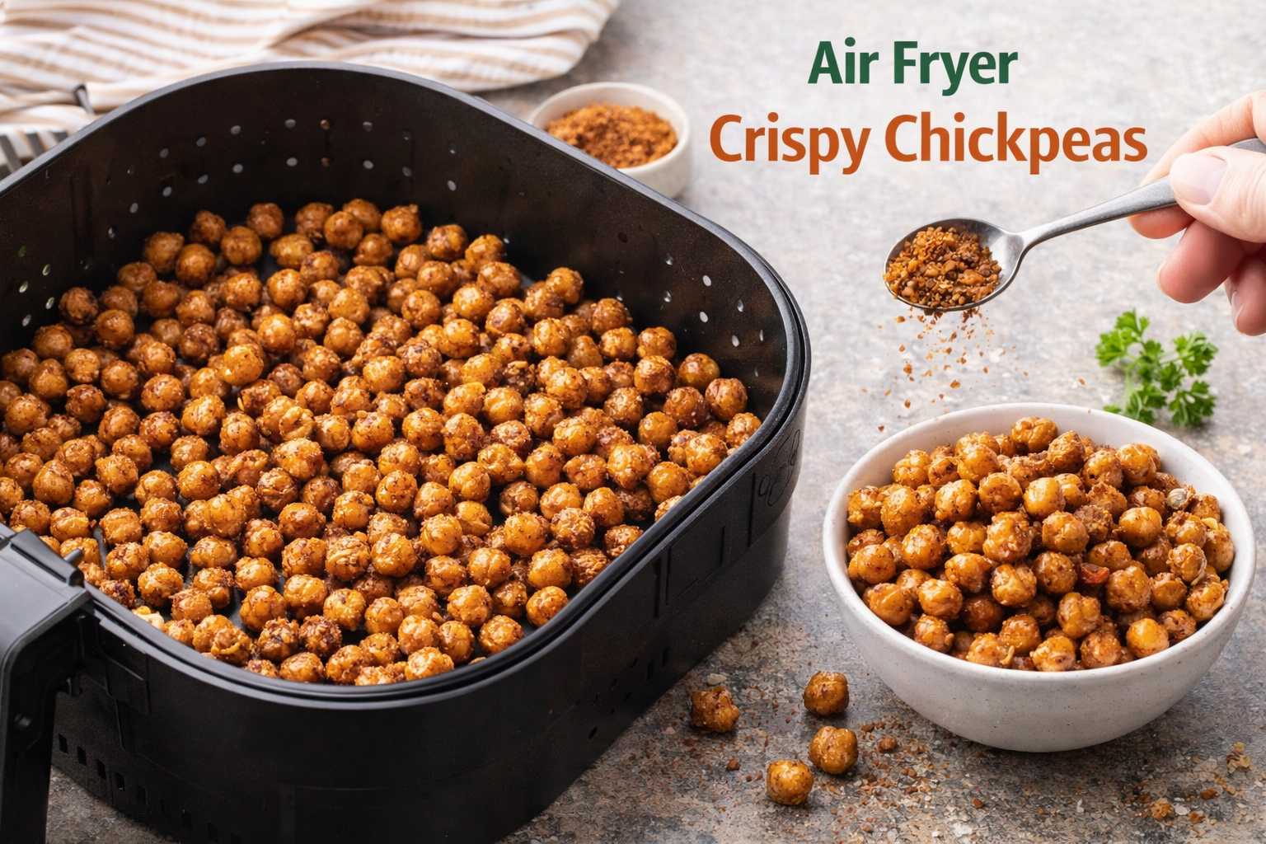
Crispy Chickpeas
Ingredients:
1 can chickpeas (drained, rinsed, dried)
1 tablespoon olive oil
Seasoning of choice
Cook at 390°F for 12–15 minutes, shake halfway
Notes:
Crispy chickpeas make a great snack and are a budget-friendly source of plant protein.
Start with one can of chickpeas that have been drained, rinsed, and dried.
Toss them with about one tablespoon of oil and your favorite seasoning.
Cook at 390°F for about 12 to 15 minutes, shaking the basket halfway through.
They come out crunchy and flavorful, and they can be used as a snack or even a salad topping.

Slide 16

Simple Quesadillas
Ingredients:
2 whole-wheat tortillas
½ cup shredded cheese
Optional: cooked chicken or vegetables
Cook at 370°F for 6–8 minutes
Notes:
Air fryers are also great for quick meals like quesadillas.
Place shredded cheese between two whole-wheat tortillas, and add optional fillings such as cooked chicken or vegetables.
Cook at 370°F for about 6 to 8 minutes.
This is a quick lunch or dinner option, and using whole-grain tortillas and vegetables can help make it more balanced.

Slide 17
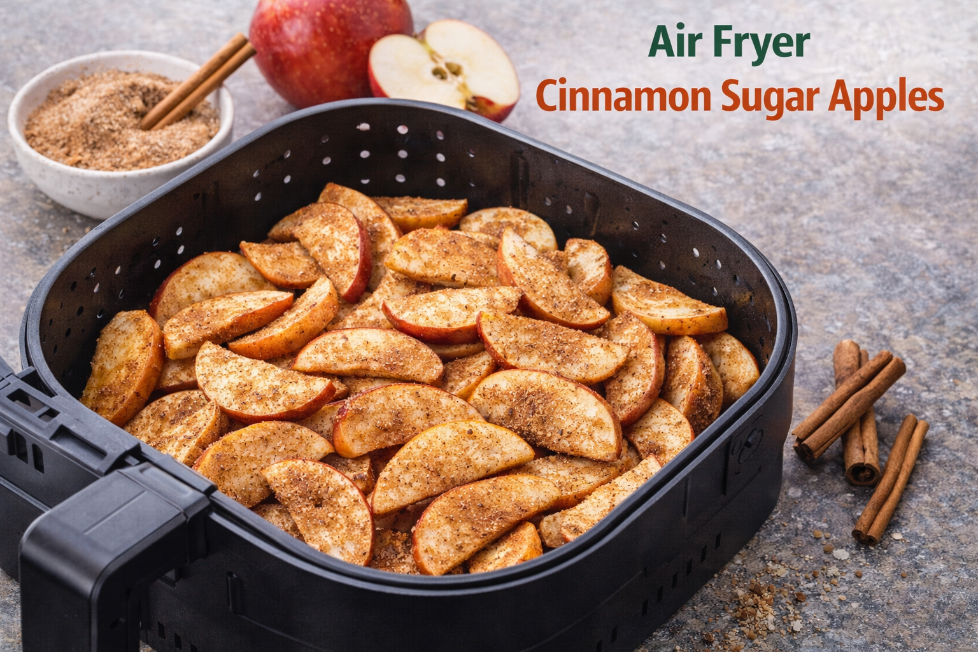
Cinnamon Sugar Apples
  Ingredients:
    2 apples, thinly sliced
    Light sprinkle cinnamon (no added sugar optional)
  Cook at 350°F for 8–10 minutes
Notes:
This is a simple recipe that works well for a quick demonstration.
Slice two apples thinly and sprinkle them with cinnamon.
You can add a small amount of sugar if desired, but the natural sweetness of the apples is often enough.
Cook at 350°F for about 8 to 10 minutes.
These apples make a warm snack or dessert and are affordable and easy to prepare, which makes them great for demonstrations.

Slide 18
Christi Evans
Department of Nutritional Sciences
O | 405.744.8786
E | christi.evans@okstate.edu
301 Nancy Randolph Davis
Stillwater, OK
https://extension.okstate.edu/programs/family-and-consumer-sciences/food-safety
Notes:
Thank you for participating today.
I hope this session gave you a better understanding of how air fryers work and how they can be used to prepare healthier meals quickly.
If you have questions later or would like additional resources, please feel free to contact me.

