Slide 1
Mindful Eating
Intuitive Eating for Well-Being
Candance Gabel, MS, RD, LD
OSU Extension – CNEP State Coordinator

Slide 2
Mindlessness
Being on “automatic pilot”
A sense of living mechanically
Living in the past or the future
Living in the present, but in a struggle with what is here
Separation from self
Sleepwalking through life

Slide 3
Mindlessness
“The average person looks without seeing, listens without hearing, touches without feeling, eats without tasting, moves without physical awareness, inhales without awareness of odor or fragrances, and talks without thinking”
                - Leonardo da Vinci

Slide 4
Mindfulness
“Paying attention/being aware in a particular way”
On purpose
In the present moment
Nonjudgmentally
- Jon Kabat-Zinn

Slide 5

Mindfulness
Being aware of our thoughts, emotions and sensations, and accepting them as they are without criticizing or judging them.

Slide 6
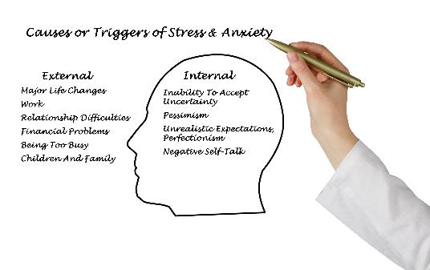
Why Practice Mindfulness?
Responding Versus Reacting
External stress
Internal stress

Slide 7
Triangle of Awareness

Slide 8
Responding vs Reacting to Stress

Slide 9
Responding vs Reacting
React
Respond
Fight, Flight or Freeze release of hormones puts our body on alert.
Awareness,
strengthen prefrontal cortex of brain where critical thinking occurs.

Slide 10
Responding vs Reacting
Stress Reaction
Stress Reaction
Increased:
Blood pressure
Pulse rate
Glucose rises
Sweat gland function
Decreased:
Digestion
Narrow mental focus
Shallower Breathing

Slide 11
Reacting to Stress
High blood pressure
Trouble sleeping
Fatigue
Acid reflux
Irregular heartbeat
Frequent infections
Feeling sad
Irritable bowel
Worrying
Headaches
Backaches
Memory loss
Intensifies symptoms of existing health conditions (i.e., diabetes, arthritis, asthma, autoimmune disorders)

Slide 12
Negative Ways of Coping
  Overwork
  Increased tobacco use
  Monkey mind
  Overeat
  Denial
  Less sleep
  Increased alcohol intake
  Increased caffeine consumption
  Zoning out on computer, phone or TV
Ongoing stress shrinks executive function in the brain-the habit-forming part of the brain.

Slide 13
Long-Term Effects of Stress
Chronic health problems
Depression/anxiety
Infertility
Weight gain
Notes:
Adpted from Kabat-Zinn, J. (1990). Full catastrophe living: Using the wisdom of your body and mind to face stress, pain and illness. New York: Dell Publishing.

Slide 14
Responding to Stress
Be aware of body sensations
Assess thoughts, feelings, perceived threats
Stay in the moment
Be conscious of the present
View situation with openness and without judgement
Accept

Slide 15
Positive Ways of Coping:
Seeing new options and opportunities in life’s challenges
Nurturing yourself: Self-care
Physical movement
Problem solving

Slide 16
Improved Health & Well-Being
Quicker recovery
Calmness
Reduced risk of health problems and illness
Positive mood and happiness

Slide 17
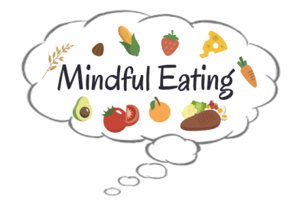
Mindful Eating

Slide 18
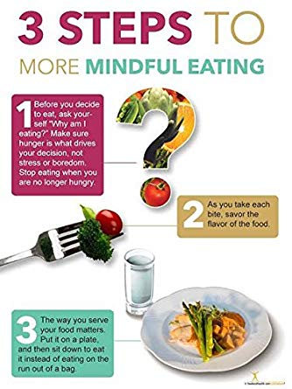
3 steps to more Mindful eating

Slide 19
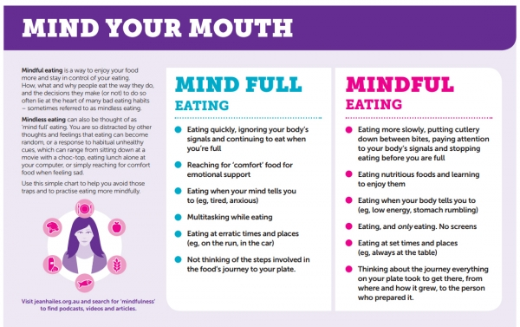
Mind Your Mouth

Slide 20
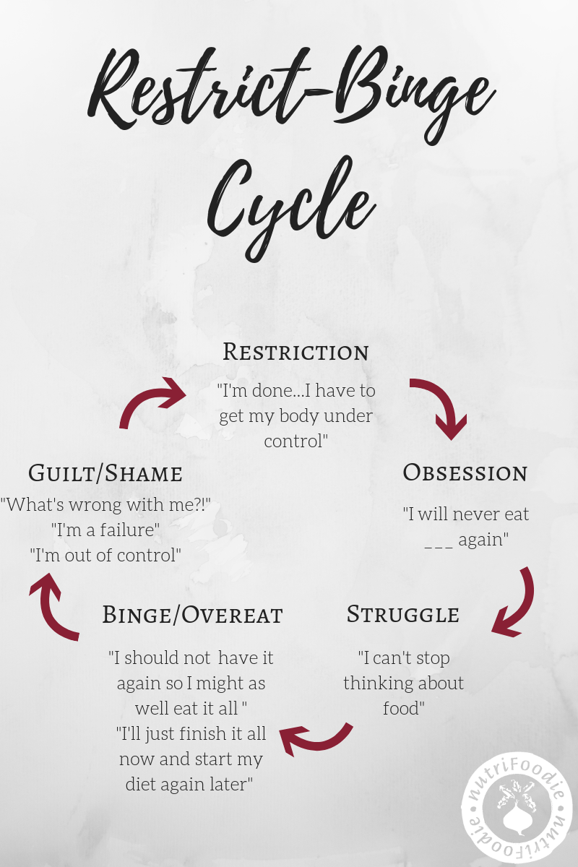
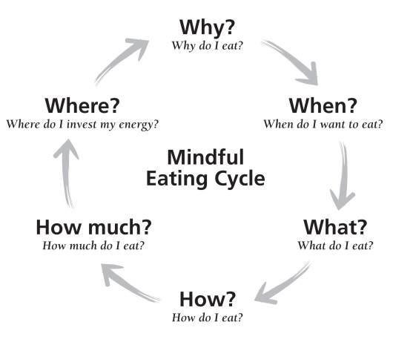
Restrict Binge cycle

Slide 21
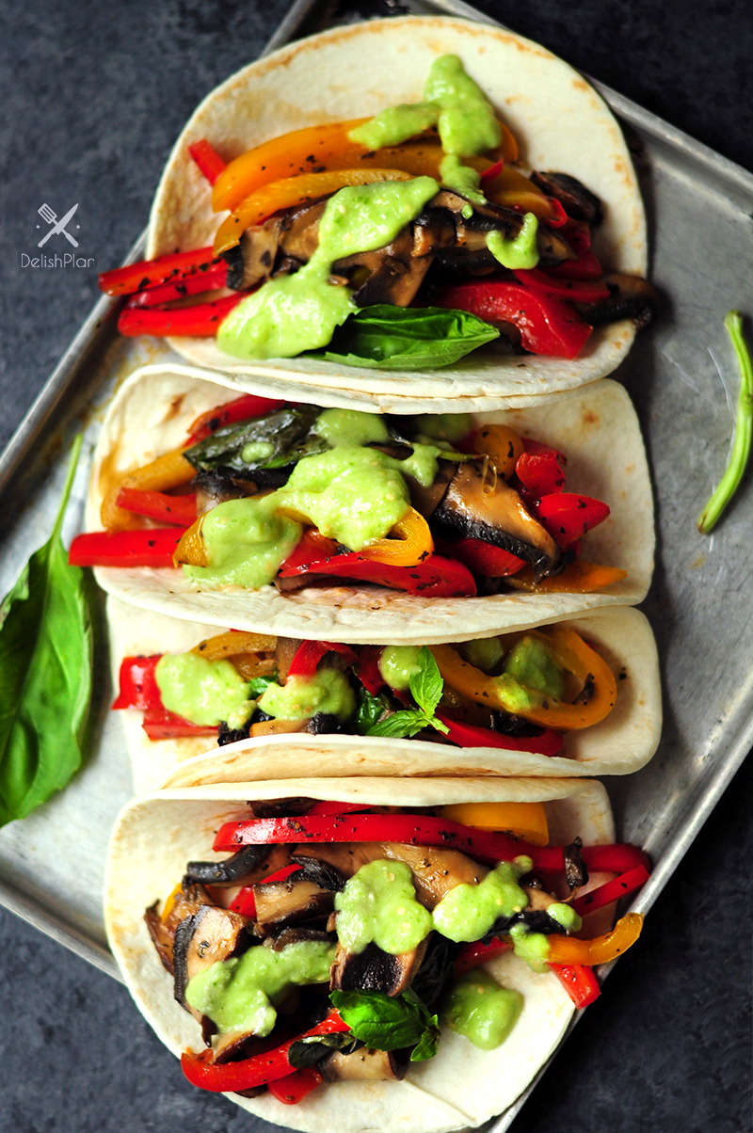
Mindful Eating
“Allowing yourself to become aware of the positive and nurturing opportunities that are available through food selection and preparation by respecting your own inner wisdom” and “using all your senses in choosing to eat food that is both satisfying to you and nourishing to your body and becoming aware of physical hunger and satiety cues to guide your decisions to begin and end eating”.
The Center for Mindful Eating

Slide 22
Hunger and Satiety Cues

Slide 23
What is Intuitive Eating
Reject the Diet Mentality
Honor Your Hunger
Make Peace with Food
Challenge the Food Police
Feel Your Fullness
Discover when you are Satisfied
Cope With Your Emotions Without Using Food
Respect Your Body
Exercise – Feel The Difference
Honor Your Health With Gentle Nutrition

Slide 24
Reject the Diet Mentality
The act of dieting increases your risk of gaining weight
Habits – Create New Habits
Unfollow social media accounts that propel the dieting myth and diet behaviors.
Notes:
Dieting and regaining weight - roller coaster dieting down 20 up 20, maintaining a healthy weight is better for our bodies.
Habits – create new ones. Stop getting pulled into new diets that are going to work miracles. Instead, practice making healthy choices and self-appreciation of your body.
Social Media that makes you feel bad about yourself

Slide 25
Honor Your Hunger
Hunger –Fullness Scale
On a Scale of 1-10 where are you?
Don’t judge whether or not you deserve to eat.
If you are hungry – eat
Pay attention to your own personal clock
  Just because most of us are on a time schedule doesn’t mean it’s the best schedule for all of us.

Slide 26
Make Peace with Food
Unconditional permission
Stop categorizing foods as “good” or “bad”
There is usually more where “that food came from.”

Slide 27
The Science Behind Intuitive Eating
Higher self-esteem
Better body image
More satisfaction with life
Optimism and well-being
Proactive coping skills
Lower body mass indexes
Higher HDL cholesterol levels
Lower Triglyceride levels
Lower rates of emotional eating
Lower rates of disordered eating

Slide 28
Challenge the Food Police
Your own thoughts defining whether you are good or bad for eating certain foods.
Language of others that define what they think is good or bad foods to eat.
There are no bad foods
  All food can fit in a healthy diet in moderation.

Slide 29
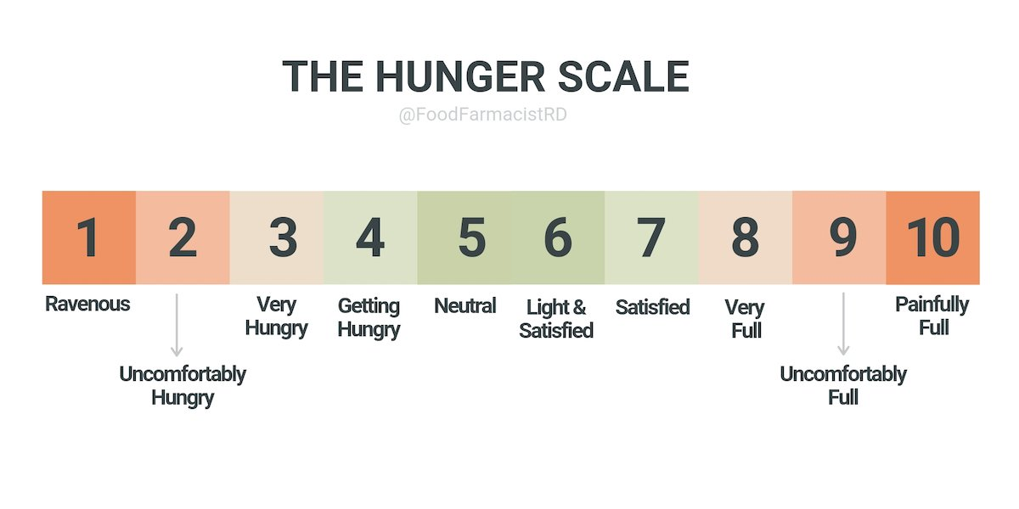
Hunger and Satiety Scale
Notes:
1 – So hungry you’ll eat anything 2 – Preoccupied with hunger; everything looks good to eat 3 – Stomach is growling and you have hunger pangs 4 – Feel hunger; time to think about what to eat 5 – Neither hungry nor full; neutral 6 – Feel satisfied but could eat more 7 – Totally satisfied; hunger is gone for a few hours 8 – You’re full and don’t want anything else to eat 9 – Stuffed and uncomfortable 20 – Painfully full and may feel sick.

Slide 30
Feel Your Fullness
When you feel satisfied and no longer hungry stop eating.
  On the Hunger and Satiety Scale this would be at a 6 or 7.
Take your time as you eat so you can savor each bite.
  By slowing down and enjoying each bite of food you allow yourself to “live in the moment”.
  Try not to multitask while you’re eating.
  Don’t worry about cleaning your plate.
Notes:
I had a friend tell me once that if she was full and continued to eat to “clean her plate” as not to waste food; her food would be wasted in her body. Either way it’s a waste.

Slide 31
Physical Activity – Feel the Difference
Physical Activity Guidelines for Americans
  150 minutes (2 hours and 30 minutes to 300 minutes (5 hours) a week of moderate-intensity,
  Or 75 minutes (1hours and 15 minutes) a week of vigorous – intensity aerobic activity.
  Muscle-strengthening activities of moderate or greater intensity and that involve all major muscle groups on 2 or more days a week
  Find something you enjoy doing…

Slide 32
Feel the Difference
Physical Activity:
  Improves your mood
  Makes you more alert
  Improves your physical health
  Improves your quality of sleep

Slide 33
Honor Your Health with Gentle Nutrition
Say no to dieting
Eat to satisfy hunger
Choose food you enjoy eating
Pay attention to your hunger and fullness cues
Listen to your body

Slide 34
Review
Mindfullness
Responding vs. Reacting to Stress
MIND FULL vs. MINDFUL Eating
Hunger – Satiety Scale
Intuitive Eating
Benefits of Physical Activity

Slide 35
Thank You!
Questions?

