Slide 1
The Power Went Out… Is My Food Still Safe?
Presented by:
Oklahoma State University

Slide 2
Objective
Learn what we can do before, during, and after a power outage that can help keep our food safe to eat.

Slide 3
Before an Outage
Keep an appliance thermometer in the refrigerator and freezer
Refrigerator should be 40ºF or below
Freezer should be 0ºF or below
Having a thermometer in the refrigerator and freezer will help determine if the food is safe after an outage.

Slide 4
Keep a Supply of Shelf-Stable Foods
Protein - canned meat, chicken, tuna, nuts, peanut butter
Vegetables- canned vegetables and vegetable juices
Fruits- canned fruits, dried fruits and fruit juices
Dairy- canned milk, dried milk, boxed shelf-stable milk
Grains - ready-to-eat cereal, crackers, pretzels
Water

Slide 5
Preparing for a Possible Outage
Check refrigerator for items that could be moved to the freezer.
Leftovers
Meat or poultry
Milk
Cheese (cheddar, swiss, mozzarella)
Lunchmeat

Slide 6
Preparing for an Outage
Locate coolers to have on hand if needed.
Group items in the freezer together.
Purchase ice or make ice.
Freeze reusable gel packs.
Fill empty water bottles or gallon jugs with water and freeze.

Slide 7
Keep Ice Stored in the Freezer
Ice can be moved to coolers or the refrigerator, if needed.
Containers of ice will fill unused freezer space.
A full freezer will keep food cold longer than a half empty freezer.
When melted, the containers of water can serve as a backup water source.

Slide 8
During a Power Outage
Keep the refrigerator and freezer doors shut.
The refrigerator will keep cold for about 4 hours, if unopened.
A full freezer will hold temperature for about 48 hours, if unopened.
A half full freezer will hold temperature for about 24 hours, if unopened.

Slide 9
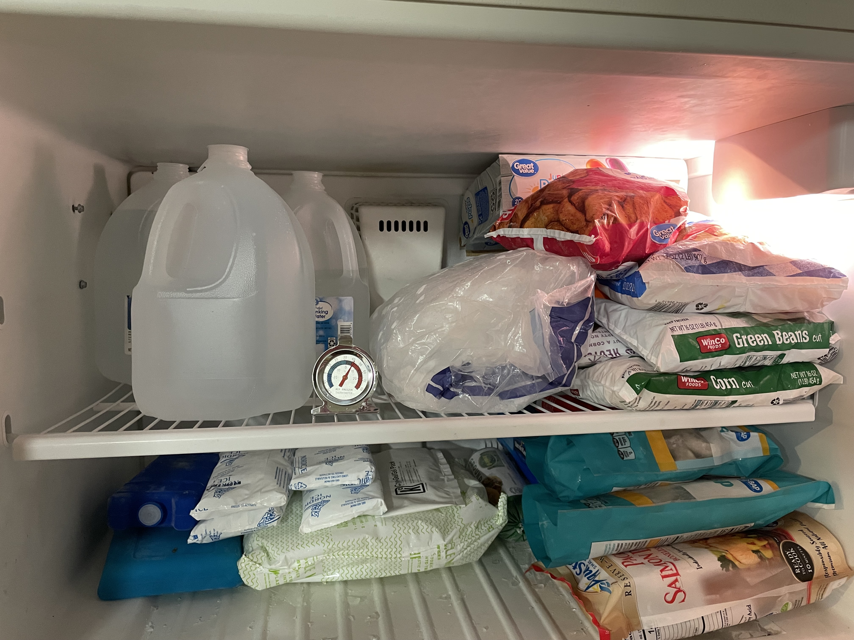
Freezer Space Comparisons
Good
Better
Best
Freezer with appliance thermometer.
Freezer with appliance thermometer and food grouped together.
Freezer with appliance thermometer, food is grouped together, and ice containers fill empty space.

Slide 10
For Outages Over 4 Hours
Move refrigerated food to an insulated cooler.
Add ice or frozen gel packs to the cooler.
Put an appliance thermometer in the cooler to monitor the temperature inside. Temperature should be kept at 40ºF or below.

Slide 11
Prolonged Outage
Do not place food outdoors, even in freezing temperature.
Containers of water can be placed outside to freeze.
Use block ice or dry ice for prolonged outages.

Slide 12
Using Dry Ice
Plan to use three pounds of dry ice per cubic foot of freezer space.
Handle dry ice with caution in a well-ventilated area.
Do not touch dry ice with bare hands- wear gloves or use tongs.
Wrap in brown paper for longer storage.
Use cardboard to separate from direct contact with food.
One large piece lasts longer than small pieces.

Slide 13
Cooking When the Power is Out
Fireplace
Chimney must be unbroken, and flue must be open.
Wood stove
Stovepipe must be undamaged and flue open.
Camp stove
Use outdoors only.
Charcoal grill
Use outdoors only. Never use charcoal indoors, not even in the fireplace.
Gas grill
Use outdoors only.

Slide 14
Eating Canned Foods
Commercially canned foods can be eaten right out of the can.
Home canned meats and vegetables must be cooked first.
Boil at least 10 minutes before eating to reduce risk of botulism poisoning.
Add one additional minute per thousand feet of altitude.
Home canned fruits can be eaten without heating.

Slide 15
After a Power Outage- Freezer
If there is an appliance thermometer, check the temperature.
The food is safe and can be cooked or refrozen if the temperature is 40ºF or below.
If no appliance thermometer, check each item individually for ice crystals.
If there are ice crystals, the food is safe.
Discard items that have thawed.

Slide 16
After a Power Outage- Refrigerator
If there is an appliance thermometer, check the temperature.
The food is safe if the temperature is 40ºF or below.
If the power was out 4 hours or less with the door closed, food should be safe.
Discard any foods with an unusual odor, color, or texture.
Discard perishables that have been above 40ºF for two hours or more, or above 90ºF for one hour.
Notes:
Refrigerated food should be safe if the power was out less than 4 hours, if the refrigerator door was kept shut.

Slide 17
Discarding Foods After an Outage
Discard the following if held above 40ºF for more than 2 hours:
Meat, poultry, fish, seafood, and soy meat substitutes
Milk, cream, sour cream, yogurt, soy milk, soft cheeses
Lunchmeats, hot dogs, bacon, sausage
Casseroles, soups, stews
Eggs, egg dishes, and egg products
Custards and puddings
Creamy-based salad dressings

Slide 18
Fruits and Vegetables to Discard
Discard the following if held above 40ºF for more than 2 hours:
Cut fresh fruits and vegetables
Sliced or shredded coconut
Packaged, pre-cut/pre-washed greens
Cooked vegetables
Baked potatoes
Opened vegetable juice

Slide 19
Other Foods to Discard
Discard the following if held above 50ºF for more than 8 hours:
Mayonnaise
Tartar sauce
Horseradish

Slide 20
Foods to Save
Butter or margarine
Hard or processed cheeses
Fresh fruits and vegetables
Vinegar based dressings
Jellies and jams
Taco sauce and hot sauce
BBQ sauce
Mustard and Ketchup

Slide 21
Removing Odors
Remove food from refrigerator/freezer.
Clean with a mixture of one of the following:
Mix one tablespoon baking soda with one quart of water.
Mix one cup vinegar in a gallon of water.
Allow to dry.
If odor persists, use activated charcoal or contact the company for suggestions.

Slide 22
Sources
https://www.foodsafety.gov/keep-food-safe/food-safety-in-disaster-or-emergency
https://extension.okstate.edu/fact-sheets/eating-and-keeping-food-safe-during-summer-and-winter-storms.html
https://hgic.clemson.edu/factsheet/food-safety-in-power-outages/

