Slide 1
Character Critters
State OHCE Leaders Lesson
Presented by:
Janna Kelley
Extension Educator, FCS/4-H & CED
Pontotoc County

Slide 2
Character Critters
Developed by LSU Agricultural – Louisiana Cooperative Extension Service.
Adopted by OSU Cooperative Extension Service in 2001
Still used by some Educators today
OHCE State Leaders Lesson July 2023

Slide 3
Character Critters Overview
Character Critters program was developed for use by teachers, Extension staff or trained Extension Volunteers
Audience is Preschool classrooms
Parents of Preschool age children
Designed to increase young children’s understanding of Character issues
Increase Parents’ understanding of character issues
Increase Parents’ involvement in developing their children’s character.

Slide 4
Key Elements in Character Development
Responsibility
Caring
Trustworthiness
Fairness
Citizenship
Respect

Slide 5
Let’s Meet the Cast of Character Critters

Slide 6
Roy the Responsible Rabbit
Says:
Do what you are supposed to do.
Keep on trying.
Always do your best.
Help friends and family.

Slide 7
Carrie the Caring Cat
Says:
Be kind to people.
Show friends and family you care.
Say please and thank you.
Help people.

Slide 8
Cindy the Citizen Crab
Says:
Cooperate.
Obey rules.
Respect people in charge.
Do not litter.

Slide 9
Fran the Fair Frog
Says:
Know and follow the rules.
Share with friends and family.
Listen to friends and family.
Not blame family and friends.

Slide 10
Rusty the Respectful Racoon
Says:
Be kind to friends and family.
Use good manners.
Not to hit or hurt.
Talk about problems.

Slide 11
Tommy the Trustworthy Turtle
Says:
Tell the truth.
Follow the rules.
Not to take things that do not belong to you.
Do what you say you will do.

Slide 12
Character Critters Activities
Each lesson come with story cards
Puppets
Take home sheets & activity
Parent Meetings

Slide 13
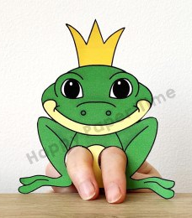
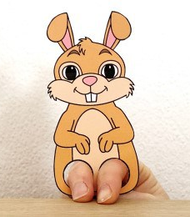
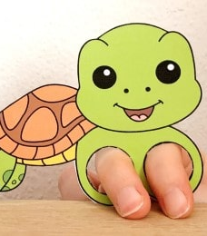
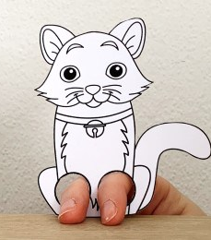
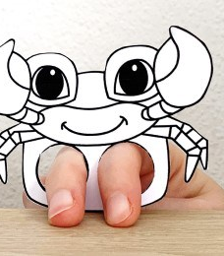
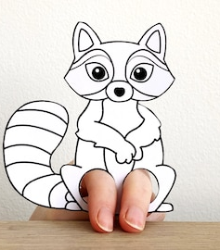
Master Sewing Volunteers Making Puppets Patterns
Finger puppets
Brainstorm puppet ideas

Slide 14
Practice
Roy the Responsible Rabbit
Notes:
Have member read the story. Group respond to questions.
Brainstorm activities you might could do to show being responsible.

Slide 15
Plant Carrot Seeds in a Cup

Slide 16
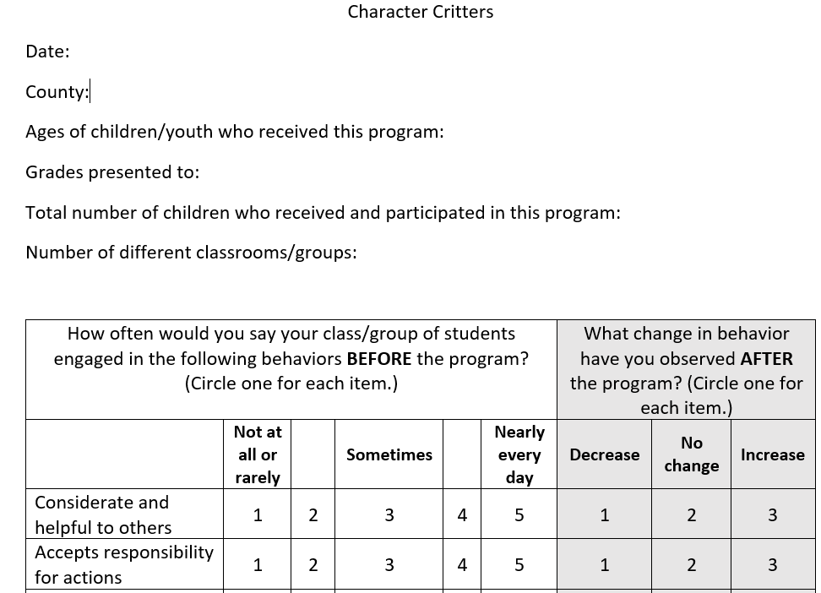
EVALUATION

