Slide 1
Families and Mental Health
Matt Brosi, PhD & Jordan Shuler, M.S.

Slide 2
Why this presentation?
Mental health issues are common yet severely overlooked. Why?
Simply raising awareness of mental health issues isn't enough.
Psychotherapy is effective, but our desire is to help individuals and families become the key resource in addressing mental health issues.

Slide 3
Mental Health in Oklahoma
In OK, 7+ of the top 10 counties reporting frequent mental distress are rural.
Where are the most MH providers in OK?
Adults residing in rural geographic locations receive mental health treatment less frequently and often with providers with less specialized training, when compared to those residing in metropolitan locations.
Notes:
Slide Resources:
https://oklahoma.gov/content/dam/ok/en/health/health2/documents/01.27.2020-mental-health-hpsa-grouped-by-score.pdf

Slide 4
Our Goals
Explore what a “healthy” family looks like
With individuals, couples, and parent-child relationships
Where things go "wrong"
Or no longer working well in the family...
How families can improve wellbeing

Slide 5
What Makes a “Healthy” Family (System)
One way to think of a healthy family is one that works well enough for everyone in it; where there are clear rules, hierarchy, and structure, yet members voices are not silenced.
There is a wide range in what a "healthy family" looks like; it can look different in each family.
At the same time, there are common patterns that family scientists and family therapists hope to help families follow

Slide 6
Family Systems Basics
A "system"...
Is made up of many parts, but makes something bigger when together.
It's pieces constantly affect and are affected by one another.
It has a way of keeping the system working in a steady state.
A "family system" works in a similar way, but it's parts:
Have unique thoughts and feelings
Constantly communicate and interpret messages (spoken and unspoken)
Uses actions & emotions to keep the system working in a consistent way
Notes:
Technical Notes:
System examples
Clock or gears are interconnected pieces in which each part is effected by any piece in the system moving, even if not directly touching it.
Air conditioning units generally work by a sensor noticing when the temperature is too hot inside its space and uses a coolant and fan system to move cool air into the living area in a home until it senses that it is back to the state/temperature it is set to.
Basic Family Systems Principles
Family members CANNOT NOT communicate (even when not together memories and beliefs continue to shape future interactions with or about family members)
Pieces of the family have a strong tendency to maintain morphostasis, a tendency towards a constantly shifting equilibrium
Types of subsystems
Couple subsystem and parental subsystem can be made of the same members, but have a distinct set of roles, rules, and boundaries. In the case of divorce and separation, the systems may become more complex, with a dissolved couple system but a maintained parental system, sometimes including step-parents who are part of new couple subsystems. These pieces continue to interact. A child subsystem could include parent and child, parent and multiple children, parents and child, parents and children, or various subsets of siblings. Technically an individual can also be considered a subsystem as they have internally interacting psychological, neurological, and biological components that mutually and simultaneously interact and maintain homeostasis (including psychological homeostasis through cognitive dissonance and bias forces)

Slide 7
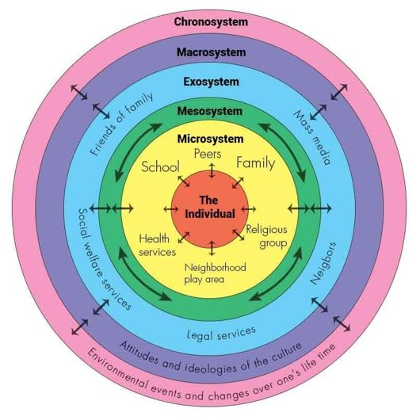
Family Systems Continued
Family Subsystems
Couple subsystem
Parental subsystem
Child/Sibling subsystem
Embedded in layers of influence
Extended family, School, Peers
Socioeconomic background
Jobs, Communities, Media
Culture, Government, Policies
Time, History
Notes:
Image Citation: Szabo, Nicole & Dubas, Judith & Karreman, Annemiek & Tuijl, Cathy & Deković, Maja & Aken, Marcel. (2011). Understanding human biparental care: Does partner presence matter?. Early Child Development and Care. 181. 10.1080/03004431003717631.
Technical Notes:
System examples
Clock or gears are interconnected pieces in which each part is effected by any piece in the system moving, even if not directly touching it.
Air conditioning units generally work by a sensor noticing when the temperature is too hot inside its space and uses a coolant and fan system to move cool air into the living area in a home until it senses that it is back to the state/temperature it is set to.
Basic Family Systems Principles
Family members CANNOT NOT communicate (even when not together memories and beliefs continue to shape future interactions with or about family members)
Pieces of the family have a strong tendency to maintain morphostasis, a tendency towards a constantly shifting equilibrium
Types of subsystems
Couple subsystem and parental subsystem can be made of the same members, but have a distinct set of roles, rules, and boundaries. In the case of divorce and separation, the systems may become more complex, with a dissolved couple system but a maintained parental system, sometimes including step-parents who are part of new couple subsystems. These pieces continue to interact. A child subsystem could include parent and child, parent and multiple children, parents and child, parents and children, or various subsets of siblings. Technically an individual can also be considered a subsystem as they have internally interacting psychological, neurological, and biological components that mutually and simultaneously interact and maintain homeostasis (including psychological homeostasis through cognitive dissonance and bias forces)

Slide 8
Common Patterns in Healthy Individuals & Families
Roles, Rules, and Boundaries that are...
Flexible
Clear
Consistent
Congruence and authenticity within and between
With self, with partner, as a parent
"I mean what I say and say what I mean..." (*and I also encourage you to do the same)

Slide 9
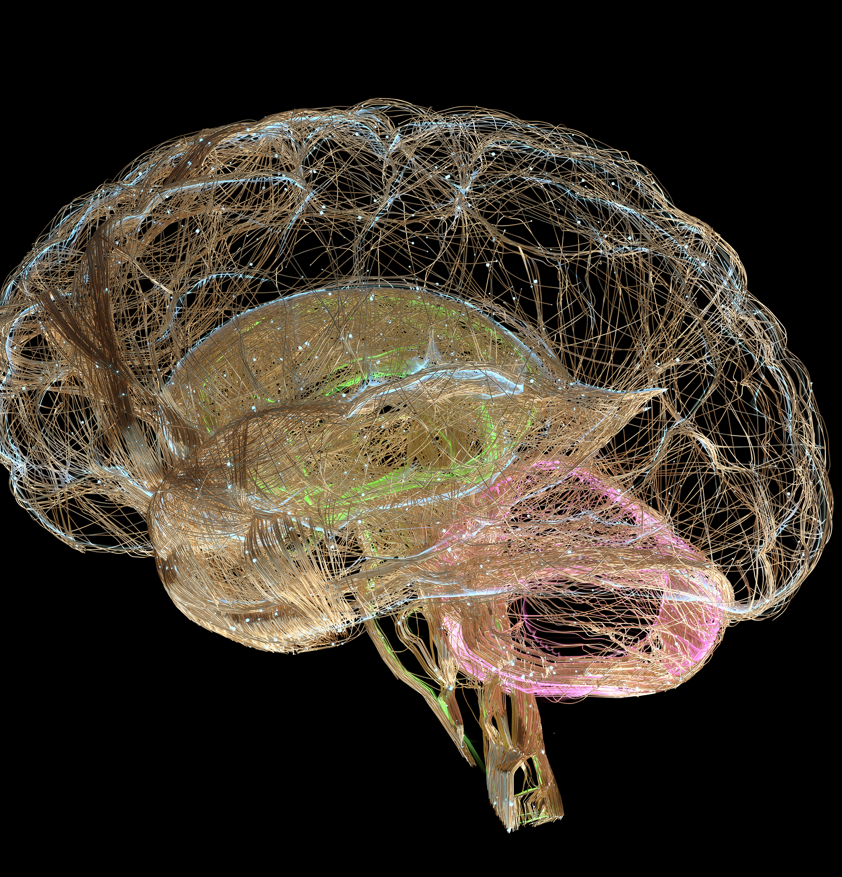
Understanding Individual Health
We have many (psychological) "parts"
A healthy individual pays attention to each of their internal parts, balances their needs, and continues to grow.
Just like your psychology, the biology of your brain is made up of different parts:
The "Thinking brain," the emotion and panic part, and the body maintenance part.
A healthy individual uses their "thinking brain" while working with their emotion and maintenance brains.
Notes:
While it is a little simplified, the basic outline of the brain is the "Thinking Brain" or the frontal cortex, where most of our planning, ability to direct behavior intentionally, and ability to be thoughtful comes from. We also have a part of our brain where emotions and danger senses start. The basics of fight/flight/freeze in terms of both evolution and experiences/memory (what fires together wires together).
https://www.ncbi.nlm.nih.gov/pmc/articles/PMC8228195/#:~:text=Emotions%20arise%20from%20activations%20of,nucleus%2C%20and%20ventral%20tegmental%20area.
Example “parts” of the brain
A thoughtful part, a playful part, a working part, a part that hopes to be cared for, a romantic part, etc.
In talking about brain balance: *So one part doesn't become the only one we use (how trauma blocks).

Slide 10
How Problems Form for Individuals
When these parts get out of balance, we become unwell (& sometimes we call that unwellness a psychological disorder)
"Anxiety Disorders" - our part that worries runs the show/ we work hard to find control and order when feeling chaos.
"Mood Disorders" - our part that wants to be cared for is neglected/ we stop fully using our thinking brain to interrupt maladaptive coping mechanisms (self-protective).
Chronic stress buildup – over activation of the stress response
Trauma – "scars" our emotion and panic center and they override our "thinking brain" when the alarms goes off

Slide 11
Skills to Build a Healthy Individual
Balancing the parts of self
Take care of your biology (caution with self-medication; SLEEP)
Take care of each of your psychological parts
Exercise your thinking brain
Use SMART goals to direct what you do
In therapy relationships with others (overcome the isolation factor):
Validate/normalize each other's experiences
Explore the mind's parts, feelings, and beliefs – get them to connect with one another
Challenge self and one another to grow....
Notes:
Parts of a SMART goal:
Specific (Something that can be DONE with your body, and something a living person can do better than a dead person – active goals to do something rather than to stop doing something)
Meanigful (DON’T SKIP THIS ONE, and no one but you can tell you what is meaningful)
Adaptive (Will this make your life better/more meaningful in the long run
Realistic (if its not a 7/10 with 10 being absolutely certain, chances are it won't work)
Time-framed (the more specific the better)
https://www.actmindfully.com.au/upimages/The_Reality_Slap_-_Appendix_4_-_Goal_Setting.pdf
What do parts need? (are you neglecting hobbies, normally neglecting yourself for others benefit OR neglecting others to protect yourself, are you ignoring a part of that is hurt)
Balancing the parts of self
Take care of your biology (caution with self-medication; SLEEP)
Take care of each of your psychological parts (be playful, do what matters, be bold enough to say discomforting things)
Exercise your thinking brain (be aware of cognitive distortions, think outside the box, mindfully meditate)

Slide 12
Couple Health
Well-functioning couples…...
Starts with "healthy” (enough) individuals
Each partner recognizes their own unique set of thoughts, feelings, and beliefs while also caring for and allowing themselves to be cared for by another person
Connect thoughtfully/intentionally
Fight fairly (rather than trying to get our partner to see that we are right)
Problem Formation
Rigid dependence (overly connected/fused) or independence (disengaged/aloof)
Doing relationships on automatic/bad habits/unaware
Inflexible roles and rules
Fighting to win (criticizing, contempt, and/or the cold-shoulder)
Maintain interdependence
Notes:
Well-functioning couples:
We tend to get into romantic relationships because they make us feel wanted & valuable, attractive and likable, sexually gratified, and ideologically fulfilled. Protecting those experiences, however, requires intentionality, thoughtfulness, and responsibility. Those sound boring, and truthfully without the first sentence they are. A well functioning couple puts faith (because we can't ever know with complete certainty that these will come through for us) into experiencing the things that make relationships beautiful by working to be interdependent,
The order of well functioning is intentional, starting with interdependence, then moving to connection, then to balance, and finally to fighting fairly (or communicating effectively). The philosophy of the order is to maintain differentiation so that connection can be intentional and thoughtful to build the emotional capacity for work around maintaining balance so that there is as little in the way of communicating effectively and using communication tools intentionally.
Explain interdependence:
A balance between being independent and dependent. Remain aware of what your thoughts, feelings, and beliefs are as separate from your partners thoughts, feelings, and beliefs. We have a bias to believe that our beliefs are common or at least right, that when we feel a certain way other people feel a similar way, and that if we think something chances are someone else will be thinking that too. This is particularly true when you spend significant time with another person, and is heightened when you can predict with reasonable accuracy what another person is thinking or feeling. Mind-mapping is sometimes a part of empathy and showing another person that you are trying to be in-tune with what is important to them, but mistakes are inevitable and when you are overconfident in your mapping skills it leads to unmet expectations and frustration. When we feel threatened emotionally most of us have a tendency to either seek approval or assert our "rightness." When taken to an extreme this leads to emotional dependence and despair WHEN the other person cannot follow through OR emotional disconnection after losing faith that the other person won't be there for you (which often leads to a self-fulfilling prophecy).
When we fight to win rather than fighting fairly we tend to either vindicate ourselves or prove a point through criticizing, show our dominance through contempt (or fall on our sword as a martyr), or shut down to avoid any further damage.
Balance roles and rules, maintain an interdependence in emotional boundaries (allow themselves to rely on another person without expecting them to take ownership of your experiences and beliefs), fight fairly (use complaints rather than criticisms, make reasonable requests before demands, be assertive and authentic without being aggressive or complacent), connect thoughtfully (spend time together in ways that both appreciate, be mindful of self and cooperative with partner during sex, maintain a friendship – fun, laughter, shared interests, etc.)

Slide 13
Skills to Build a Healthy Couple
Attend to what is mine first; then care for what is theirs
Acknowledging mutual influence.
Say "I" instead of "you"; "and" instead of "but", compromise when you can; balance the pain with joy and kindness.
Lean into curiosity ("Help me understand..."; be able to say "I was wrong").
Build Rituals......Plan SMART time together (*make the relationship a priority).
Discuss and balance roles; including asking for help.
❋❋❋❋❋
In therapy – we spend so much time on "communication"
Break down miscommunications; Address wounds; Create new patterns.
Notes:
SMART goal for couples with example:
Specific (kiss at the door)
Motivated by value (being the kind of partner who shows partner appreciation; for connection)
Adaptive (does this work for me in the long run?; a kiss at the door fits within our couple relationship and long-term capacity)
Realistic (easily added)
Time specific/bound (will happen when I leave for work)

Slide 14
Healthy Children and Families
Flexible Parenting
Warmth balanced with structure
Emotion Guides
Active involvement as guides on understanding emotions and guiding behaviors
Facilitating Child’s Use of Voice
Help children find the language, safety, and space to use their voice
Consistency Over Grandiosity
We spell “love” with TIME
Parenting that adapts as children grow
Everyday consistency does more than grand gestures

Slide 15
Problem Formation in Parent-Child Health
Aloof or patronizing parenting
Transgenerational nature of doing business "this" way...
Using Shame to drive child behavior
Drill sergeant and Best friend parenting
Drill sergeants get results in the short term but end up with kids who either "wash out" or cut-off as soon as they can get away
A best friend doesn't give rules/expectations to each other to follow; they are on equal footing when it comes to rules and expectations. Kids aren't ready to go without direction/support/correction yet.
Notes:
Aloof or patronizing parenting
Don't listen to child's needs; Minimize/trivialize child's problems, needs, fears
Transgenerational nature of doing business "this" way... (impact of trauma; homeostasis 101)
Using Shame to drive child behavior
Getting child to do "good behavior" by making them feel like bad kids if they fail = a kid who eventually gives up on "being good" if they can never measure up, or a kid who only "does good" when there is someone telling them what good (a problem when they try to gain independence)
Drill sergeant and Best friend parenting
Drill sergeants get results in the short term but end up with kids who either "wash out" or cut-off as soon as they can get away
A best friend doesn't give rules/expectations to each other to follow; they are on equal footing when it comes to rules and expectations. Kids aren't ready to go without direction/support/correction yet.
Best friends equally rely on each other for support, and kids aren't ready to emotionally support their parents.

Slide 16
Skills to Build a Healthy Parent-Child Relationship
Become Predictable
Plan out specific routines and what to do when routines go off the rails
Practice what you preach
Play alongside your children
Praising the positive gets you further than pointing out the problems
use logically connected consequence when you need to use consequences to reinforce your lesson.
In therapy – we spend a lot of time educating parents about developmental needs of children and ways they can facilitate children's use of voice....
Help parents really listen to what a child is saying with their words and behaviors
Help parents respond intentionally rather than reactively
Ultimately works to help parents become a child's "therapist"

Slide 17
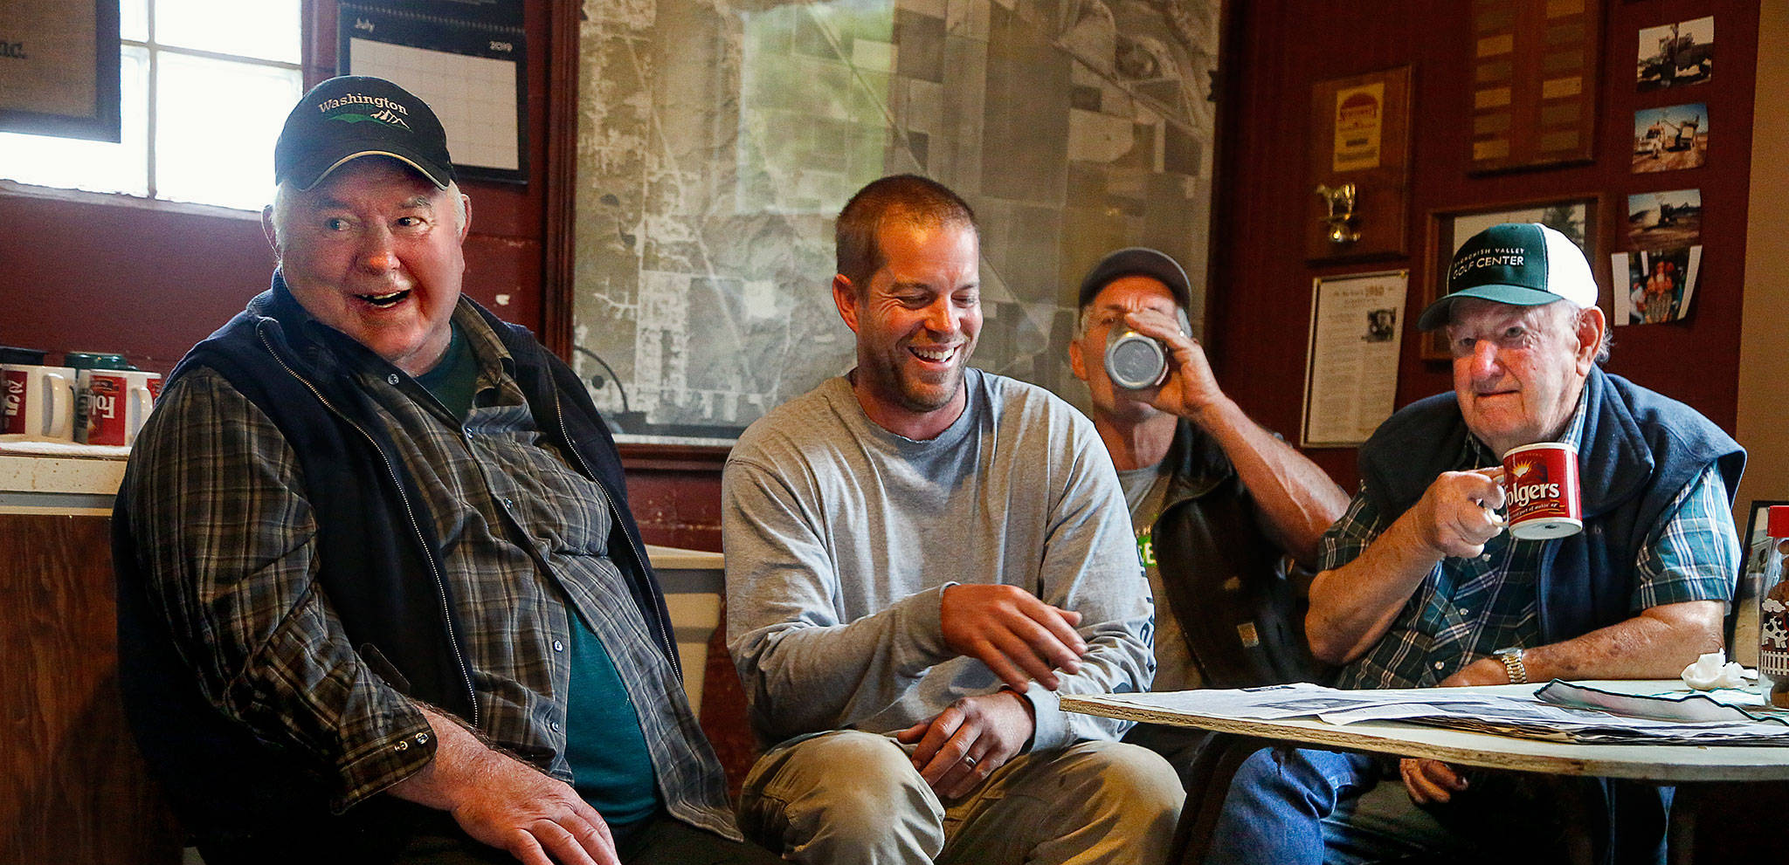
Key Takeaways:
No person is an island
Flexibility is the spice of life
Genuine/caring communication works
Healthy individuals support healthy relationships and families (and rural communities)

Slide 18
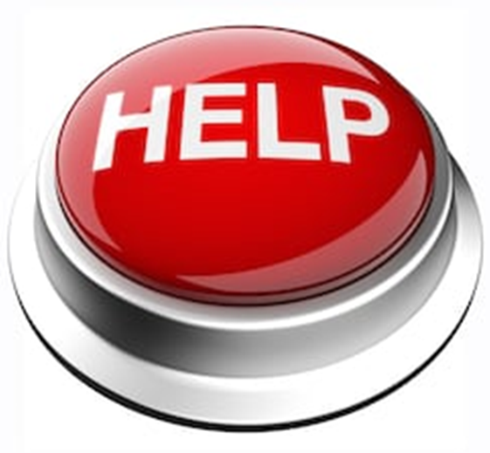
Where to Find Help (*put in your phone contacts list)
•988 (was 211)
•NAMI helpline 1-800-950-6264 (NAMI) or info@nami.org
•Suicide Hotline 1-800-273-8255
•Ok Child Abuse Hotline 1-800-522-3511
•Disaster Distress helpline 1-800-985-5990
•Text: TALKWITHUS to 66746
•Crisis Text 24/7: Text HELLO to 741741

