Slide 1
Families and Mental Health
Matt Brosi, PhD & Jordan Shuler, M.S.

Slide 2
Why this presentation?
Simply raising awareness of mental health issues isn't enough.
In OK, 7+ of the top 10 counties reporting frequent mental distress are rural.
Psychotherapy is effective, but our desire is to help individuals and families become the key resource in addressing mental health issues.

Slide 3
What Makes a “Healthy” Family (System)
One way to think of a healthy family is one that works well enough for everyone in it; where there are clear rules, hierarchy, and structure, yet members voices are not silenced.
There is a wide range in what a "healthy family" looks like; it can look different in each family.
At the same time, there are common patterns that family scientists and family therapists hope to help families follow, especially flexible roles, rules, and boundaries

Slide 4
Family Systems Basics
A "system"...
Is made up of many parts, but makes something bigger when together.
It's pieces constantly affect and are affected by one another.
It has a way of keeping the system working in a steady state.
A "family system" works in a similar way, but it's parts:
Have unique thoughts and feelings
Constantly communicate and interpret messages (spoken and unspoken)
Uses actions & emotions to keep the system working in a consistent way
Notes:
Technical Notes:
System examples
Clock or gears are interconnected pieces in which each part is effected by any piece in the system moving, even if not directly touching it.
Air conditioning units generally work by a sensor noticing when the temperature is too hot inside its space and uses a coolant and fan system to move cool air into the living area in a home until it senses that it is back to the state/temperature it is set to.
Basic Family Systems Principles
Family members CANNOT NOT communicate (even when not together memories and beliefs continue to shape future interactions with or about family members)
Pieces of the family have a strong tendency to maintain morphostasis, a tendency towards a constantly shifting equilibrium
Types of subsystems
Couple subsystem and parental subsystem can be made of the same members, but have a distinct set of roles, rules, and boundaries. In the case of divorce and separation, the systems may become more complex, with a dissolved couple system but a maintained parental system, sometimes including step-parents who are part of new couple subsystems. These pieces continue to interact. A child subsystem could include parent and child, parent and multiple children, parents and child, parents and children, or various subsets of siblings. Technically an individual can also be considered a subsystem as they have internally interacting psychological, neurological, and biological components that mutually and simultaneously interact and maintain homeostasis (including psychological homeostasis through cognitive dissonance and bias forces)

Slide 5
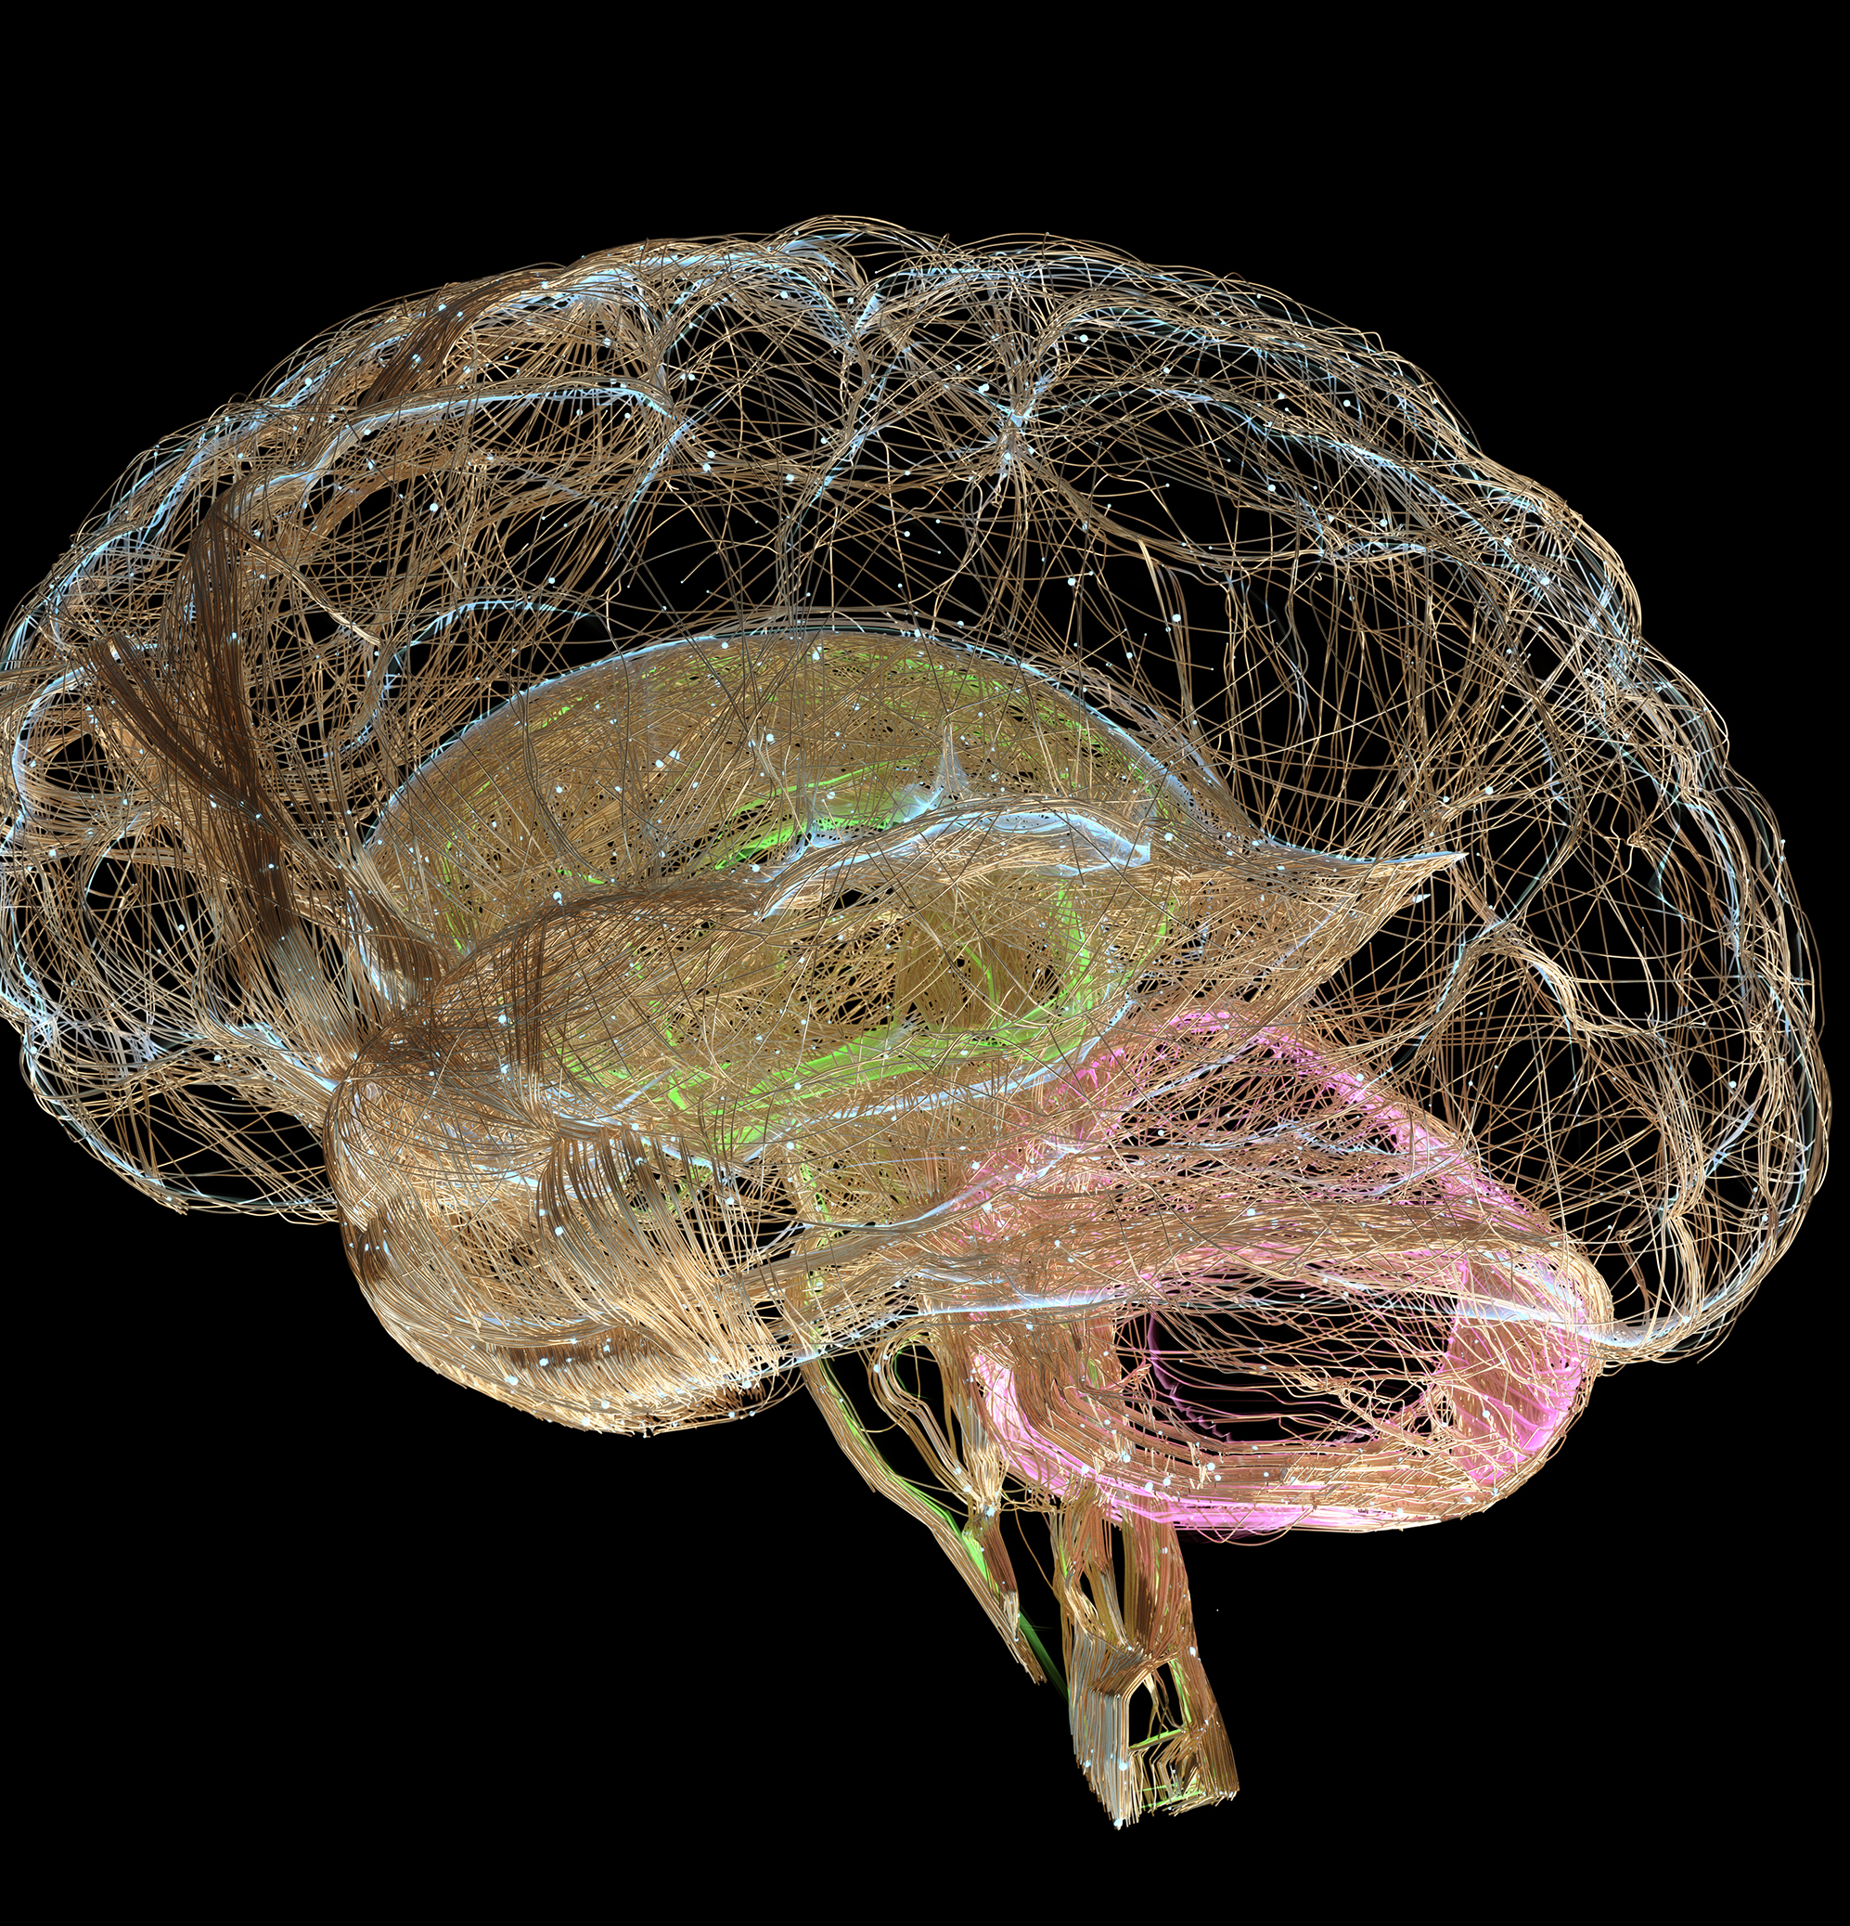
Understanding Individual Health
We have many (psychological) "parts"
A healthy individual pays attention to each of their internal parts, balances their needs, and continues to grow.
Just like your psychology, the biology of your brain is made up of different parts:
The "Thinking brain," the emotion and panic part, and the body maintenance part.
Notes:
While it is a little simplified, the basic outline of the brain is the "Thinking Brain" or the frontal cortex, where most of our planning, ability to direct behavior intentionally, and ability to be thoughtful comes from. We also have a part of our brain where emotions and danger senses start. The basics of fight/flight/freeze in terms of both evolution and experiences/memory (what fires together wires together).
https://www.ncbi.nlm.nih.gov/pmc/articles/PMC8228195/#:~:text=Emotions%20arise%20from%20activations%20of,nucleus%2C%20and%20ventral%20tegmental%20area.
Problem Formation
Parts getting out of balance = survival stances (placator, blamer, superreasonable, irrelevant) AND shoving away disowned parts
We push away unwelcome emotions, we neglect the part that hopes to be cared for, we listen too much to parts that want to please others
Example “parts” of the brain
A thoughtful part, a playful part, a working part, a part that hopes to be cared for, a romantic part, etc.
In talking about brain balance: *So one part doesn't become the only one we use (how trauma blocks).

Slide 6
Skills to Build a Healthy Individual
Balancing the parts of self
Take care of your biology (caution with self-medication; SLEEP)
Manage stress
Take care of each of your psychological parts
Exercise your thinking brain
Use SMART goals to direct what you do
Notes:
Parts of a SMART goal:
Specific (Something that can be DONE with your body, and something a living person can do better than a dead person – active goals to do something rather than to stop doing something)
Meanigful (DON’T SKIP THIS ONE, and no one but you can tell you what is meaningful)
Adaptive (Will this make your life better/more meaningful in the long run
Realistic (if its not a 7/10 with 10 being absolutely certain, chances are it won't work)
Time-framed (the more specific the better)
https://www.actmindfully.com.au/upimages/The_Reality_Slap_-_Appendix_4_-_Goal_Setting.pdf
What do parts need? (are you neglecting hobbies, normally neglecting yourself for others benefit OR neglecting others to protect yourself, are you ignoring a part of that is hurt)
Balancing the parts of self
Take care of your biology (caution with self-medication; SLEEP)
Take care of each of your psychological parts (be playful, do what matters, be bold enough to say discomforting things)
Exercise your thinking brain (be aware of cognitive distortions, think outside the box, mindfully meditate)

Slide 7
Couple Health
Well-functioning couples…...
Connect thoughtfully/intentionally
Negotiate flexible roles and rules
Fight fairly (rather than trying to get our partner to see that we are right)
Maintain interdependence
Notes:
Well-functioning couples:
We tend to get into romantic relationships because they make us feel wanted & valuable, attractive and likable, sexually gratified, and ideologically fulfilled. Protecting those experiences, however, requires intentionality, thoughtfulness, and responsibility. Those sound boring, and truthfully without the first sentence they are. A well functioning couple puts faith (because we can't ever know with complete certainty that these will come through for us) into experiencing the things that make relationships beautiful by working to be interdependent,
The order of well functioning is intentional, starting with interdependence, then moving to connection, then to balance, and finally to fighting fairly (or communicating effectively). The philosophy of the order is to maintain differentiation so that connection can be intentional and thoughtful to build the emotional capacity for work around maintaining balance so that there is as little in the way of communicating effectively and using communication tools intentionally.
Explain interdependence:
A balance between being independent and dependent. Remain aware of what your thoughts, feelings, and beliefs are as separate from your partners thoughts, feelings, and beliefs. We have a bias to believe that our beliefs are common or at least right, that when we feel a certain way other people feel a similar way, and that if we think something chances are someone else will be thinking that too. This is particularly true when you spend significant time with another person, and is heightened when you can predict with reasonable accuracy what another person is thinking or feeling. Mind-mapping is sometimes a part of empathy and showing another person that you are trying to be in-tune with what is important to them, but mistakes are inevitable and when you are overconfident in your mapping skills it leads to unmet expectations and frustration. When we feel threatened emotionally most of us have a tendency to either seek approval or assert our "rightness." When taken to an extreme this leads to emotional dependence and despair WHEN the other person cannot follow through OR emotional disconnection after losing faith that the other person won't be there for you (which often leads to a self-fulfilling prophecy).
When we fight to win rather than fighting fairly we tend to either vindicate ourselves or prove a point through criticizing, show our dominance through contempt (or fall on our sword as a martyr), or shut down to avoid any further damage.
Balance roles and rules, maintain an interdependence in emotional boundaries (allow themselves to rely on another person without expecting them to take ownership of your experiences and beliefs), fight fairly (use complaints rather than criticisms, make reasonable requests before demands, be assertive and authentic without being aggressive or complacent), connect thoughtfully (spend time together in ways that both appreciate, be mindful of self and cooperative with partner during sex, maintain a friendship – fun, laughter, shared interests, etc.)

Slide 8
Skills to Build a Healthy Couple
Attend to what is mine first; then care for what is theirs
Say "I" instead of "you"; "and" instead of "but", compromise when you can; balance the pain with joy and kindness.
Lean into curiosity ("Help me understand..."; be able to say "I was wrong").
Build Rituals......Plan SMART time together (*make the relationship a priority).
Discuss and balance roles; including asking for help.
Notes:
SMART goal for couples with example:
Specific (kiss at the door)
Motivated by value (being the kind of partner who shows partner appreciation; for connection)
Adaptive (does this work for me in the long run?; a kiss at the door fits within our couple relationship and long-term capacity)
Realistic (easily added)
Time specific/bound (will happen when I leave for work)

Slide 9
Healthy Children and Families
Flexible Parenting
Warmth balanced with structure
Emotion Guides
Active involvement as guides on understanding emotions and guiding behaviors
Facilitating Child’s Use of Voice
Help children find the language, safety, and space to use their voice
Consistency Over Grandiosity
We spell “love” with TIME
Parenting that adapts as children grow
Everyday consistency does more than grand gestures

Slide 10
Skills to Build a Healthy Parent-Child Relationship
Become Predictable
Plan out specific routines and what to do when routines go off the rails
Practice what you preach
Play alongside your children
Praising the positive gets you further than pointing out the problems
use logically connected consequence when you need to use consequences to reinforce your lesson.
Notes:
Teach parents about what to expect, and help them construct the way they want to respond at different ages and stages
Become Predictable
Plan out specific routines (bedtimes, off-to-school, holiday traditions, chore/homework expectations) and what to do when routines go off the rails
Practice what you preach (if you have rules around electronic use, chores, language, follow similar rules yourself; do expected chores alongside or in view of children; expect your children to become echoes of what you say.)
Play alongside your children (varies by age and personality)
Praising the positive gets you further than pointing out the problems
Go out of your way to let your kids know what they do well
When you need to help children change their behavior be specific, as calm as you can be (even if you need to step away to breath for a moment), and use logically connected consequence when you use consequences to reinforce your lesson.
In therapy – we spend a lot of time educating parents about developmental needs of children and ways they can facilitate children's use of voice....
Build connections between parents and children
Help parents really listen to what a child is saying with their words and behaviors
Help parents respond intentionally rather than reactively
Interrupts the transmission of intergenerational trauma or excessively harsh/permissive parenting
Ultimately works to help parents become a child's "therapist"

Slide 11
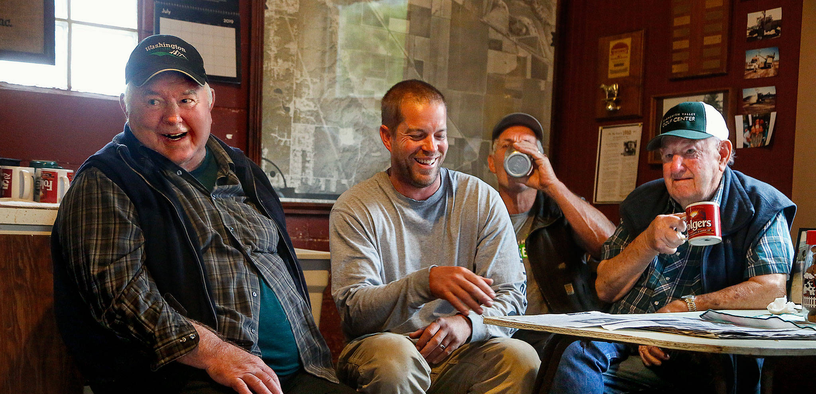
Key Takeaways:
No person is an island
Flexibility is the spice of life
Genuine/caring communication works
Healthy individuals support healthy relationships and families (and rural communities)

Slide 12
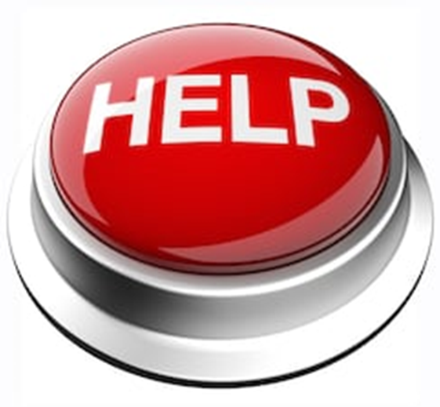
Where to Find Help (*put in your phone contacts list)
•988 (was 211)
•NAMI helpline 1-800-950-6264 (NAMI) or info@nami.org
•Suicide Hotline 1-800-273-8255
•Ok Child Abuse Hotline 1-800-522-3511
•Disaster Distress helpline 1-800-985-5990
•Text: TALKWITHUS to 66746
•Crisis Text 24/7: Text HELLO to 741741

