Slide 1
Bone Broth: Is it the Newest Elixir?
Christi Evans, MS, RD
Assistant State Specialist, Food Safety
Oklahoma State University Extension

Slide 2
Objectives
Define bone broth.
Discuss the current trends and health claims.
Look at the scientific evidence related to bone broth.
Discuss how you can safely prepare, store, and preserve broth at home.

Slide 3
Broth vs. Stock vs. Bone Broth
Broth: Liquid cooked with meat or vegetables.
Stock: Liquid made from simmering meat bones long with herbs, spices, and vegetables.
Bone Broth: Another name for stock but usually cooked longer.
Might be cooked for 24 hours or more.
Longer cooking process extracts minerals and gelatinous material from bones.
Sometimes vinegar is added to help extract minerals.

Slide 4
Claimed Health Benefits
Relives arthritis.
Helps wounds heal faster.
Improves gut health.
Improves the immune system.
Aids digestion.
Important for hair and skin.
Improves joint health.
Improves brain health.
Fight off colds and flu.
Rebuild bones with collagen.
Benefits the kidneys.
Improves sleep.

Slide 5
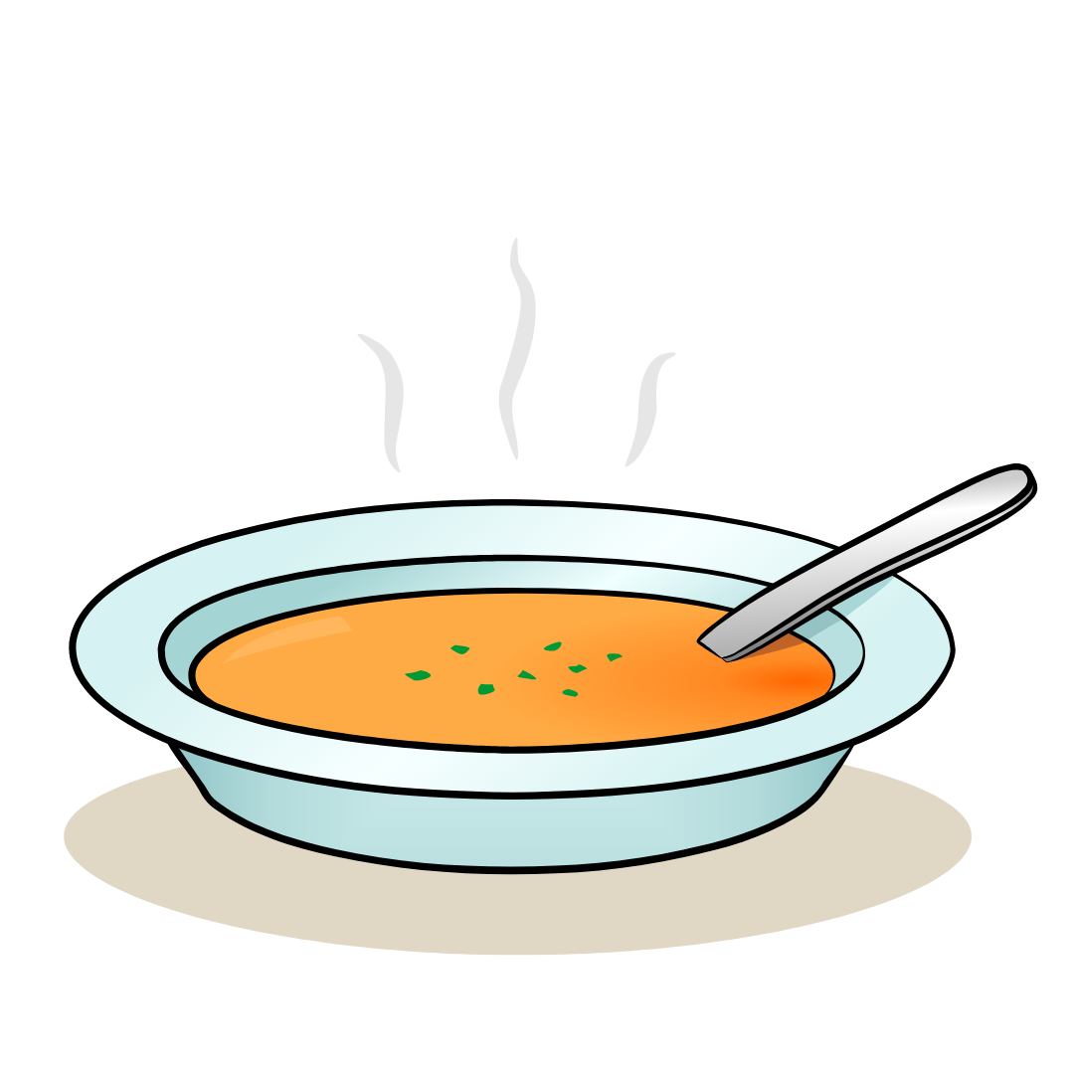
Bone Broth Is Not a New Food
Broths made from simmering bones and vegetables in water have been around for centuries.
Sipping warm soups is common in cold weather.
Soups and broths are often consumed when ill.

Slide 6
Bone Broth Nutrition Facts
Nutritional value varies with the ingredients used.
Example from USDA FoodData Central:
Serving Size= 100g (less than 4 ounces)
Calories = 33
Protein = 4g
Carbohydrates = 2g
Fat = trace
NOT A SIGNIFICANT SOURCE OF SATURATED FAT, TRANS FAT, CHOLESTEROL, DIETARY FIBER, SUGARS, VITAMIN A, VITAMIN C, AND CALCIUM.
https://fdc.nal.usda.gov/

Slide 7
Nutritional Profile of Bone Broth
Protein
Amino acids
Collagen
Minerals
Iron
Calcium
Magnesium
Phosphorus
Other compounds
Glucosamine
Chondroitin

Slide 8
Protein
Makes up our muscles.
A nutrient that the body needs for growth and maintenance.
Important for our hair, skin, eyes, and body organs.
Other functions include forming blood cells and making antibodies to protect us from illness and infection.

Slide 9
Amino Acids
The building blocks of protein.
There are 20 amino acids - 9 are essential and must come from the food we eat.
The body takes these amino acids and links them together to make the different proteins the body needs.

Slide 10
Collagen
Makes up about 30 percent of the protein in our bodies.
A structural protein that provides support and elasticity.
Binds our bones, tendons, ligaments, cartilage, muscles, blood vessels, corneas, and other parts of our bodies.

Slide 11
Minerals
Nutrients our bodies needs.
Calcium, iron, magnesium, phosphorus, zinc, and more.
Make up our bones and teeth.
Help maintain acid-base balance to keep a neutral pH.
Regulate body processes and enzyme systems.
Transmit nerves impulses and muscle contractions.
Help release energy from food.

Slide 12
Glucosamine and Chondroitin
Components of cartlidge in the joints.
Glucosamine helps build the structure of cartlidge.
Chondroitin in cartlidge plays a role in the resistance to compression.
Often sold as dietary supplements to aid osteoarthritis.

Slide 13
Scientific Evidence
Bone broth is a good source of protein, minerals, and electrolytes.
Bone broth does NOT provide complete nutrition.
Our bodies get amino acids to produce collagen by consuming a well-balanced diet.
Eating collagen-rich broth does not mean that the collagen becomes collagen in our bodies.
Studies on glucosamine and chondroitin have had inconsistent results.
It’s important to eat a variety of foods.

Slide 14
Commercial Bone Broths
Ingredients and nutritional value can vary.
Can be found in powder forms.
Prices can vary.
May be high in sodium.
Important to read the labels.

Slide 15
Making Bone Broth at Home
You have control over the ingredients.
You determine the preparation method and cooking time.
Can help reduce food waste.

Slide 16
Food Safety with Bone Broth
Safe preparation
Always wash hands before, during, and after preparing food, especially after handling raw meat and poultry.
Clean kitchen surfaces, utensils, cutting boards, etc. after contact with raw meat and poultry.
Safe storage
Keep raw meat and poultry separate from other foods while shopping and in the refrigerator.
Keep raw meat and poultry in sealed containers to prevent leaking onto other foods.
Cook and reheat foods thoroughly, according to recommended temps.
Leftovers should be heated to 165°F.

Slide 17
Storing Bone Broth
Commercially produced canned broth can be stored in the pantry according to use-by date.
Home canned broth can be stored up to one year.
Must be refrigerated after opening.
Leftovers should be used within 3-4 days, if refrigerated.
Use within 2-3 months, if frozen.

Slide 18
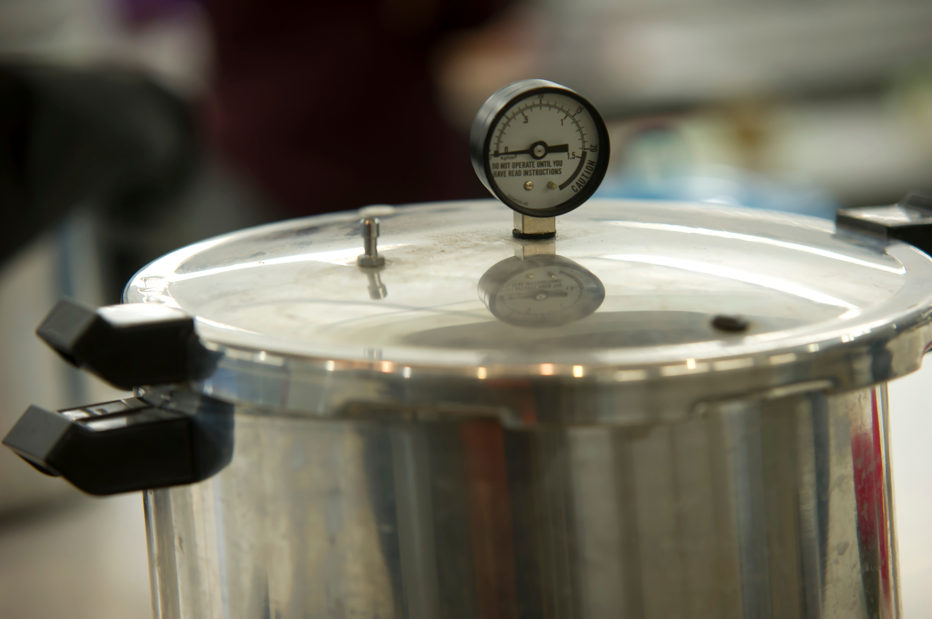
Home Canning
Recipes can be found at National Center for Home Food Preservation
https://nchfp.uga.edu
Meat, poultry, and vegetables are low acid foods.
Low acid foods must be processed at 240° to 250°F to destroy Clostridium botulinum bacteria.
Bone broth (stock) must be processed in a pressure canner.

Slide 19
Home Canned Beef Stock
Start with fresh trimmed beef bones.
Rinse bones with water.
Place in pot, cover bones with water, add lid, and simmer for 3-4 hours.
Remove bones and let cool.
Skim excess fat, then reheat to boiling.
Reheat to boiling and fill jars, leaving 1” headspace.
Wipe rims of jars and cover with a clean, unused lid and band.
Process in pressure canner.
20 min (pints) or 25 min (quarts) at 10 lb psi for weighted gauge or 11 lb in a dial gauge canner
Will need to adjust for altitude.

Slide 20
Home Canned Chicken or Turkey Stock
Start with carcass bones, meat removed, in a large stockpot.
Cover bones with water, add lid, and simmer for 30-45 minutes.
Remove bones, cool broth and discard fat.
Reheat to boiling and fill jars, leaving 1” headspace.
Wipe rims of jars and cover with a clean, unused lid and band.
Process in pressure canner.
20 min (pints) or 25 min (quarts) at 10 lb psi for weighted gauge or 11 lb in a dial gauge canner
Will need to adjust for altitude.

Slide 21
Conclusion
We get the nutrients our bodies need by eating a well-balanced diet.
Bone broth can be consumed as part of a healthy diet.
It’s important to eat a variety of foods.
Follow food safety practices for food preparation and storage.
Home canned stocks and broths must be processed in a pressure canner.

Slide 22
Sources
https://www.bestfoodfacts.org/bone-broth-magic-elixir-trendy-soup/
https://fdc.nal.usda.gov/fdc-app.html#/food-details/1814781/nutrients
https://www.nccih.nih.gov/health/glucosamine-and-chondroitin-for-osteoarthritis-what-you-need-to-know
https://nchfp.uga.edu

