Slide 1
Alpha-gal Syndrome
Presented by
Janice Hermann, PhD, RD/LD
Oklahoma Cooperative Extension Service Nutrition Specialist
Professor, Department of Nutritional Sciences

Slide 2
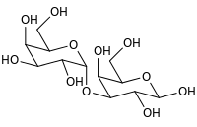
What is Alpha-gal?
Alpha-gal is not a female leader of the pack.
Alpha-gal (galactose-α-1,3-galactose) is a sugar molecule.
Photo Unsplash: Taylor; Figure Galactose-alpha-1,3-galactose Wikipedia
Notes:
What is Alpha-gal?
Alpha-gal is not a female leader of the pack.
Alpha-gal (galactose-α-1,3-galactose) is a sugar molecule.

Slide 3
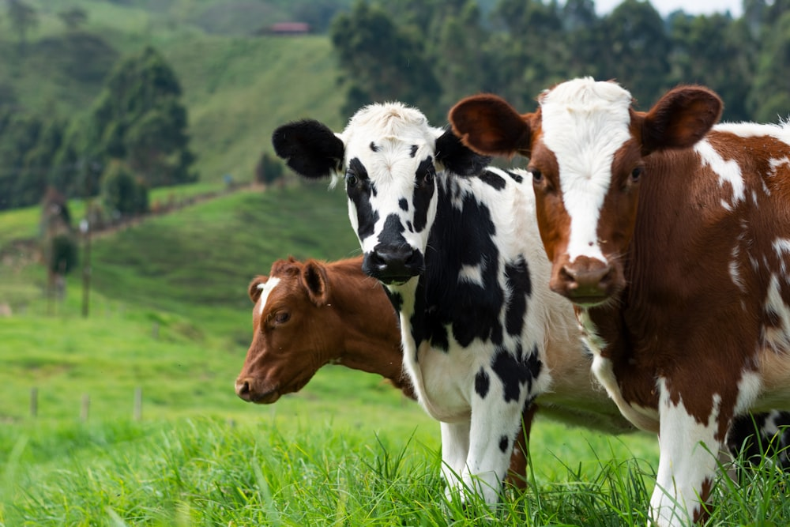
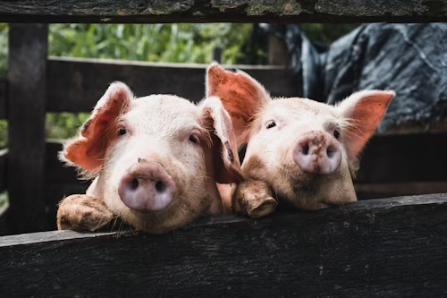
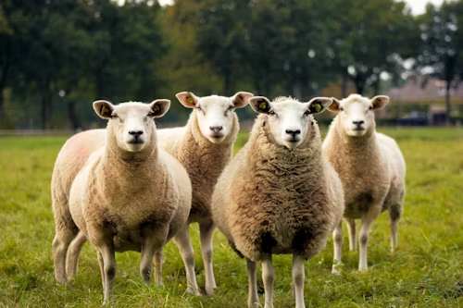
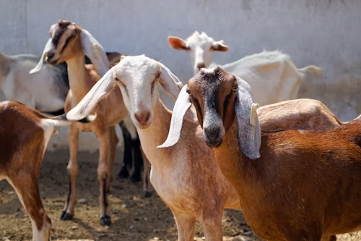
Alpha-gal is a found in most non-primate mammals, and products made from mammals
Photos Unsplash: Daniel Quiceno M, Annika Terial, Jorge Salvador, Bryce Olsen, Judith Prins, Kenneth Schipper Vera, Aswathy N, Divide by Zero
Notes:
Alpha-gal
Alpha-gal is found in most non-primate mammals:
Cows
Pigs
Rabbits
Lambs
Venison (deer)
Goats
Bison, buffalo
Horses, etc.
And products made from mammals, including:
Cow’s milk,
Milk products
Gelatin, etc.

Slide 4
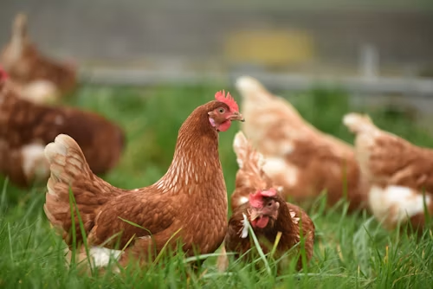
Alpha-gal is not found in people, birds, fish & reptiles
Photos Unsplash: Tylor Nix, Thomas Iversen, Ellisa Stone, Sebastian Pena Lambearri, sipppakom yamkasikom, Wexor Tmg
Notes:
Alpha-gal
Alpha-gal is not found in primates (people), fish, birds, and reptiles.

Slide 5
Alpha-gal Syndrome (AGS)
AGS is a serious, potentially life-threatening allergic reaction.
Also called alpha-gal allergy, red meat allergy, or tick bite meat allergy.
AGS symptoms occur in some people, who have been bitten by a tick, after they have eaten mammalian meat or other products containing alpha-gal.
Notes:
Alpha-gal Syndrome (AGS)
Alpha-gal syndrome (AGS) is a serious, potentially life-threatening allergic reaction.
Also called alpha-gal allergy, red meat allergy, or tick bite meat allergy.
AGS symptoms occur in some people, who have been bitten by a tick (mostly the Lone Star tick in U.S), after they have eaten mammalian meat or other products containing alpha-gal.

Slide 6
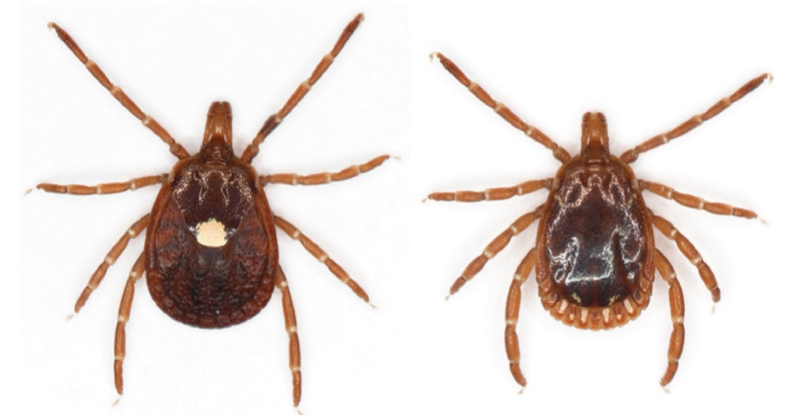
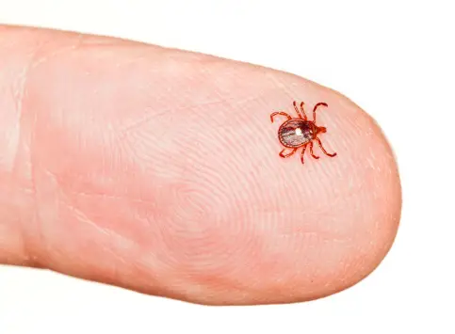
AGS and Lone Star Tick Bites
In U.S., evidence suggests AGS associated with Lone Star tick bite.
Other ticks not ruled out.
Research underway to understand role ticks play in starting AGS.
Female
Male
Lone Star Tick Size
Notes:
Can I get AGS from a tick bite?
Evidence suggests, that in the U.S., AGS is primarily associated with the bite of a Lone Star tick, but other kinds of ticks have not been ruled out (Blacklegged tick in the U.S.)
Exposure to alpha-gal from a tick bite triggers an immune response causing the body to form antibodies (alpha-gal sIgE) to the alpha-gal.
Once IgE (antibodies) to alpha-gal reaches sufficient levels, ingestion of mammalian meat can trigger reactions (can take weeks to months).
More research is needed to understand the role ticks play in starting this condition, and why certain people develop AGS.
Alpha-gal found in the saliva of lone star ticks – but more research needed to understand why exposure to alpha-gal through a tick bite triggers AGS.
Is alpha-gal naturally present in tick saliva.
Is alpha-gal in tick saliva from previously feeding on mammals.
Is the alpha-gal in tick saliva reacting to another compound in the tick saliva.

Slide 7
AGS Recently Recognized, Often Under-Diagnosed
AGS has only relatively recently been recognized
AGS in under-recognized
2023 CDC report found:
42% of health care providers had limited knowledge of AGS
35% were not confident in their ability to diagnose or manage AGS in patients.
Concerning because number of suspected cases is increasing and range of tick, primarily associated with AGS is expected to expand.
Notes:
AGS Fairly Recently Recognized
AGS has only relatively recently been recognized
AGS is under-diagnosed.
2023 CDC report found:
42% of health care providers had limited knowledge of AGS.
35% were not confident in their ability to diagnose or manage AGS in patients
Concerning because the number of suspected cases is increase, and the range of the tick primarily associated with this condition is expected to expand.

Slide 8
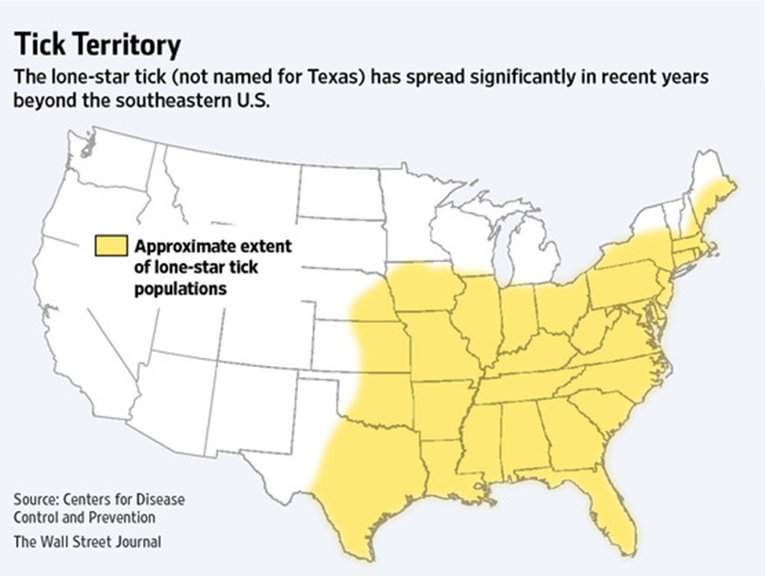
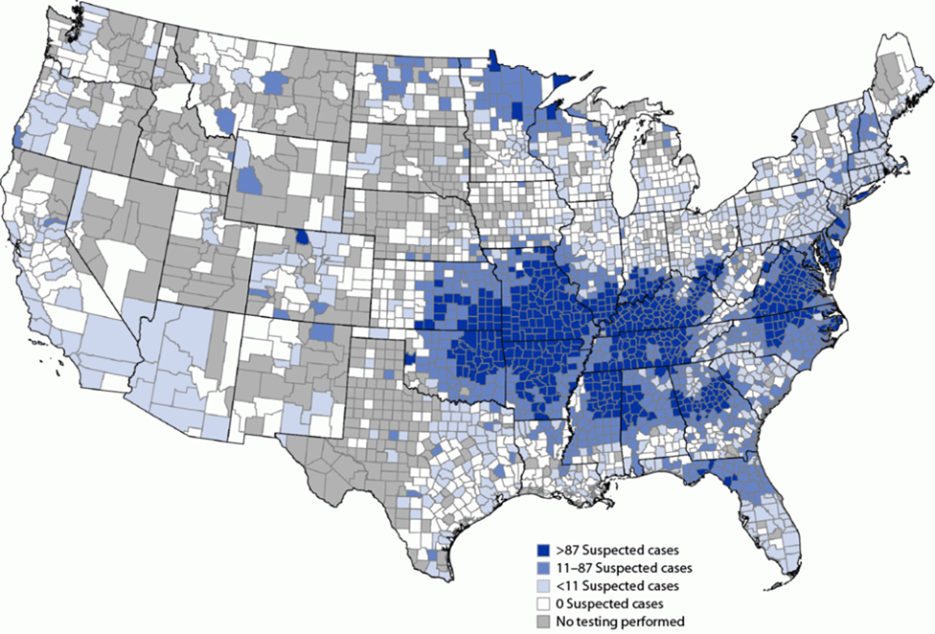
Lone Start Ticks in the United States
Between 2010 and 2022, more than 110,000 suspected cases of AGS identified; however, AGS not nationally notified to CDC
Notes:
Location of Lone Star Ticks in the United States
Lone Star ticks are found through the southeastern and eastern United States.
Lone Star ticks are moving westward.
Between 2010 to 2020, more than 110,00 suspected cases of AGS were identified. However, AGS cases are not nationally notified to CDC, so it is not know how many cases of AGS exist in the U.S.

Slide 9
Novel AGS Features
Alpha-gal is a carbohydrate; food allergies are typically to proteins.
AGS symptoms delayed, 2-6 hours after eating mammalian meat.
Most food allergy symptoms develop within a few minutes to 2 hours after exposure.
Most people who develop AGS able to eat mammalian meats prior to a tick bite.
Notes:
Novel AGS Features
Alpha-gal is a carbohydrate; whereas, most food allergies are to proteins in food.
Symptoms of AGS are delayed, 2-6 hours (NOTE TO EDUCATOR: Different ranges have been reported: 2-6 hours and 3-8 hours) after eating mammalian meat; whereas, most food allergy symptoms develop within a few minutes to 2 hours after.
Delayed AGS symptoms are believed to be due to the slow digestion and absorption of alpha-gal in the body.
Also delayed reactions to alpha-gal often occur late in the evening or in the middle of the night.
SIDE NOTE TO EDUCATOR: AGS symptoms from food are delayed, but AGS symptoms to the cancer drug Cetuximab (which contains alpha-gal is more immediate, but the cancer drug is injected so the alpha-gal is not having to be digested and absorbed through the gastrointestinal tract.
Most people who develop AGS were able to eat mammalian meats prior to a tick bite.
So people who were previously able to eat mammalian meats were exposed to alpha-gal in the meat; but something is happening to the alpha-gal in the tick so that after being bitten and exposed to alpha-gal through the bite triggers the syndrome.

Slide 10
AGS Symptoms
Skin:
Hives, itching, flushing
Swelling of the lips, throat, tongue, eye lids, or face
Gastrointestinal:
Abdominal pain, cramping
Diarrhea
Heartburn or indigestion
Nausea or vomiting
Lung:
Cough
Shortness of breath, wheezing, or difficulty breathing
Other:
Drop in blood pressure
Dizziness or faintness
Heart palpitations
Notes:
AGS Symptoms
Skin:
Hives, itching, flushing
Swelling of the lips, throat, tongue, eye lids, or face
Gastrointestinal:
Abdominal pain, cramping
Diarrhea
Heartburn or indigestion
Nausea or vomiting
Lung:
Cough
Shortness of breath, wheezing or difficulty breathing
Other:
Drop in blood pressure
Dizziness or faintness
Heart palpitations

Slide 11
AGS Symptoms - continued
Symptoms commonly appear 2-6 hours after eating meat or dairy products, or after exposure to products containing alpha-gal
Alpha-gal reactions differ from person-to-person.
They can range from mild to severe or even life-threatening.
Not all people bitten by a Lone Star tick develop AGS.
People who have AGS may not have an allergic reaction after every alpha-gal exposure.
Not all people have reactions to every ingredient containing alpha-gal.
Notes:
AGS Symptoms
Alpha-gal symptoms commonly appear 2-6 hours (NOTE TO EDUCATOR: different ranges reported: 2-6 hours and 3-8 hours) after eating meat or dairy products, or after exposure to products containing alpha-gal.
The delayed appearance of symptoms may be to slower digestion and absorption of the alpha-gal sugar molecule.
Alpha-gal reactions can be different from person-to-person.
They can range from mild to severe or even life-threatening.
Anaphylaxis is a potentially life-threatening reaction involving multiple organ systems and may need urgent medical care.
Not all people bitten by a Lone Star tick develop AGS.
People who have AGS may not have an allergic reaction after every alpha-gal exposure.
Not all people have reactions to every ingredient containing alpha-gal.

Slide 12
AGS Diagnosis
AGS is diagnosed by an allergist or other healthcare provider:
Detailed patient history.
Physical examination.
Main diagnostic test for AGS is a blood test looking for specific antibodies (proteins made by your immune system) to alpha-gal.
Immunoglobulin-E antibodies specific to alpha-gal (alpha-gal sIgE)
Healthcare provider may also recommend allergy skin testing.
Notes:
AGS Diagnosis
AGS is diagnosed by an allergist or other healthcare provider through:
Aa detailed patient history
Physical examination
Blood test that looks for specific antibodies (proteins made by your immune system) to alpha-gal.
The main diagnostic test for AGS is a blood test looking for immunoglobulin-E antibodies specific to alpha-gal (alpha-gal sIgE).
Your healthcare provider may also recommend allergy skin testing.
Skin tests documenting reaction to certain allergens (such as pork or beef) may also be used to support a diagnose of AGS.

Slide 13
Foods To Avoid If You Have AGS
Most healthcare providers recommend people with AGS stop eating mammalian meat.
Beef, pork, lamb, venison (deer), rabbit, goat, bison, buffalo, horse etc.
Based on sensitivity and severity of allergic reaction, your healthcare provider may also suggest you avoid other foods and ingredients which may contain alpha-gal, such as:
Cow or goat milk
Milk-products
Gelatin, etc.
Notes:
Foods to Avoid If You Have AGS
REMEMBER: Not all people with AGS have reactions to every ingredient containing alpha-gal.
Most healthcare providers recommend people with AGS stop eating mammalian meat
Such as beef, pork, lamb, venison (deer), rabbit, goat, bison, buffalo, horse, etc.
Depending on your sensitivity and the severity of your allergic reaction, your healthcare provider may also suggest you avoid other foods and ingredients which may contain alpha-gal.
Such as cow’s milk, goat-milk, milk-products, and gelatin, etc..

Slide 14
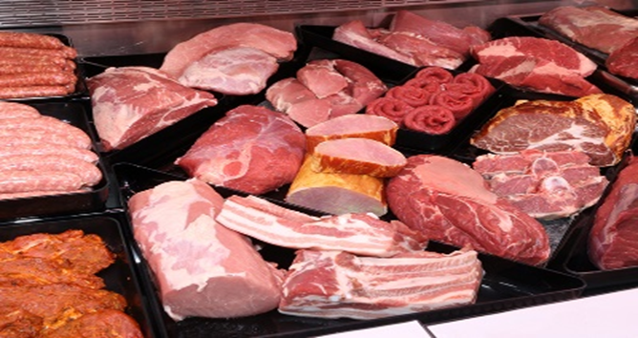
Alpha-gal and Mammalian Meat
Mammalian meat contains high amounts of alpha-gal.
Certain cuts may contain more alpha-gal than others.
Organ meats and those with high mammalian fat
Notes:
Alpha-gal and Mammalian Meat
Mammalian meat contains high amounts of alpha-gal.
Such as beef, pork, lamb, venison (deer), rabbit, goat, bison, buffalo, horse, etc).
Certain cuts of meat may contain more alpha-gal than others.
Organ meats and those with high mammalian fat.
For example, organ meat of mammals, including liver, lung, heart, kidneys, intestines (tripe), sweetbreads, scrapple, and Rocky Mountain or prairie oysters generally contain high amounts of alpha-gal.

Slide 15
Alpha-gal and Milk and Milk Products
Cow and goat milk and milk products and foods containing milk and milk products typically contain alpha-gal.
Many people with AGS (80-90%) can tolerate milk and milk products.
Cow’s milk is the only alpha-gal containing ingredient classified as a major food allergen.
Food labels must clearly identify the food source names of any ingredients that are one of the major food allergens or contain protein derived from a major food allergen in the ingredient list or a separate “Contains” statement.
Notes:
Alpha-gal and Milk and Milk Products
Cow and goat milk and milk products and foods containing cow and goat milk and milk products typically contain alpha-gal.
Many patients with AGS can tolerate milk products.
About 80-90% of people with AGS can tolerate milk and milk products.
Cow’s milk is the only alpha-gal containing ingredient classified as a major food allergen.
Under the Food Allergen Labeling Requirements of the Food, Drug, and Cosmetic Act, food labels must clearly identify the food source names of any ingredients that are one of the major food allergens or contain protein derived from a major food allergen in the ingredient list or a separate “Contains” statement.

Slide 16
Alpha-Gal and Mammalian Meat By-Products
Some people with AGS may also be sensitive to alpha-gal found in:
Gelatin made from beef or pork.
Products made from or cooked with mammalian fat (lard, tallow, or suet).
Meat broth, bouillon, stock, and gravy.
Caution with food listing “natural flavorings” may be from mammalian sources.
Notes:
Alpha-gal and Mammalian Meat By-Products
Some people with AGS may also be sensitive to alpha-gal found in
Gelatin made from beef or pork.
Most gelatin is from beef or pork; however, there are vegetarian gelatins.
Products made from or cooked with mammalian fat (such as lard, tallow, or suet).
Inquire about fried foods. Some restaurants add lard or suet to fryer.
Meat broth, bouillon, stock, and gravy.
Caution of foods label listing “natural flavorings” – they may be mammalian sources.

Slide 17
Gelatin Is In Many Foods
Just a few foods that may contain gelatin:
Gelatin desserts
Most gummy candy, fruit chews, gumdrops, jellybeans
Marshmallows
Puddings, yogurt, ice cream
Frosting
Dips
Commercially prepared sauces, soups, broths
Commercially prepared cakes
Wines
Sausage casing
Read food product labels carefully.
Notes:
Gelatin Is In Many Foods
Gelatin is an ingredient used in a variety of common grocery and health products.
Gelatin functions as a gelling agent, contributes to a smooth palatable texture, and can be used as a thickening or whipping agent.
Just a few foods that may contain gelatin:
Gelatin desserts
Most gummy candy, fruit chews, gumdrops, jellybeans
Marshmallows
Puddings, yogurt, ice cream
Frosting
Dips
Commercially prepared sauces, soups, broths
Commercially prepared cakes
Wines
Read food product labels carefully.

Slide 18
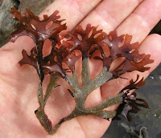
Unexpected Source: Carrageenan
Carrageenan is known to contain alpha-gal epitopes
Reaction risk is quite low (1-2%).
Carrageenan is extracted from red edible seaweeds
Widely used in food industry as thickener and stabilizer.
Can be included in plant-based foods such as nut ‘milks’, which otherwise would be alpha-gal free.
Can occur in unsuspected products:
Toothpaste.
Beer.
Personal lubricants.
Shampoos.
Carrageen can go by many names
Notes:
Unexpected Source: Carrageenan
Carrageenan is known to contain alpha-gal epitopes, evidence suggests the risk of reaction appears to be quite low (1-2% of people with AGS).
Carrageenan (a phycocolloid polysaccharide) is extracted from red edible seaweeds
Carrageenan is widely used in the food industry as a thickener and stabilizer.
A problem with carrageenan is that it can be included in plant-based foods such as nut ‘milks’, which otherwise would be alpha-gal free.
Carrageenan can occur in unsuspected manners: toothpaste, beer, personal lubricants, and shampoos.
Other names for carrageenan
PES (processed Eucheuma seaweed)
Carogeenan gum
Chodrus
Carrageenin
Irish moss, Irish moss extract, Irish moss gelose
Vegetable gelatin, Norsk gelatin
Danish agar
Carastay, Carastay C
Eucheuma spinosum gum
Marine colloids
Red (Rhodophycease) seaweed extract

Slide 19
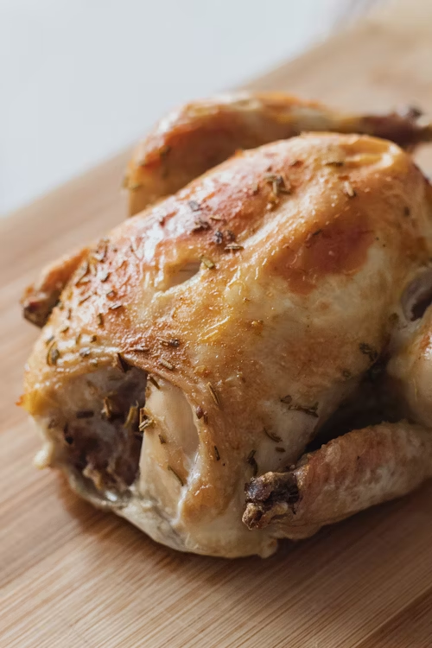
Foods That DO NOT Contain Alpha-gal
Animal foods:
Poultry, such as chicken, turkey, duck or quail
Eggs
Fish and seafood, such as shrimp
Plant foods:
Grains
Fruits
Vegetables
Beans, peas, legumes and lentils
However, alpha-gal containing ingredients can be added to these foods.
Photos Unsplash: Tofan Teodor, Katherine Chase, CA Creative, Engin Akyurt, Tomasz Flipek
Notes:
Foods That DO NOT Contain Alpha-gal
Animal foods:
Poultry, such as chicken, turkey, duck or quail
Eggs
Fish and seafood, such as shrimp
Plant foods:
Grains
Fruits
Vegetables
Beans, peas, legumes and lentils
However, alpha-gal containing ingredients can be added to thsre foods.

Slide 20
Non-Food Products That May Contain Alpha-Gal: Some Medications and Vaccines
Although very rare, some people with severe AGS may react to ingredients in certain vaccines or medications.
Some may contain small amounts of alpha-gal-containing additives, stabilizers, or coatings.
Cancer drug Cetuximab (Erbitux®)
Gelatin capsules (“gel-caps”) are used for many medications.
Talk to healthcare provider before taking a new medication or receiving a vaccine.
No comprehensive lists of alpha-gal containing medications.
Healthcare providers/pharmacists can look for products containing ingredients such as gelatin, glycerin, magnesium stearate, and bovine extract.
Notes:
Non-Food Products That May Contain Alpha-Gal: Some Medications and Vaccines
Although very rare, some people with severe AGS may react to ingredients in certain vaccines or medications.
Some medications and vaccines may contain small amounts of alpha-gal-containing additives, stabilizers, or coatings.
Examples:
Cancer drug Cetuximab (Erbitux®)
Gelatin capsules (“gel-caps”) are used for many medications.
Talk to your healthcare provider before taking a new medication or receiving a vaccine.
There is no comprehensive lists of alpha-gal containing medications.
Healthcare providers/pharmacist can look for products containing ingredients such as gelatin, glycerin, magnesium stearate, and bovine extract.
Glycerin and magnesium stearate can be derived from animal sources.

Slide 21
Non-Food Products That May Contain Alpha-Gal: Other Medical Products
Other medical products are animal-derived and may contain alpha-gal, such as:
Heart valves from pigs or cows
Monoclonal antibodies
Heparin
Certain anti-venoms.
Notes:
Non-Food Products That May Contain Alpha-Gal
Other medical products, such as heart valves from pigs or cows, monoclonal antibodies, heparin, and certain antivenoms are animal-derived and may contain alpha-gal.
As with any severe allergy, patients with AGS should work with their healthcare providers to make decisions about individual risk and benefit from specific vaccines and medications.

Slide 22
If You Have AGS
AGS should be treated and managed under the care of an allergist or other healthcare provider
Many foods and products contain alpha-gal; you need to work with your healthcare provider to understand which products you need to avoid.
A registered/licensed dietitian can to help you identify hidden sources of alpha-gal.
Notes:
If You Have AGS
AGS should be treated and managed under the care of an allergist or other healthcare provider.
Many foods and products contain alpha-gal; you will need to work with your healthcare provider to understand which products you need to avoid.
It may be helpful to work with a registered/licensed dietitian to help you identify hidden sources of alpha-gal.

Slide 23
If You Have AGS - continued
AGS symptoms can be exacerbated if foods containing alpha-gal are consume coupled with other factors such as:
Alcohol.
Exercise.
People with AGS must read food product labels carefully.
Notes:
If You Have AGS - continued
AGS symptoms can be exacerbated if foods containing alpha-gal are consume coupled with other factor as alcohol and exercise.
Also possibly stress, lack of sleep, illness, infections and menses.
People with AGS must read food product labels carefully.

Slide 24
If You Have AGS – continued2
AGS symptoms can be severe, and even life-threatening.
Seek immediate emergency care if you are having a severe allergic reaction.
You may need to carry an epinephrine pen.
Prevent tick bites.
New tick bites may reactivate allergic reactions to alpha-gal.
Notes:
If You Have AGS – continuted2
AGS can be severe, and even life-threatening.
Seek immediate emergency care if you are having a severe allergic reaction.
You may need to carry an epinephrine pen.
Prevent tick bites.
New tick bites may reactivate allergic reactions to alpha-gal.

Slide 25
Avoid Additional Tick Bites
People with AGS should avoid tick bites.
New tick bites may reactive allergic reactions to alpha-gal.
Notes:
Avoid Additional Tick Bites
People with AGS should avoid additional tick bites.
New tick bites may reactive allergic reactions to alpha-gal.

Slide 26
Is AGS A Lifelong Condition?
Some evidence suggests that alpha-gal containing foods may be safely reintroduced in people after long periods of avoiding alpha-gal and tick bites.
Work with your healthcare provider.
Notes:
Is AGS A Lifelong Condition?
Some evidence suggests that products may be safely reintroduced in people after long periods of avoiding alpha-gal and tick bites.
Work with your healthcare provider.

Slide 27
Preventing AGS
Preventing tick bites reduces risk of tick-borne diseases and AGS.
Before you go outdoors
Avoid grassy, brushy, and wooded areas, where ticks may be found.
Treat clothing and gear with permethrin or buy pre-treated items.
Use Environmental Protection Agency - registered insect repellents.
Photos: CDC Tick Image Gallery
Notes:
Preventing AGS
Preventing tick bites is important in preventing tick-borne disease and may reduce your chances of developing AGS.
Before you go outdoors
Avoid grassy, brushy, and wooded areas, where ticks may be found.
Treat clothing and gear with permethrin or buy pre-treated items.
Use Environmental Protection Agency (EPA)-registered insect repellents.
After you come indoors
Check your clothing for ticks.
Examine gear and pets for ticks.
Shower and perform a thorough tick check.
If you see an attached tick, remove it immediately.
Take steps to prevent ticks on you pets and in your yard.

Slide 28
Preventing AGS - continued
After you come indoors
Check your clothing for ticks.
Examine gear and pets for ticks.
Shower and perform a thorough tick check.
If you see an attached tick, remove it immediately.
Images: CDC Tick Image Gallery
Notes:
Preventing AGS
After you come indoors
Check your clothing for ticks.
Examine gear and pets for ticks.
Shower and perform a thorough tick check.
If you see an attached tick, remove it immediately.
Take steps to prevent ticks on you pets and in your yard.

Slide 29
Questions?
Thank You for Coming!

Slide 30
USDA
United States Department of Agriculture
Non-Discrimination Statement
In accordance with Federal civil rights law and U.S. Department of Agriculture (USDA) civil rights regulations and policies, the USDA, its Agencies, offices, and employees, and institutions participating in or administering USDA programs are prohibited from discrimi­nating based on race, color, national origin, religion, sex, gender identity (including gender expression), sexual orientation, disability, age, marital status, family/parental status, income derived from a public assistance program, political beliefs, or reprisal or retaliation for prior civil rights activity, in any program or activity conducted or funded by USDA (not all bases apply to all programs). Remedies and complaint filing deadlines vary by program or incident.
Persons with disabilities who require alternative means of communication for program information (e.g., Braille, large print, audio­tape, American Sign Language, etc.) should contact the responsible Agency or USDA's TARGET Center at (202) 720-2600 (voice and TTY) or contact USDA through the Federal Relay Service at (800) 877-8339. Additionally, program information may be made available in languages other than English.
To file a program discrimination complaint, complete the USDA Program Discrimination Complaint Form, AD-3027, found online at How to File a Program Discrimination Complaint and at any USDA office or write a letter addressed to USDA and provide in the letter all of the information requested in the form. To request a copy of the complaint form, call (866) 632-9992. Submit your completed form or letter to USDA by: (1) mail: U.S. Department of Agriculture, Office of the Assistant Secretary for Civil Rights, 1400 Indepen­dence Avenue, SW, Washington, D.C. 20250-9410; (2) fax: (202) 690-7442; or (3) email: program.intake@usda.gov. USDA is an equal opportunity provider, employer, and lender.

Slide 31
References
Carpenter A, Drexler NA, McCormick DW, Thompson JM, Kersh G, Commins SP, Salzer JS. Health care provider knowledge regarding alpha-gal syndrome – United States, March – May 2022. MMWR. 2023 July;72(30):809-814. https://www.cdc.gov/mmwr/volumes/72/wr/mm7230a1.htm?s_cid=mm7230a1_w
Centers for Disease Control and Prevention. Alpha-gal syndrome. 2023 https://www.cdc.gov/ticks/alpha-gal/index.html
Centers for Disease Control and Prevention. Products that may contain alpha-gal. 2023. https://www.cdc.gov/ticks/alpha-gal/products.html
Centers for Disease Control and Prevention. For Public Health Officials. 2022. https://www.cdc.gov/ticks/alpha-gal/for-public-health-officials.html
Centers for Disease Control and Prevention. Preventing tick bites. 2022. https://www.cdc.gov/ticks/avoid/on_people.html
Centers for Disease Control and Prevention. Preventing tick bites on your pets. 2019. https://www.cdc.gov/ticks/avoid/on_pets.html
Crispell G, Commins SP, Archer-Hartman SA, et al. Discovery of Alpha-Gal-Containing Antigens in North American Tick Species Believed to Induce Red Meat Allergy. Front Immunol 2019;10:1056. https://doi.org/10.3389/fimmu.2019.01056

Slide 32
References - continued
Commins, S.P. Diagnosis and management of alpha-gal syndrome: lessons from 2,500 patients. Expert Rev Clin Immunol. 2020;16(7):667-677. https://pubmed.ncbi.nlm.nih.gov/32571129/
Sharma, S.R., Karim, S. Tick saliva and the alpha-gal syndrome: Finding a needle in a haystack. Frontiers in Cellular and Infection Microbiology 2021; 11 Article 680264. https://doi.org/10.3389/fcimb.2021.680264
Steinke, J.W., Platts-Mills, T.A.E., Commins, S.P. The alpha gal story: Lessons learned from connecting the dots. J Allergy Clin Immunol. 2015; 135(3):589-597. https://pubmed.ncbi.nlm.nih.gov/25747720/
Thompson JM, Carpenter A, Kersh GJ, Wachs T, Commins SP, Salzer JS. Geographic distribution of suspected alpha-gal syndrome cases – United States, January 2017-December 2022. MMWR. 2023 July;72(30):815-820. https://www.cdc.gov/mmwr/volumes/72/wr/mm7230a2.htm?s_cid=mm7230a2_w
Wilson JM, Schuyler AJ, Workman L, et al. Investigation into the α-gal syndrome: characteristics of 261 children and adults reporting red meat allergy. J Allergy Clin Immunol Practice 2019;7(7):2348-2358.e4.
Young I, Prematunge C, Pussegoda K, Corrin T, Waddell L. Tick exposures and alpha-gal syndrome: A systematic review of the evidence. Ticks and Tick-borne Diseases 2021;12(3):101674.
U.S. Health and Human Services, Tick-Born Disease Working Group. (2022). Alpha-Gal Syndrome Subcommittee Report to the Tick-Borne Disease Working Group. https://www.hhs.gov/ash/advisory-committees/tickbornedisease/reports/alpha-gal-subcomm-2020/index.html

