Slide 1
What is “Normal” Aging?
Dr. Kristopher M. Struckmeyer
Assistant State Specialist for Caregiving

Slide 2
Take Aways
What can be expected from typical aging?
What can be done now to help successful aging?
Notes:
Aging can sometimes be a scary thing – mostly because we do not always know how aging is supposed to progress. This lesson will cover “normal” aging, as well as discussing simple strategies you can do now to help you to continue aging successfully.

Slide 3
First & foremost…
There is no normal!
Notes:
One important thing you need to know is that there is no specific normal.
There are general bodily changes that occur across time – what we will cover today.
May happen sooner or later for some
May not happen in others
Is there someone you remember who never seemed to age? Or aged rapidly?
It’s a combination of genetics, our environment, and our own personal factors (diet, exercise, mental health, etc.)

Slide 4
Physical Changes
Skin thins & becomes rigid
Hair “grays”
Joints less flexible
Trouble Sleeping
Loss in Touch Differentiation
Presbyopia – trouble focusing on near objects
Presbycusis – trouble hearing high frequencies
Gradual loss of smell
Changes in taste buds
Sweet, Salty, Sour, Bitter
Notes:
Let’s talk about some physical changes that can occur:
The skin becomes thinner and more rigid
The collagen in the skin connect to each other and become more rigid, the skin becomes less flexible, losses elasticity
Bottom layer of skin begins to thin, becoming more transparent
Hair “grays”
Strands begin to lose their color – do not turn gray, just look gray due to surrounding colored hairs
Joints are less flexible
Cartilage that is protecting your joints begin to degrade in your 20s and 30s
Joints wear out from use.
Trouble sleeping
Should be getting 7-9 hours of sleep
This is problem is linked to lifestyle factors and bodily changes
Changes in circadian rhythm – the natural process of your body releasing melatonin
Lifestyle factors include:
Stress
Obesity
Physical inactivity
Alcohol use
Loss in touch differentiation
Have difficulty differentiating between two points of pressure (can feel them, but cannot tell which one you are feeling)
Presbyopia (prez-be-oh-pee-a) – loss of ability to focus vision on near objects
Due to thickening and hardening of the lens – cannot adapt its shape for near objects
Fixed through reading glasses/bi-focals
Older adults are increasingly vulnerable to cataracts, glaucoma, and macular degeneration
Cataracts: clouding of the lens
Glaucoma: Increased pressure inside the eyeball, resulting in nerve damage
Macular degeneration: Center of retina degenerates – resulting in a black spot in the center of your vision (rely on peripheral vision)
Presbycusis (prez-be-cue-sis) – loss of high-pitched sounds
Degeneration in the cochlea or auditory nerve
Can also experience tinnitus – hear noises in your head even though there is no sound
Gradual loss of smell
You constantly make new smell receptors, however area that contains the receptors shrinks (reducing number of available receptors)
Changes in taste buds
Gradual loss in taste sensitivity
Sweet then salty, then sour, then bitter

Slide 5
Psychological Changes
Longer to react
Attention may become difficult
Slight decline in executive functioning
Skills necessary for decision-making
Slight memory issues
Trouble remembering events long ago and tip-of-the-tongue
Remember distinct events, past events, and procedures
Personality is stable
Only slight changes
Notes:
As we get older, we take longer to react – no more cat like reflexes
This is due to what is called the general slowing hypothesis – we just have a general decline in how long it takes to process information
Attention can become more difficult – have difficulty keeping attention on a task for a period of time, multitasking declines
Slight decline in executive functioning
Executive functioning is the mental skills needed to make decisions, plan, and use mental energy for a task
There is a slight decline in executive functioning because it draws upon some parts of memory and attention
Slight memory issues
Older adults may have trouble remembering events that occurred long ago, difficulty with remembering names or words (tip-of-the-tongue), or remembering where you heard something (the source)
But there are several abilities that do not decline:
Remembering distinctive events that are different from other past memories (ex. JFK assassination)
Remembering word meanings or how to do something (like tie your shoes or ride a bike)
Remembering some information from your own past (typically between your 10s and 30s)
Personality traits are stable.
There can be some slight changes in an individual’s personality
If there is a drastic change, then something is wrong!

Slide 6
Social Changes
Changes in family relationships
May disengage from society or stay involved
Depends on personality
More selective with friendships
Based on “time horizon”
May work or volunteer
Notes:
It is not surprising to know that there are changes in family relationships
As children grow up, the relationship changes a bit
Becomes more friendly (in most cases) – have to navigate being parent to an independent adult
Was this difficult for anyone?
There is a shift in the way we want to interact with society
Some individuals disengage from society – may stay at home and not really do much
Others may stay very involved – through work or volunteering
Either way is okay – it just depends on the person’s personality
If they chose to disengage, that is okay – do not push them to re-engage with society
More selective with friendships
We all have had friends that we loved dearly and others that we wanted to see rarely.
As we get older, we put more emphasis on those friendships that provide more enjoyment
Time horizon – see how much time we have left in life
Don’t want to waste time being unhappy – focus on relationships that make us happy
More and more older adults are going back to work or volunteering

Slide 7
What is not normal?
Notes:
So far we have talked about some general bodily changes – these are not all of them. But what is not normal? The biggest thing that people are concerned about is their memory. We’ve talked about “normal” memory loss, but what does atypical memory loss look like?

Slide 8
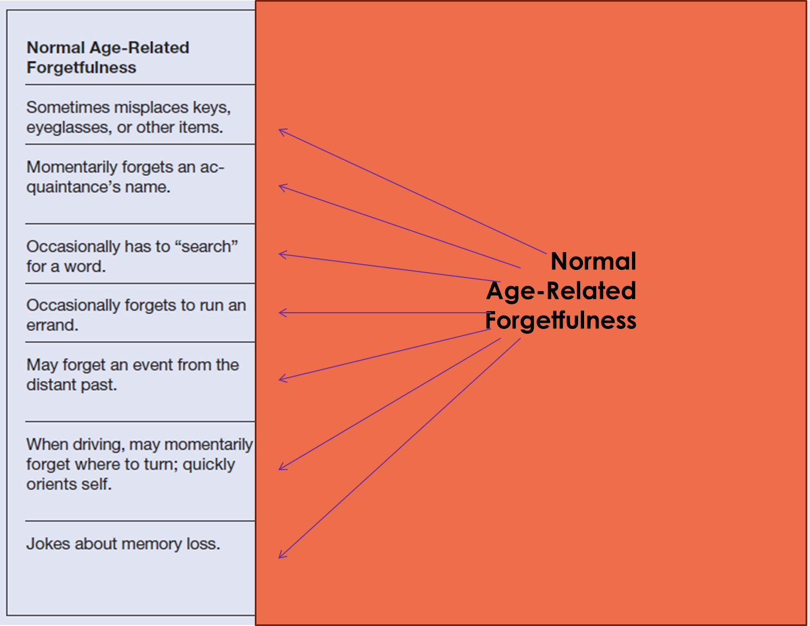
Normal Age-Related Forgetfulness
Notes:
On the left you will see some normal things that we may forget about on a daily basis.
How many of us have walked into a room and forgotten why we walked in there?
Or where we left our keys?
Or our glasses?
What other common things do we forget?

Slide 9
Dementia-Related Forgetfulness
Notes:
On the right, you will see things that are not typical things we forget about:
Things like who someone is (we may forget their name, but not that we don’t know them).
A great example is that the difference between normal forgetting and dementia is the difference between remembering where the spoon goes and remembering what a spoon is.

Slide 10
What can you do now?
Physical:
Training
Strength training or resistance training
Yoga
Diet
Psychological:
Keep your mind engaged
Learn
Read
Crossword puzzles, word searches, etc.
Social
Stay engaged with your social network
Notes:
So now that we’ve talked about what we can expect to happen, what can be done about it?
Physically, you can do some strength or resistance training exercises.
Now don’t worry, you don’t need to go to a fancy gym to be able to do these exercises, you can do them in your own home!
Link to exercises: https://www.silversneakers.com/blog/strength-training-for-seniors/
For your joints, you can do flexibility training like stretching or yoga to help your joints.
You can take tai chi if you want to improve your balance as well.
Diet – be sure that you are eating healthy
We want to keep our bodies and our minds healthy
We need to make sure that we are taking in all the proper nutrients to keep ourselves healthy
Extension has numerous nutrition classes – also see your doctor for more specific information regarding your own special concerns
Psychologically
Keep your mind engaged
If you don’t use it, you’ll lose it.
Always be learning new things – this is a great first step
Read the newspaper, books, etc.
Do crossword puzzles, word searches, anything to help keep your mind engaged.
Socially
Stay engaged with family and friends.
Science has linked social isolation to health issues
Be sure that you are staying engaged as much as possible.

Slide 11
When in doubt…
Talk to your doctor!
Notes:
If you are ever in doubt about any health concern that you may have, be sure that you reach out to your doctor!

