Slide 1
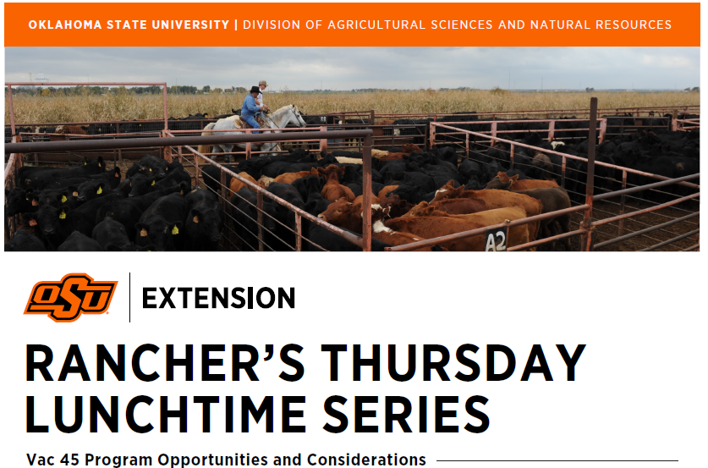

Slide 2

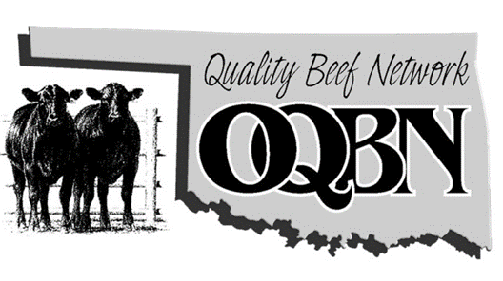

Oklahoma Quality Beef Network
A joint program between Oklahoma Cattleman’s Association and the Oklahoma Cooperative Extension Service
Composed of academia, industry professionals, veterinarians, cattle producers and buyers, and livestock marketers
Health management certification
Value-added marketing to cow/calf producers

Slide 3
Oklahoma Quality Beef Network
Reduced cattle stress and shrink
Improved immune system
Increased sale weight of cattle
Seasonal price increase
Increased market demands
Animal welfare

Slide 4
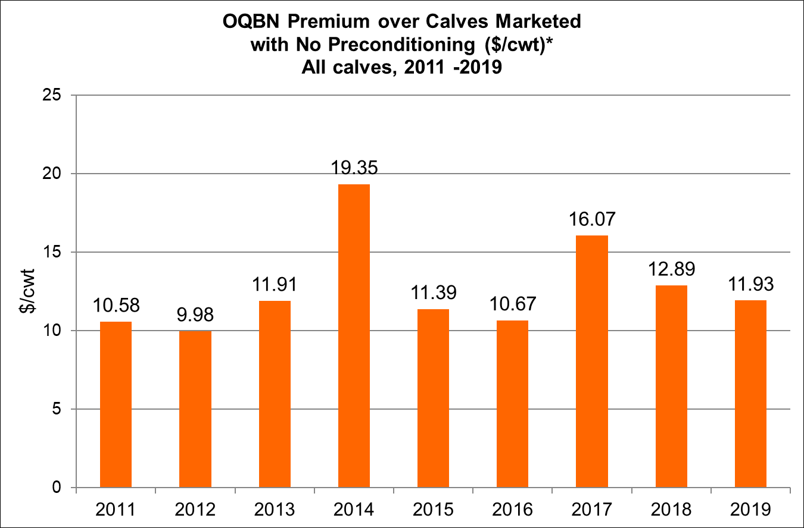

Slide 5
Vac-45 Program Requirements
Ranch raised
Minimum 45 days weaned
Castrated/healed
Dehorned/healed
Dewormed
Beef Quality Assurance (BQA) Certified
  New in 2020
  www.bqa.org
2 doses of:
  5 –way viral respiratory vaccine
  7- way clostridial bacterins
1 dose of Pasteurella haemolytica
Program ear tag
3rd party verification
  Cattle inspection prior to shipping
  Vaccination records

Slide 6
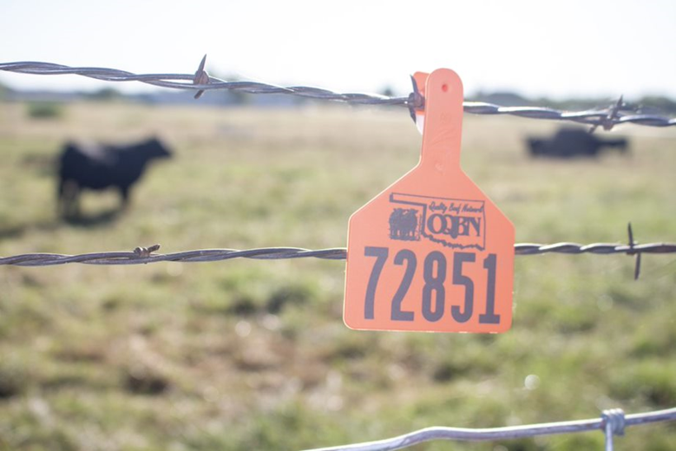
Oklahoma Quality Beef Network
Enrollment Process
  Complete enrollment form
  Purchase program ear tags
  Complete vaccination record
  Verification of cattle

Slide 7
Choosing an Option
Option 1 – vaccinations given at branding and weaning
Requires use of modified-live vaccine (MLV) for both vaccinations
Option 2 – vaccinations given at preweaning (2-6 weeks prior to wean) and weaning
May use killed vaccine for 1st vaccination only
Followed up with a MLV
Option 3 – vaccinations given at weaning and postweaning (14-28 post wean)
Requires the use of MLV for both vaccinations

Slide 8
Oklahoma Quality Beef Network
http://oqbn.okstate.edu/

Slide 10
Oklahoma Quality Beef Network
Verifications
  Confirm number of cattle to be marketed
  Confirm sale date and location
  Check weaning dates
  Review vaccination protocols
    Vaccines used
    Timing of vaccinations
    Serial numbers
  Animal observations
    Healed
    Healthy
    Quality defects

Slide 11
OQBN Fall Sale Dates
Location | Wean Date (45 days) | Sale Date
OKC West Livestock; El Reno, OK | 8/29/2020 | 10/13/2020*
Cherokee Sales Co.; Cherokee, OK | 9/20/2020 | 11/04/2020
McAlester Stockyards; McAlester, OK | 9/27/2020 | 11/10/2020
McAlester Stockyards; McAlester, OK | 10/03/2020 | 11/17/2020
Payne County Stockyards; Perkins, OK | 10/04/2020 | 11/18/2020
Woodward Livestock; Woodward, OK | 10/05/2020 | 11/19/2020
Southern Plains Livestock; Blackwell, OK | 10/07/2020 | 11/21/2020
*OQBN sales at OKC West will be held every Tuesday at noon starting October 13, 2020 and continue through February 2, 2021

Slide 12
Contact
Jeff Robe – OQBN Coordinator
  405-744-4268
  jerobe@okstate.edu
Brian Freking – Southeast Area Livestock Specialist
  580-322-7011
  Brian.freking@okstate.edu
Earl Ward – Northeast Area Livestock Specialist
  918-686-7800
  Earl.ward@okstate.edu
Dana Zook – Northwest Area Livestock Specialist
  580-237-7677
  Dana.zook@okstate.edu
Marty New – Southwest Area Livestock Specialist
  580-255-3674
  Marty.new@okstate.edu
Britt Hicks – Northwest Area Livestock Specialist
  580-349-5439
  Britt.hicks@okstate.edu

Slide 13
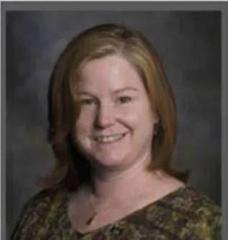
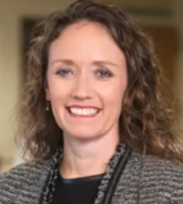
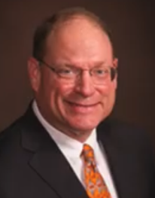
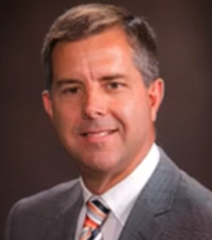
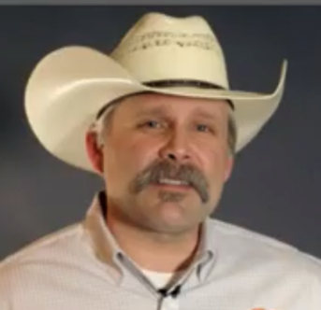
Webinar Beef Cattle Extension Team
Kellie Raper – Extension Ag Economist
Rosslyn Biggs – Extension Beef Cattle Veterinarian
Paul Beck – Extension Beef Cattle Specialist
David Lalman – Extension Beef Cattle Specialist
Jeff Robe – Oklahoma Quality Beef Network Coordinator

Slide 14
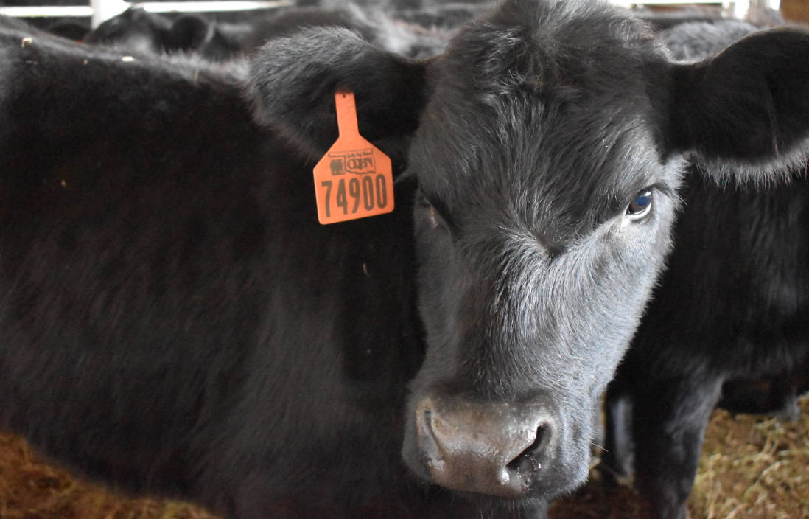
Questions

