Slide 1

Protein Sources: What are the Options to Reduce Costs?
Paul Beck

Slide 2
Feed Markets
Feed prices are at the mercy of all the outside influences we have been blaming everything on for the last couple of years.
COVID-19 – slowed economy and decreased oil use/prices
Supply chain issues, labor shortages, trucking…
Increased economic activity – increased oil use oil and fuel prices and commodity prices
War in Eastern Europe
Reduced oilseed production (sunflower, soybean etc.)
High oil/natural gas and less fertilizer leads to high fertilizer prices
High value for soybeans for oil

Slide 3
My original theory
Corn is a high input crop
Very high fertilizer use
Shift acres to soybeans
Lots of soybean meal influencing costs of all protein feeds
High fuel cost increases the value of Ethanol
Lots of ethanol = lots of Distiller’s Grains
If we can produce abundant low quality hay, straw, and stalks
We should be able to get cattle through on roughage and cake

Slide 4
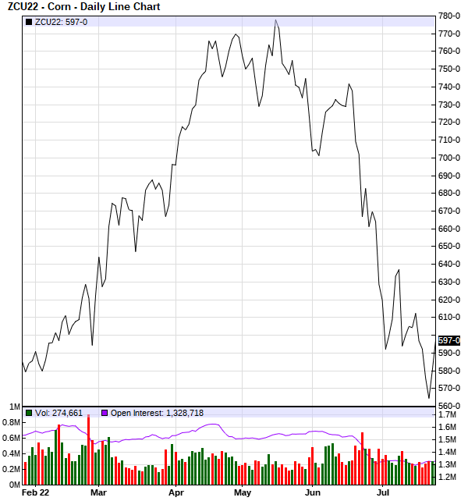
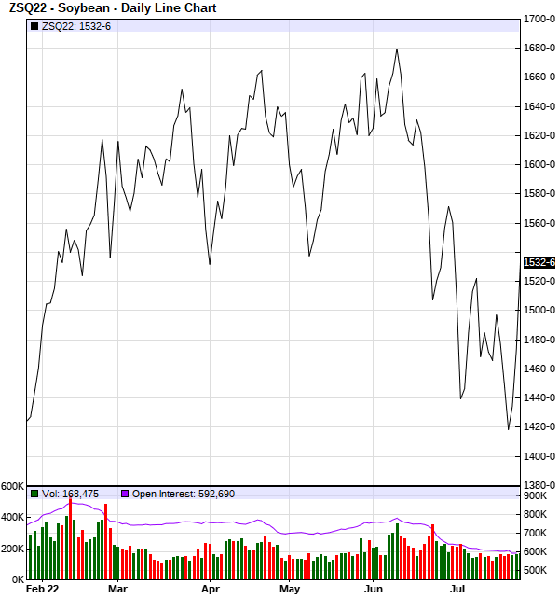

Slide 5
Global Market
“On the soybean side, there is great potential for revisions higher to the export estimate, as 2.11 billion or the 2.115 billion bushel estimate export forecast has already been sold or shipped…soybeans will see tighter stocks-to-use [ratios] ahead if sales continue” CattleFax Update, April 15, 2022.
U.S. oilseed production is projected down 3.4 m bu
Projected soybean crush reduced, based on reduced meal exports
Corn production is forecast 45 million bushels higher based on greater planted and harvested acres.
Ethanol production is up 10%
Distiller’s Grains Exports are also up

Slide 6
Value of Protein Feeds
Feedstuff | $/ton | $/lb | $/lb DM | $/lb CP
SBM | 559 | 0.2795 | 0.31 | 0.64
Corn Gluten Feed | 230 | 0.115 | 0.1278 | 0.51
Dried Distillers Grains | 290 | 0.145 | 0.1611 | 0.47
Hominy Feed | 265 | 0.1325 | 0.147 | 1.47
Soybean Hulls | 270 | 0.135 | 0.15 | 1.07
Molasse Tub HI | 960 | 0.48 | 0.6857 | 2.44
Molasses Tub LI | 1,184 | 0.592 | 0.6231 | 2.96
Alfalfa Hay | 275 | 0.1375 | 0.1562 | 0.625

Slide 7
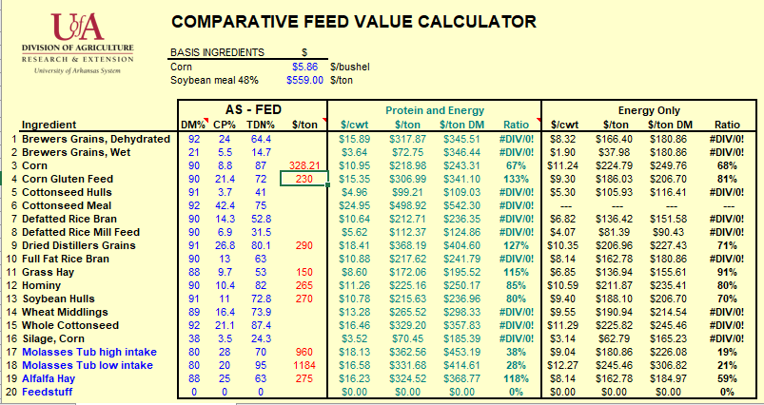

Slide 8
Factors Affecting Protein Requirements
Genetics –
Maintenance requirements – Milk potential
Growth potential
Composition of gain – frame size, compensatory gain, gender
Gain– 600 lb steer calf
1 lb/day 9.3%CP & 59%TDN
1.5lb/day 10.5%CP & 64%TDN
2 lb/day 11.9%CP & 69%TDN
Stage of Production
Dry matter intake – effects and is affected by diet protein

Slide 9
Class | n | CP | ADF | NDF | TDN | DMI, % BW
Mean | 670 | 11.3 | 42.6 | 69.4 | 54.8 | 1.7
I | 32% | 3.0 -16.1 9.2 | 47.5 | 74.8 | 31 - 52 49.2 | 1.6
II | 15% | 5.2 – 17.4 10.4 | 44.3 | 71.3 | 52 – 54 52.9 | 1.7
III | 36% | 6.5 – 20.9 12.0 | 40.8 | 67.9 | 54 – 59 56.8 | 1.8
IV | 17% | 7.4 – 26 14.6 | 37 | 59 | 59 - 72 60.6 | 2.0

Slide 10
Percentage of Hays Deficient in ….
Nutrient | Dry Cow | Lactating Cow/Growing Calf
Crude Protein | 19% | 45%
Total Digestible Nutrients | 31% | 83%
Based on 670 hay test results in SW Arkansas

Slide 11
Forage Resources
Forage | % CP | % TDN | TDN:CP
Winter Range | 5 | 44 | 8.8
Prairie Hay | 7 | 48 | 6.9
Bermudagrass Hay | 10 | 56 | 5.6
Wheat Straw | 4.5 | 45 | 10.0
Corn Stalks | 6.4 | 45 | 7.0
Milo Stover | 7.8 | 53 | 6.8
Cotton Gin Trash | 12.3 | 43 | 3.5

Slide 12
Correct Ruminal Nutrient Imbalances
Quantity of microbial protein synthesis is limited by amount of protein available to microbes and the efficiency of energy use.
TDN:CP ratio between 4:1 and 8:1 are considered balanced. (Moore, 1992)
> 8:1 Deficiency of Ruminal Nitrogen limiting MCP
4:1 to 8:1 Ruminal energy and Nitrogen in balance
<4:1 Associated with losses of Rumen Nitrogen
When Ruminal Nitrogen is limiting
Microbial digestion of fiber is slowed and total fiber digestion reduced
Passage of fiber from the rumen slows
Reduce total hay intake
Feeding protein supplement results in increased hay intake and digestibility

Slide 13
DDG (31% CP) and Hay Intake (5%CP 53% TDN)
15.1 lb/d
13.6 lb/d

Slide 14
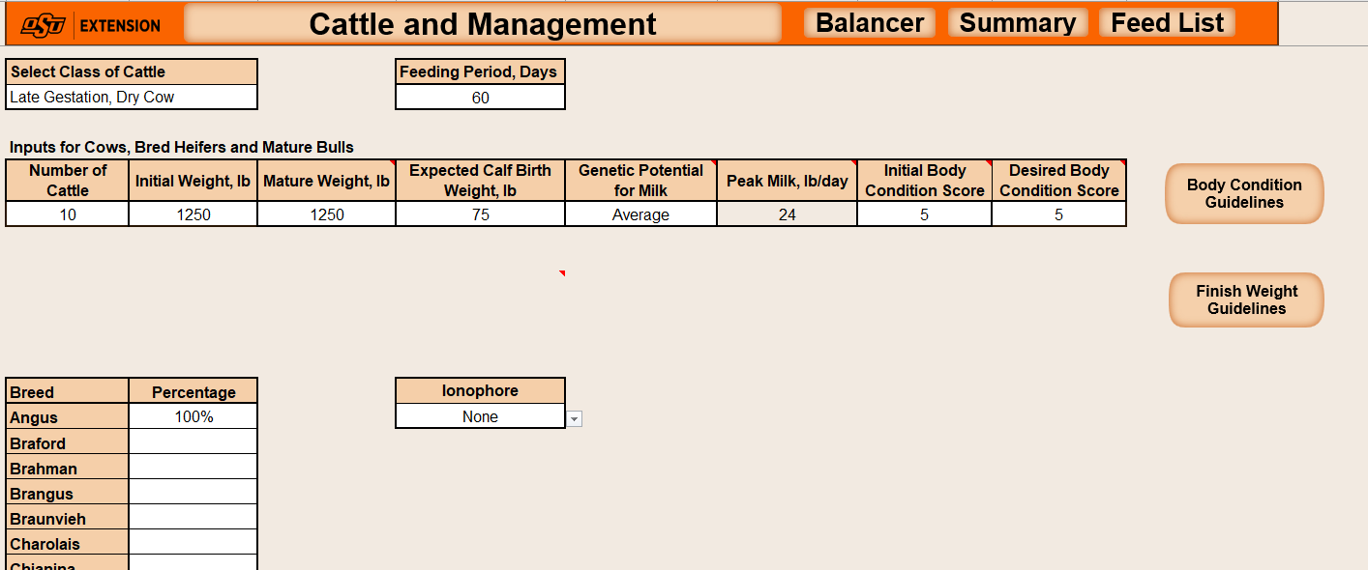
Cow-Calf Examples

Slide 15
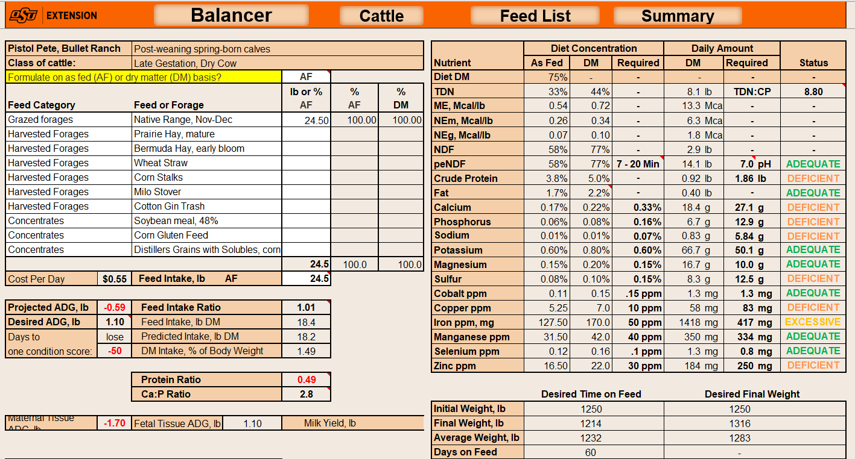

Slide 16
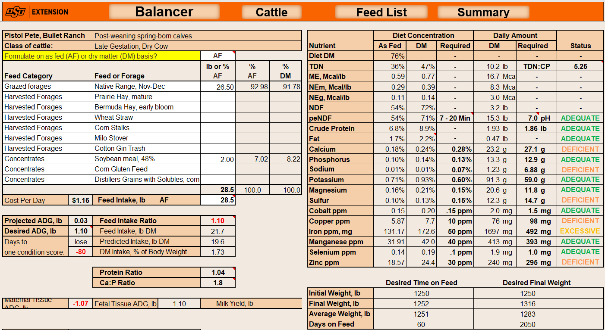

Slide 17
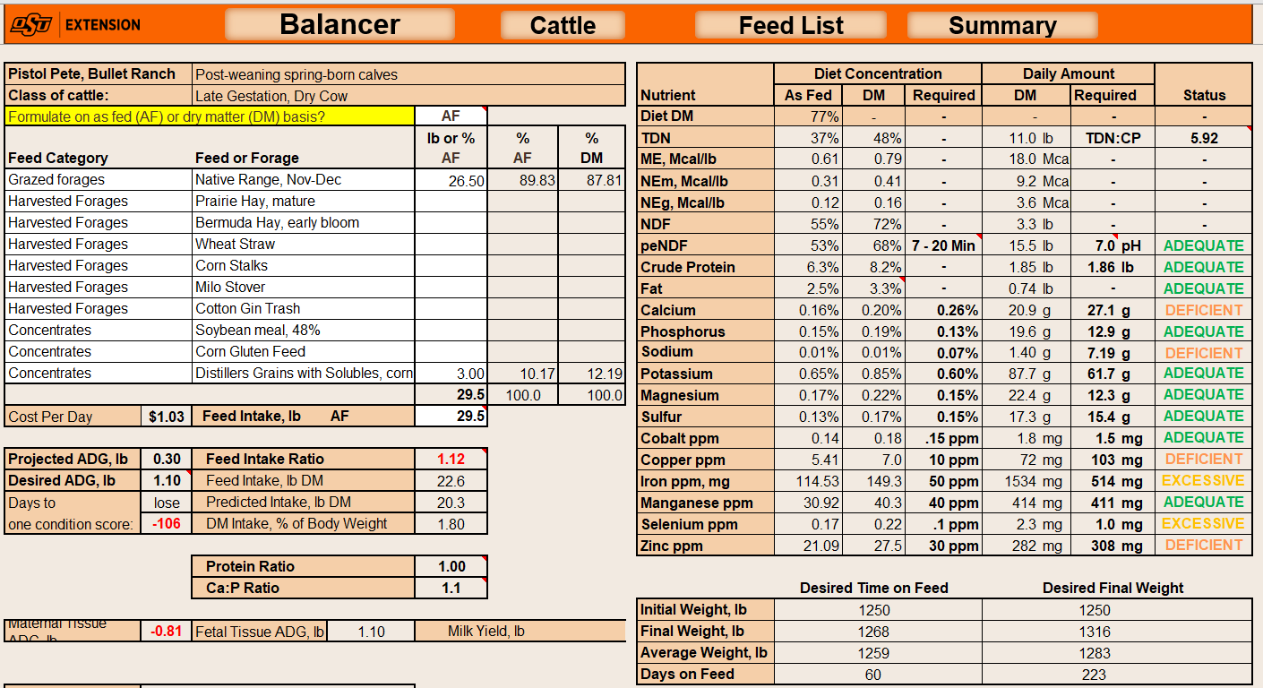

Slide 18
Protein/Forage Source Comparisons - Gestation
Item | Prairie H | Berm H | Straw | Stalks | Stover | Trash
DMI, lbs | 22.5 | 26.0 | 20.6 | 21 | 26.5 | 20
Assoc Ef | + | 0 | + | + | 0 | 0
SBM, lbs | 1 | - | 2 | 1.5 | 0.3 | 0.15
cost/d | 1.60 | 1.95 | 1.00 | 0.88 | 0.61 | 0.44
BCS +/- | (0.5) | 0.10 | (0.67) | (0.70) | (0.2) | (1.2)
CGF, lbs | 2 |  | 5 | 3 | 0.7 | 0.3
cost/d | 1.55 |  | 0.98 | 0.79 | 0.61 | 0.43
BCS +/- | (0.34) |  | (0.3) | (0.5) | (0.1) | (1.1)
DDGS, lbs | 1.5 |  | 3.5 | 2 | 0.5 | 0.2
cost/d | 1.53 |  | 0.95 | 0.75 | 0.59 | 0.43
BCS +/- | (0.42) |  | (0.40) | (0.6) | (0.1) | (1.1)

Slide 19
Protein Source Comparisons - Gestation
Item | Prairie H | Straw | Stover | Trash
DMI, lbs | 22.5 | 20.6 | 26.5 | 20
Assoc Ef | + | + | 0 | 0
Mol. Tub HI, lbs | 2 | 2 (66%) | 2 | 2
cost/d | 2.33 | 1.41 | 1.49 | 1.36
BCS +/- | (0.4) | (0.77) | - | (1.0)
Mol Tub LI, lbs | 0.75 (90%) | 0.75 (55%) | 0.75 | 0.75
cost/d | 1.82 | 0.90 | 0.98 | 0.89
BCS +/- | (0.5) | (1.0) | (0.1) | (1.0)
DDGS, lbs | 1.5 | 3.5 | 0.5 | 0.2
cost/d | 1.53 | 0.95 | 0.59 | 0.43
BCS +/- | (0.42) | (0.40) | (0.1) | (1.1)

Slide 20
Conclusions
Protein feeds will be high this winter
Most roughage sources will be low in protein
Will also require energy supplementation
Even on lowest requirement animals
Byproduct feeds may be of economic value compared to other feeds
Even though they are higher than normal
Cheaper per unit protein basis
Supply protein and energy
Self-fed supplements work with moderate quality roughages
Low requirement cows

Slide 21
